Slide 1
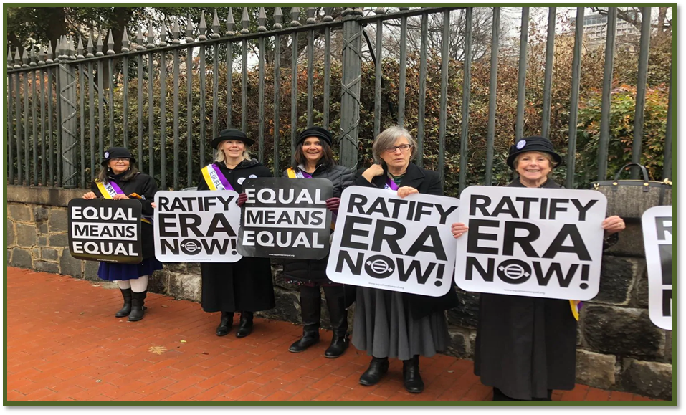
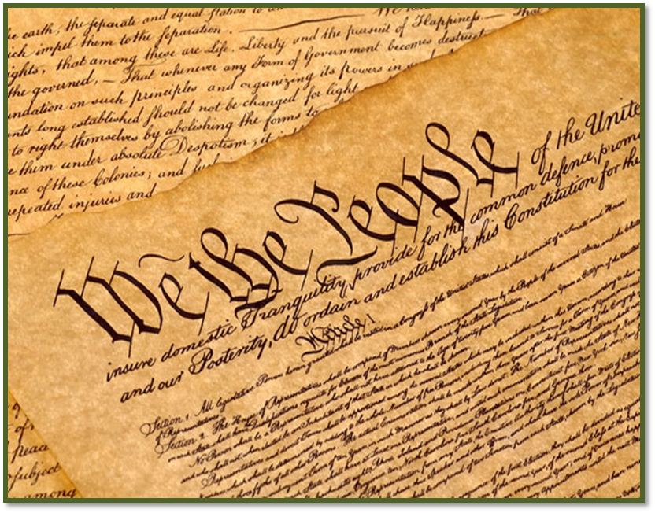
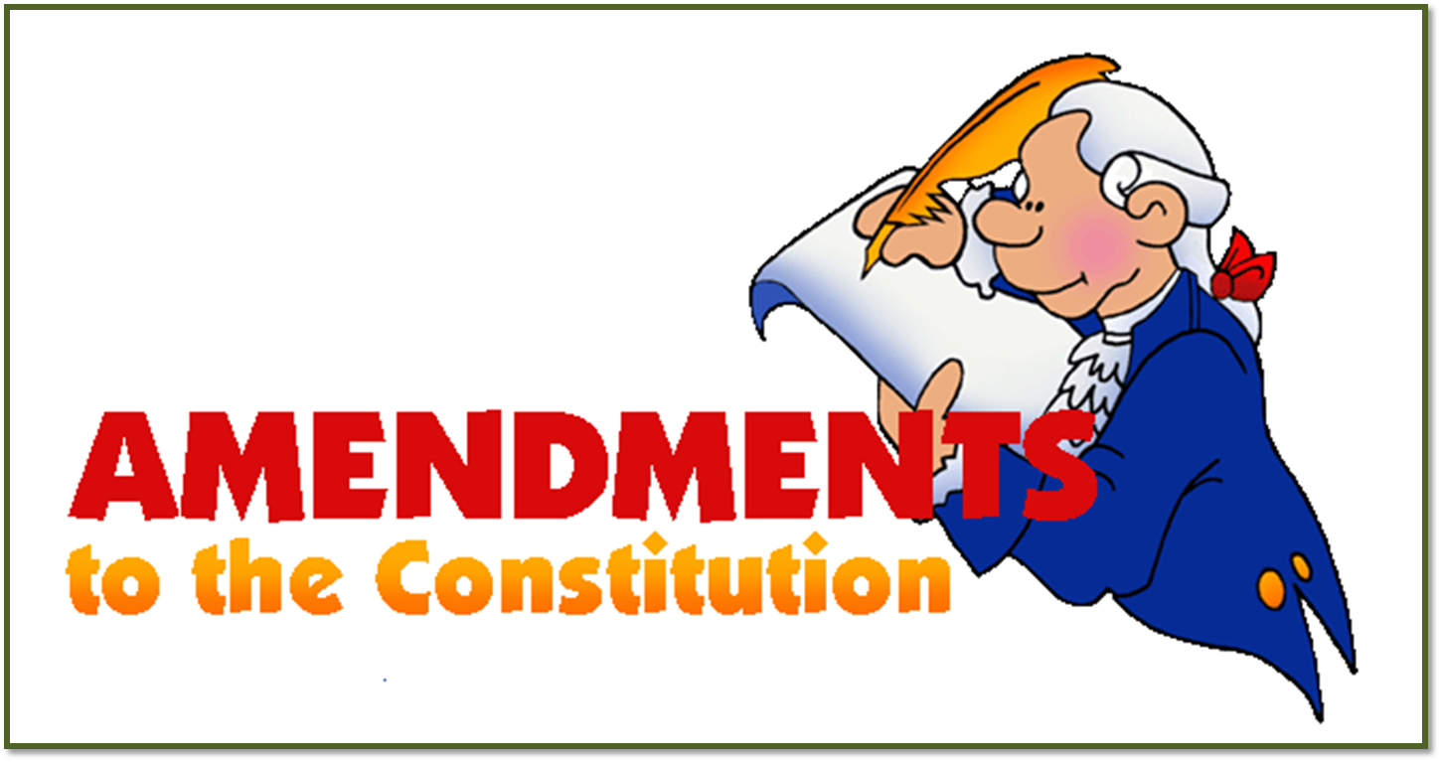
citizen’s rights
SS5CG2ab

Slide 2
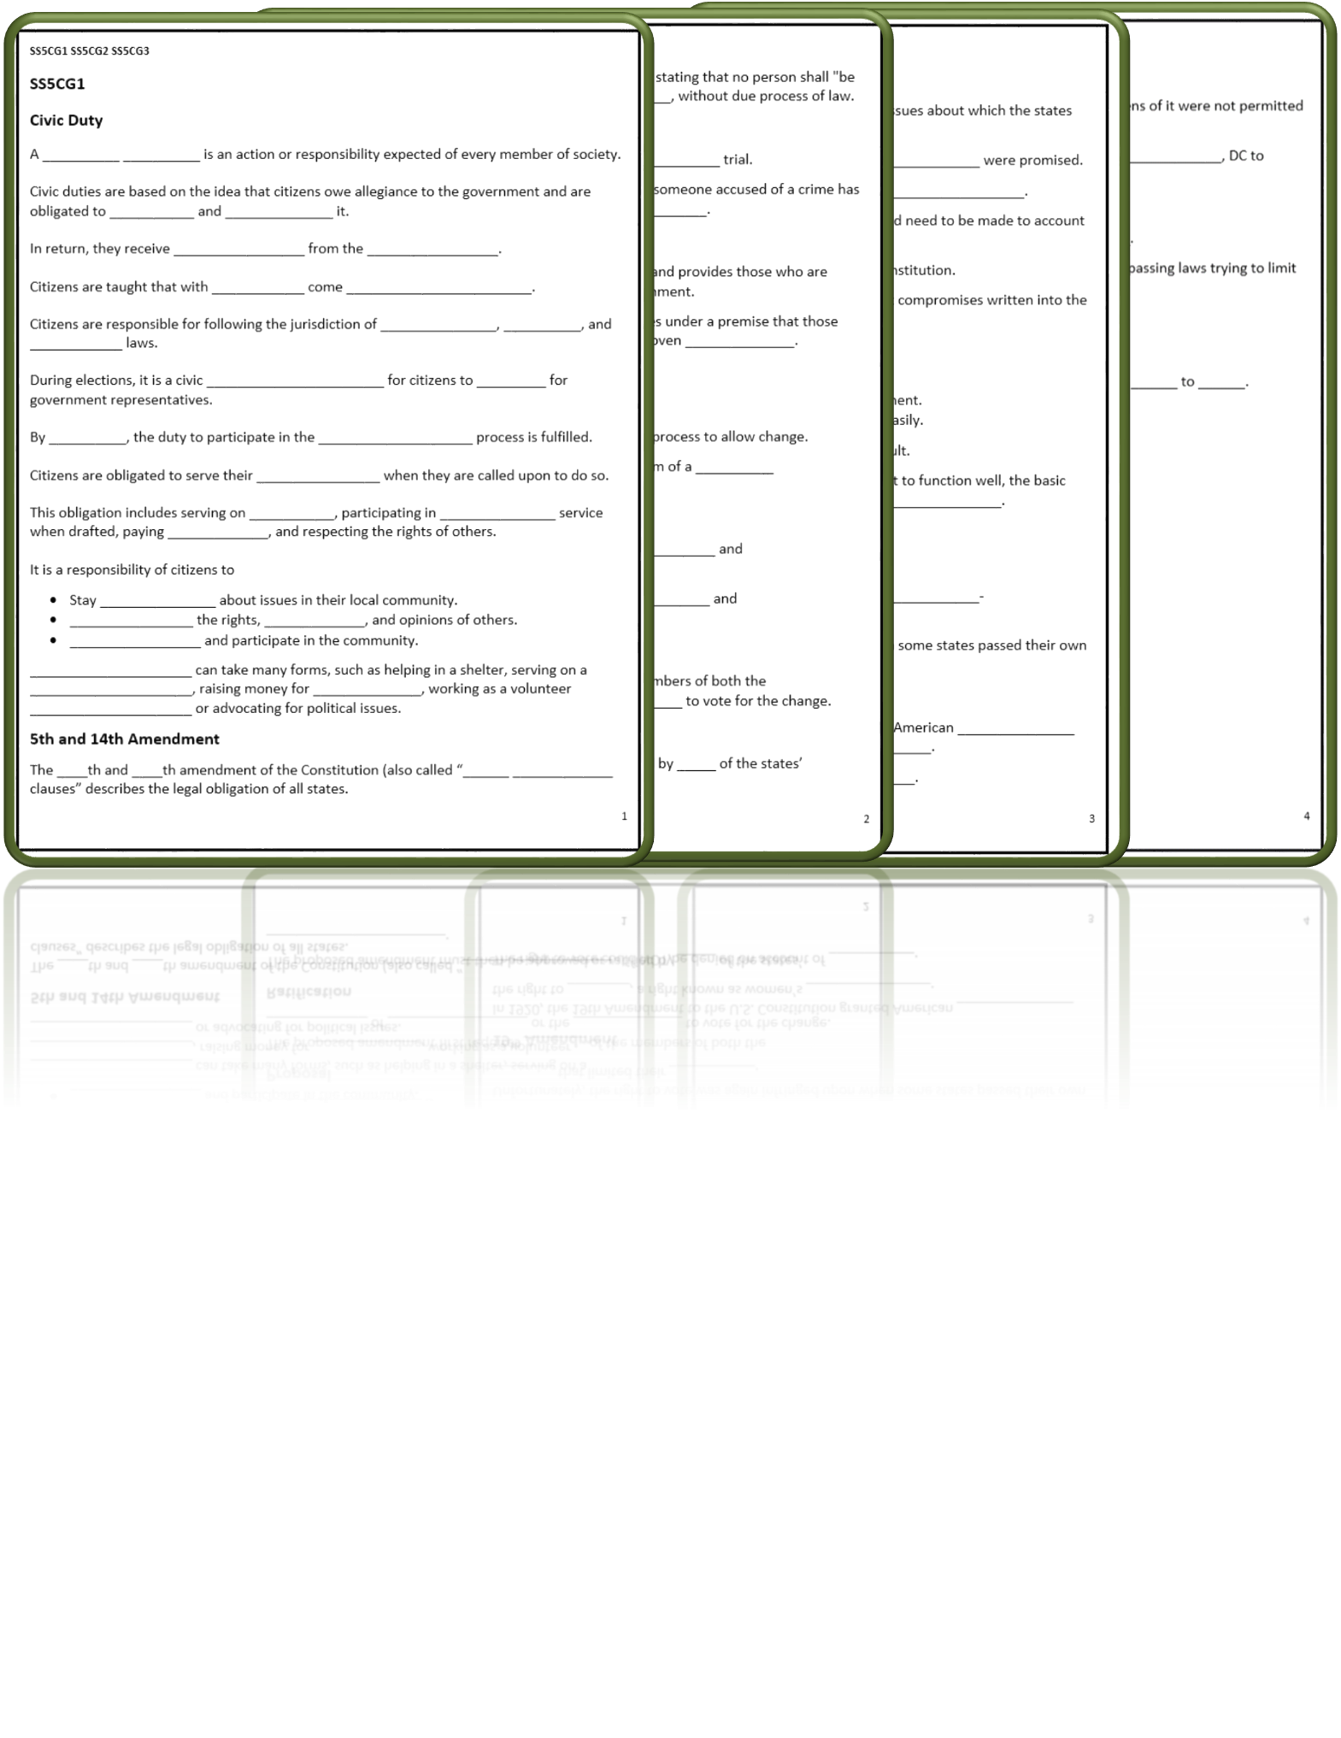
Slotted Notes
Words in a box like this are commentary and not for slotted notes.

Slide 3
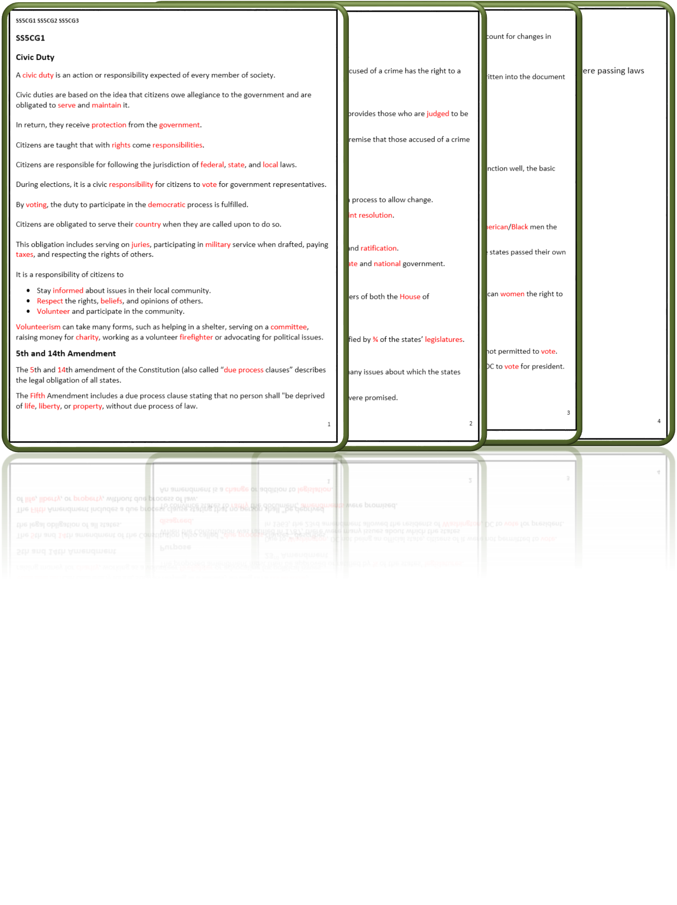
Slotted Notes Answer Key
Words in a box like this are commentary and not for slotted notes.

Slide 4
SS5CG2 Explain the process by which amendments to the U.S. Constitution are made.
a. Explain the amendment process outlined in the Constitution.

Slide 5
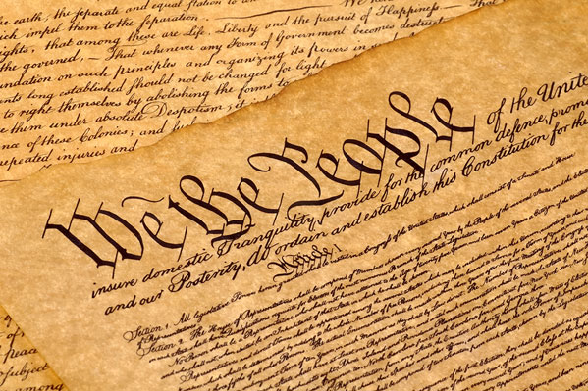
Amendment Process
Article V of the Constitution was established to set forth a process to allow change.
A proposed amendment must be done in the form of a joint resolution.
The Constitution has been amended only 27 times since it was drafted in 1787, including the first 10 amendments adopted four years later as the Bill of Rights.

Slide 6
Amendment Components
The amendment process has two components, proposal and ratification.
The amendment process is difficult because it includes state and national government.
While there are two ways, only one has ever been used. All 27 Amendments that have been ratified after two-thirds of the House and Senate approve of the proposal and send it to the states for a vote. Then, three-fourths of the states must affirm the proposed Amendment.

Slide 7
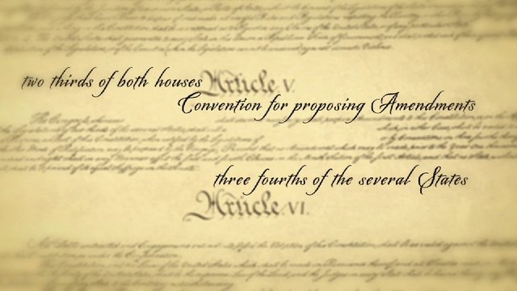
Proposal
The proposed amendment first requires 2/3 of the members of both the House of Representatives or the Senate to vote for the change.
A significant amount of time often passes between the proposal of an amendment and its ratification.

Slide 8
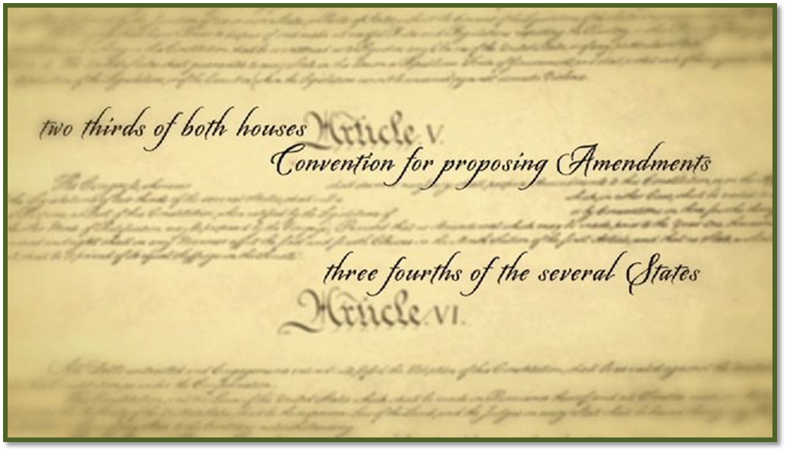
Ratification
The proposed amendment must then be approved or ratified by ¾ of the states’ legislatures.
Though thousands of amendments to the US Constitution have been proposed, only 27 have been ratified.

Slide 9
Amendment Scenario
The second Amendment states: A well regulated Militia, being necessary to the security of a free State, the right of the people to keep and bear Arms, shall not be infringed.
A proposal is created to allow silencers to be purchased without federal regulations.

Slide 10
Amendment Scenario
Two thirds of the Senate vote to approve this amendment.
It is then sent to the legislatures.
The proposed amendment must then be ratified by ¾ of the states’ legislatures.

Slide 11
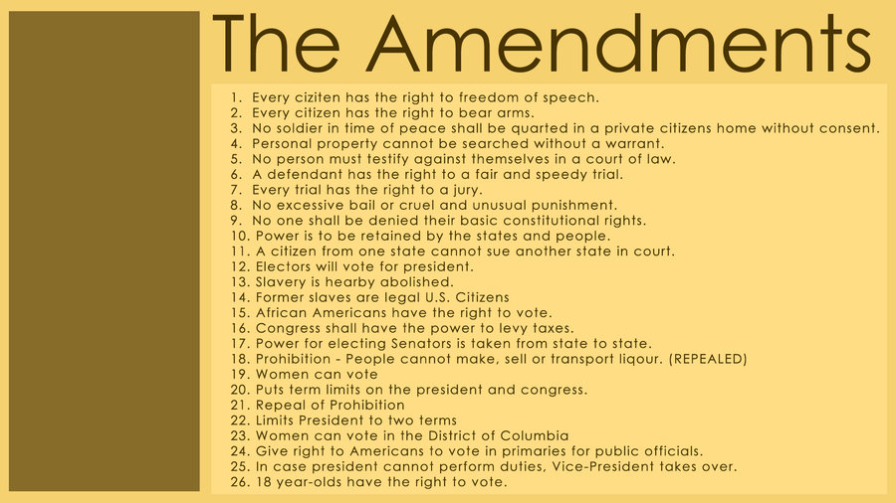
Amendment Scenario

Slide 12
SS5CG2 Explain the process by which amendments to the U.S. Constitution are made.
b. Describe the purpose for the amendment process.

Slide 13
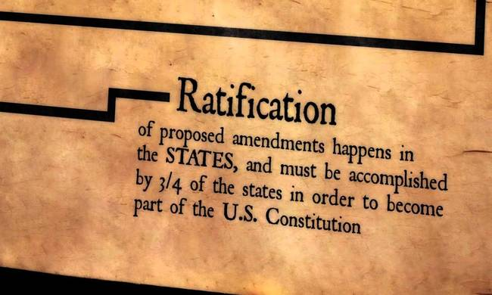
Purpose
When the Constitution was ratified in 1787, there were many issues about which the states disagreed.
To convince states to ratify the document, amendments were promised.
An amendment is a change or addition to legislation.

Slide 14
Purpose
Framers knew that, over time, changes would need to be made to account for changes in society.
Framers described the process of amending the constitution.
It was intentionally made difficult to keep important compromises written into the document intact.

Slide 15
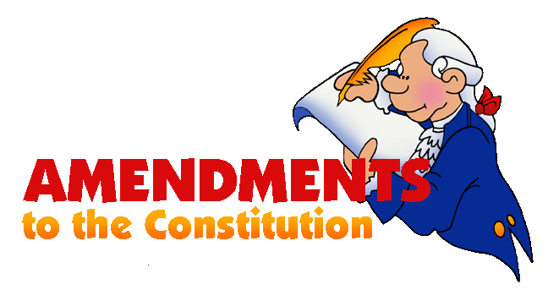
Purpose
Not just any idea to improve America deserves an amendment. The idea must be one of major impact affecting all Americans or securing rights of citizens.

Slide 16
Purpose
The amendment process
Allows a way for the Constitution to be changed.
Enables new ideas to influence American government.
Prevents the Constitution from being altered easily.

Slide 17
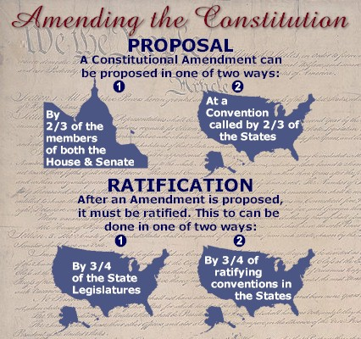
Purpose
Some constitutional scholars believe that Article V, which sets forth the amendment process, is the key to the Constitution's success. It establishes a process where adding amendments is not too easy, which would make the Constitution more like statutory law and less permanent—but also not too difficult, which would make violent revolution more likely.

Slide 18
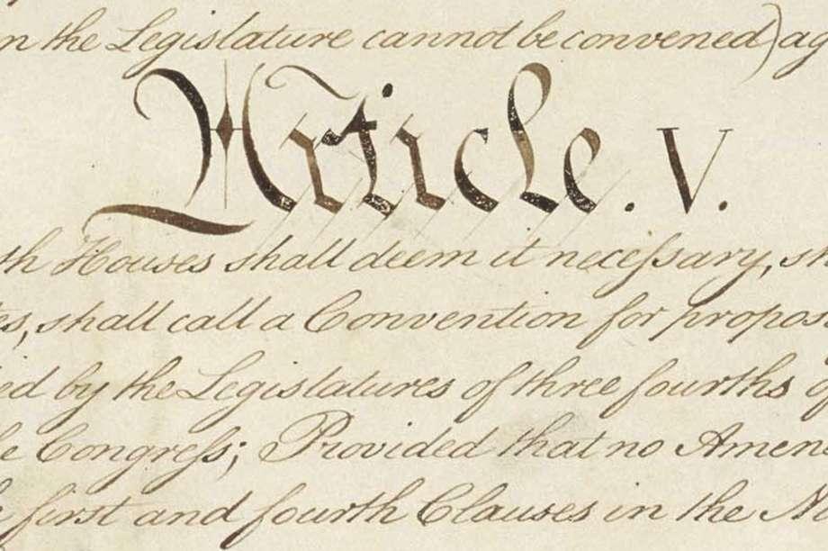
Purpose
The amendment process was deliberately designed to be difficult.
The framers of the Constitution recognized that for government to function well, the basic foundations of our government must be stable.

Slide 19
Purpose
Failed Amendment Example:
The Child Labor Amendment
In 1926, an amendment was proposed which granted Congress the power to regulate the labor of children under the age of 18. This amendment is still outstanding, having been ratified by 28 states. Ratification by 38 states is required to add an amendment. Congressional research shows that the amendment was ratified by 28 states, the last being in 1937.
The text:
Section 1. The Congress shall have power to limit, regulate, and prohibit the labor of persons under eighteen years of age.
Section 2. The power of the several States is unimpaired by this article except that the operation of State laws shall be suspended to the extent necessary to give effect to legislation enacted by the Congress.

Slide 20
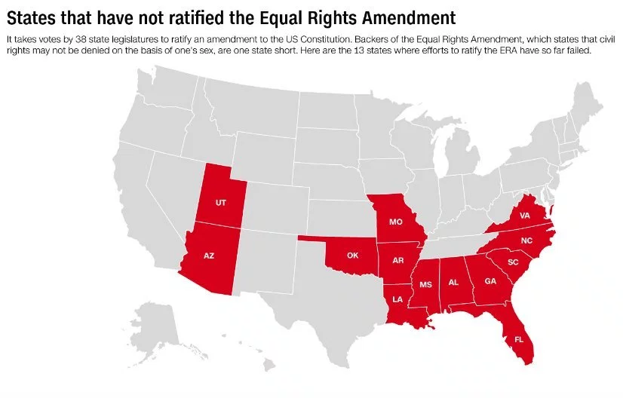
Purpose

Slide 21
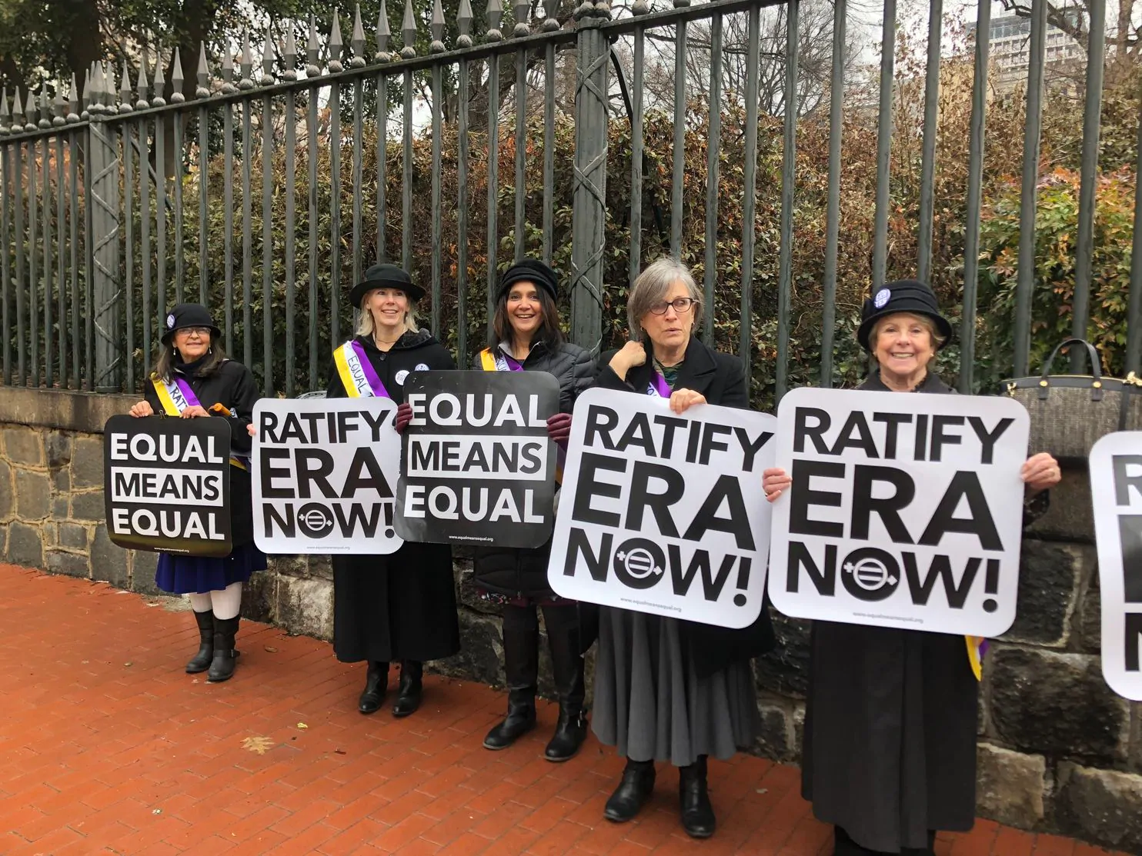
Purpose
Proposed Amendment Example:
The Equal Right Amendment is a proposed amendment to the United States Constitution designed to guarantee equal legal rights for all American citizens regardless of sex; it seeks to end the legal distinctions between men and women in terms of divorce, property, employment, and other matters.

Slide 22
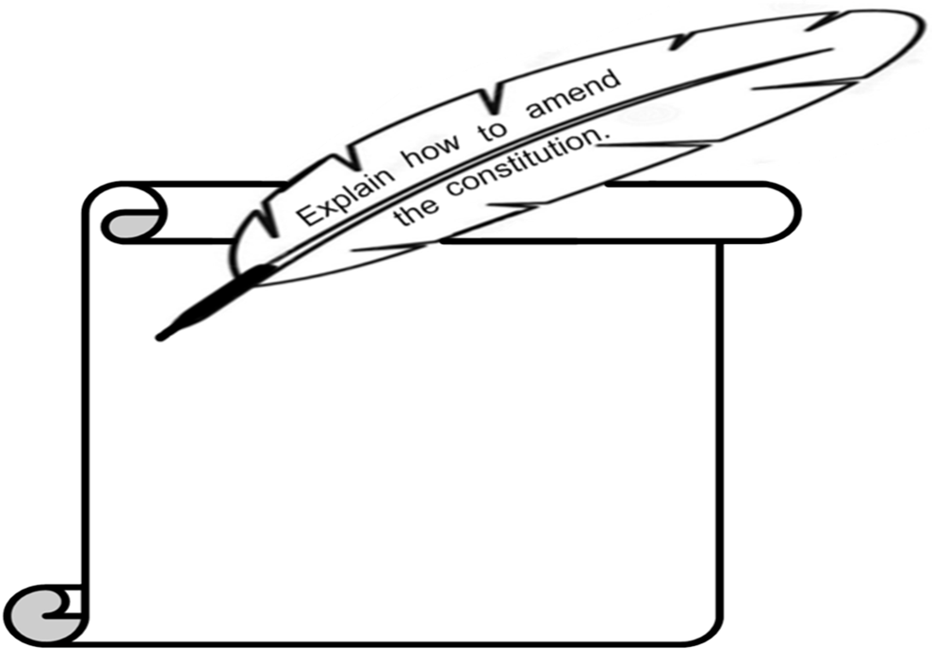
Feather Out the Door

Slide 23
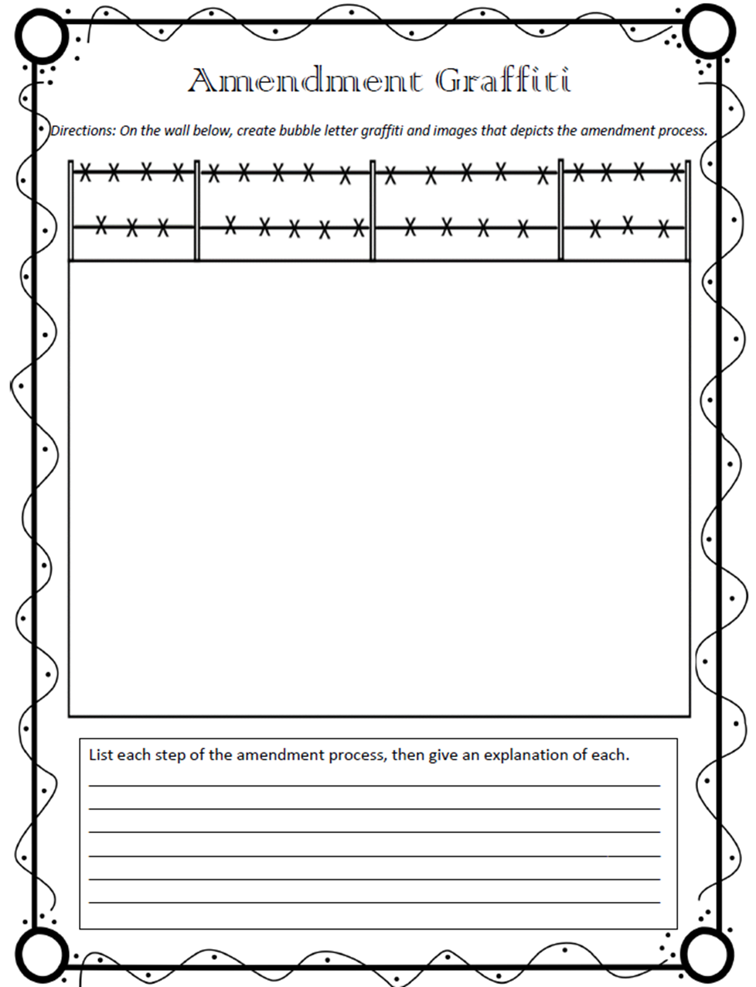
Amendment Graffiti

Slide 24
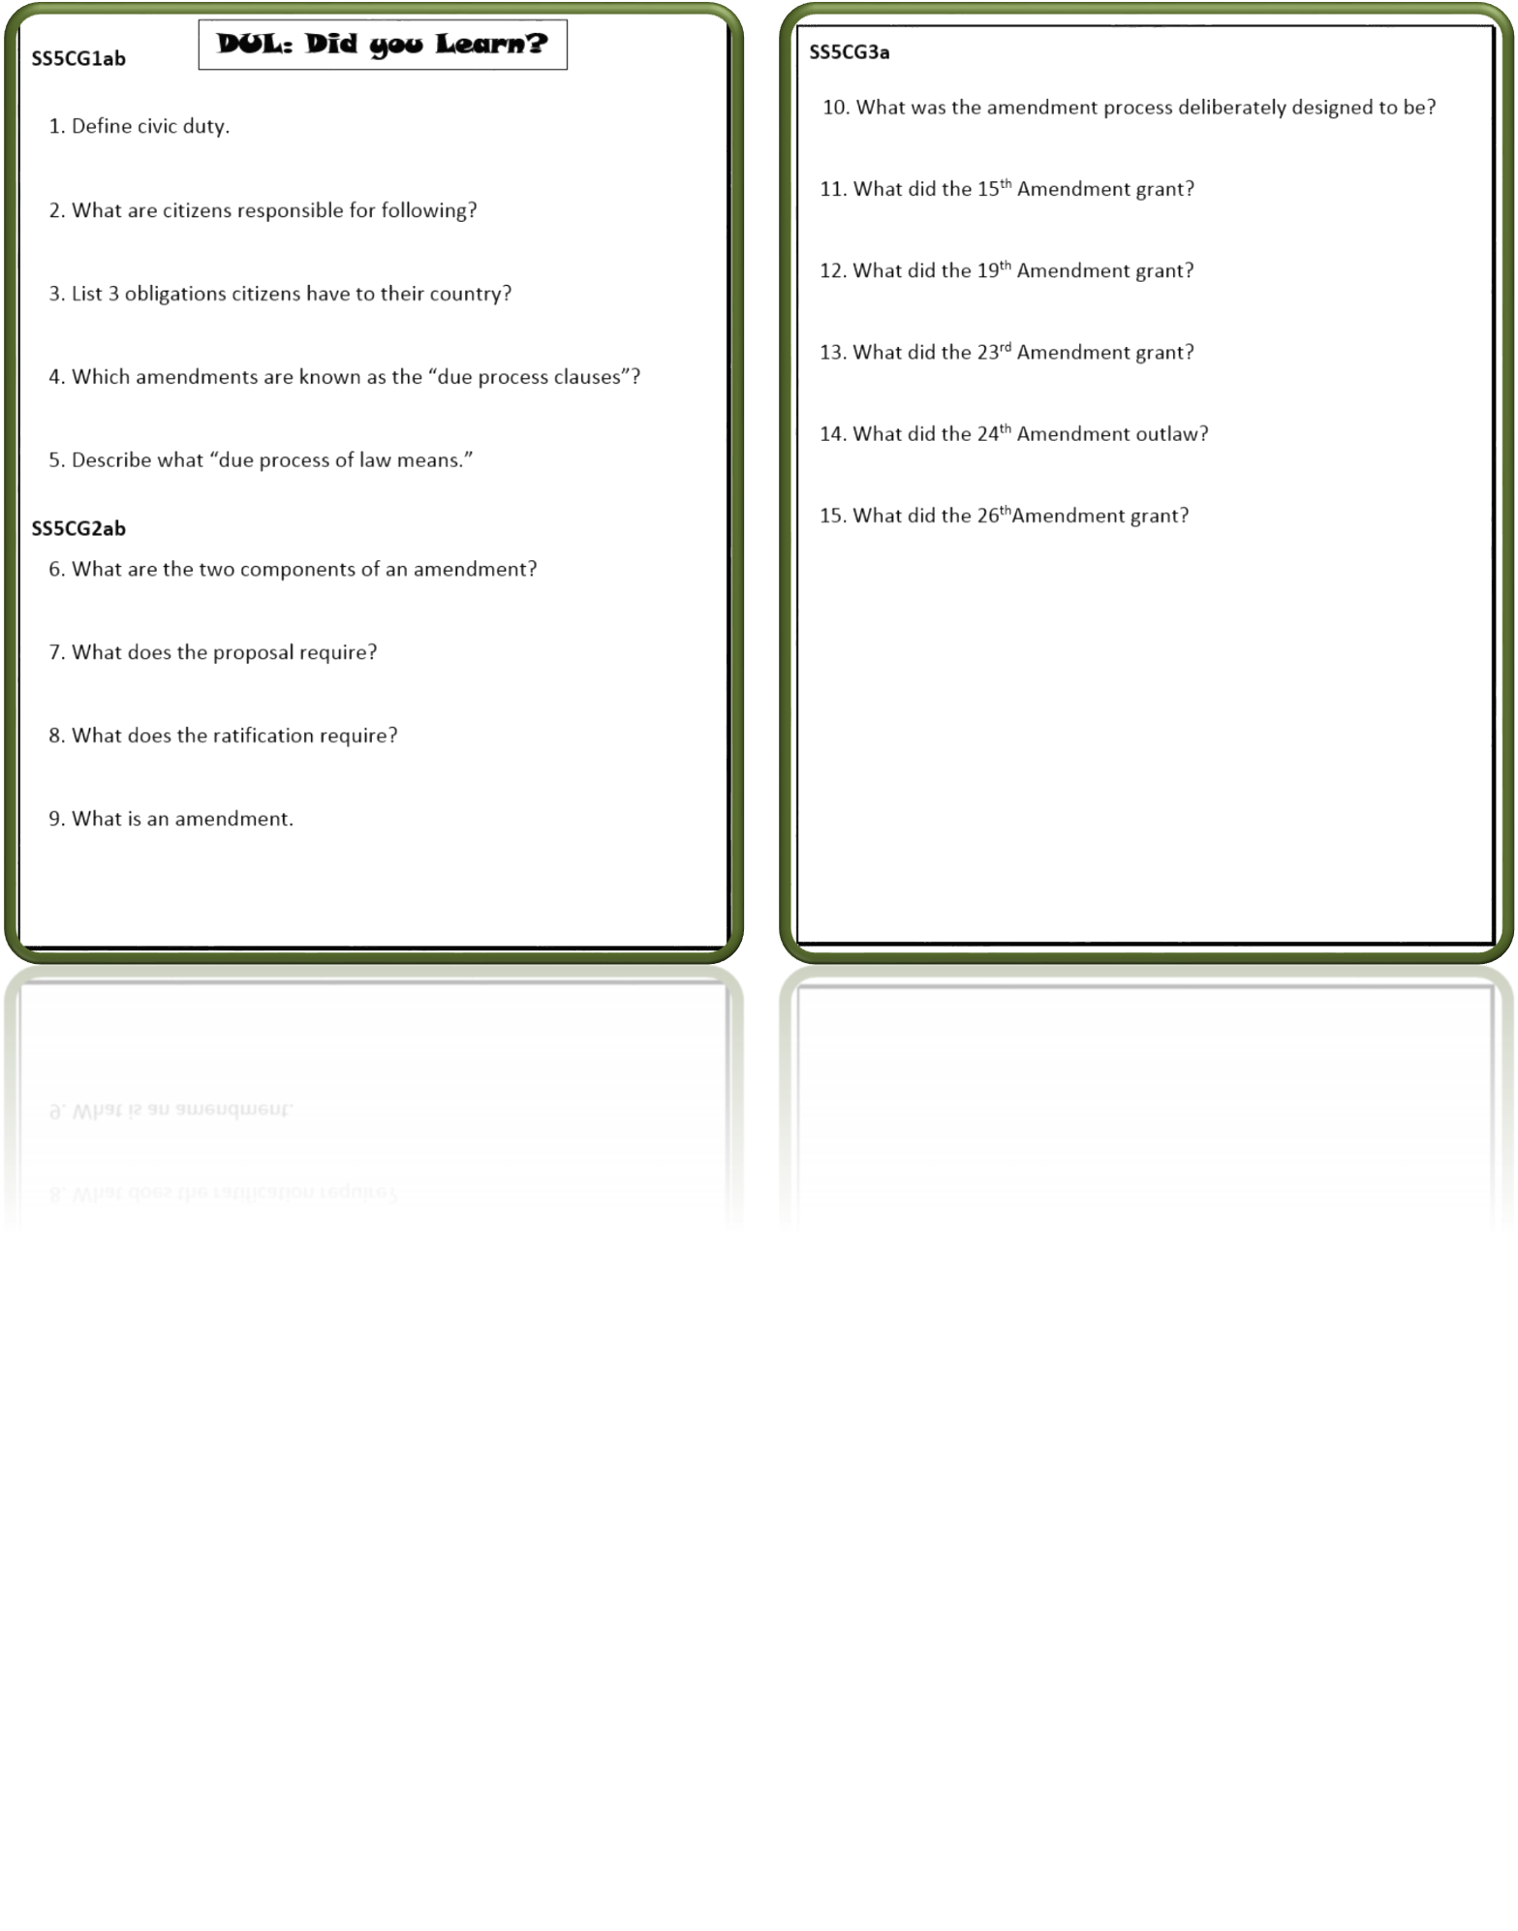
DUL

Slide 25
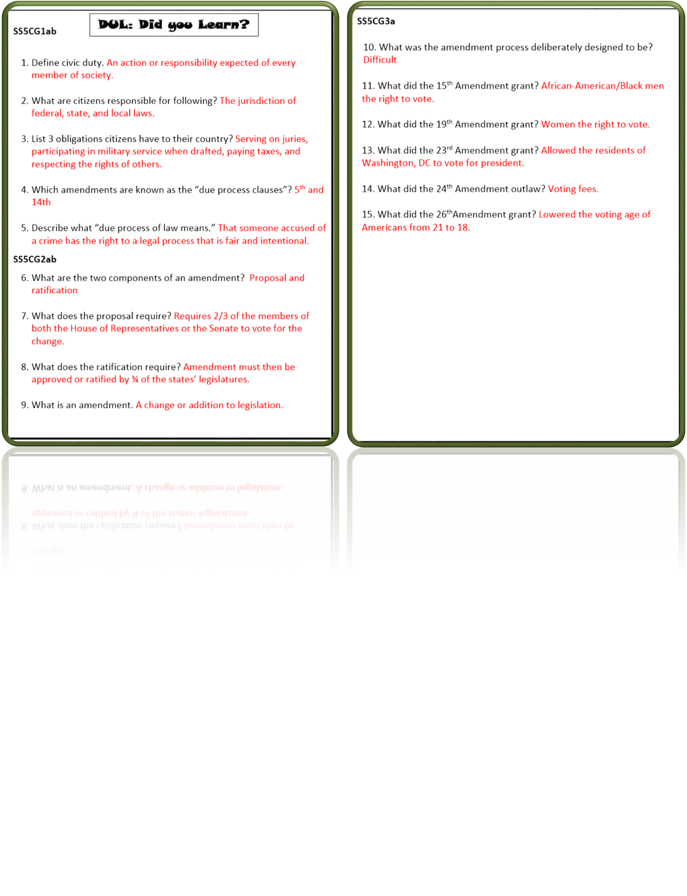
DUL Answer Key

Slide 26
Terms of Use
© Brainy Yak. Your download includes a limited use license from Brainy Yak. The purchaser may use the resource for personal classroom use only. The license is not transferable to another person. Other teachers should purchase their own license through my store.
This resource is not to be used:
By an entire grade level, school, or district without purchasing the proper number of licenses. For school/district licenses at a discount, please contact me.
As part of a product listed for sale or for free by another individual.
On shared databases.
Online in any way other than on password-protected website for student use only.
© Copyright Brainy Yak. All rights reserved. Permission is granted to copy pages specifically designed for student or teacher use by the original purchaser or licensee. The reproduction of any other part of this product is strictly prohibited. Copying any part of this product and placing it on the Internet in any form (even a personal/classroom website) is strictly forbidden. Doing so makes it possible for an Internet search to make the document available on the Internet, free of charge, and is a violation of the Digital Millennium Copyright Act (DMCA).
Thank you,
James at Brainy Yak

