Slide 1
CUBES Math Strategy
How to Solve Math Problems

Slide 2
Day 1: Standard:
MGSE5.NBT.5 Fluently multiply multi-digit whole numbers using the standard algorithm (or other strategies demonstrating understanding of multiplication) up to a 3 digit by 2-digit factor.

Slide 3
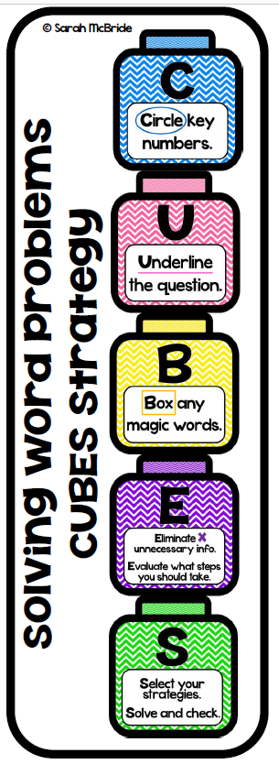
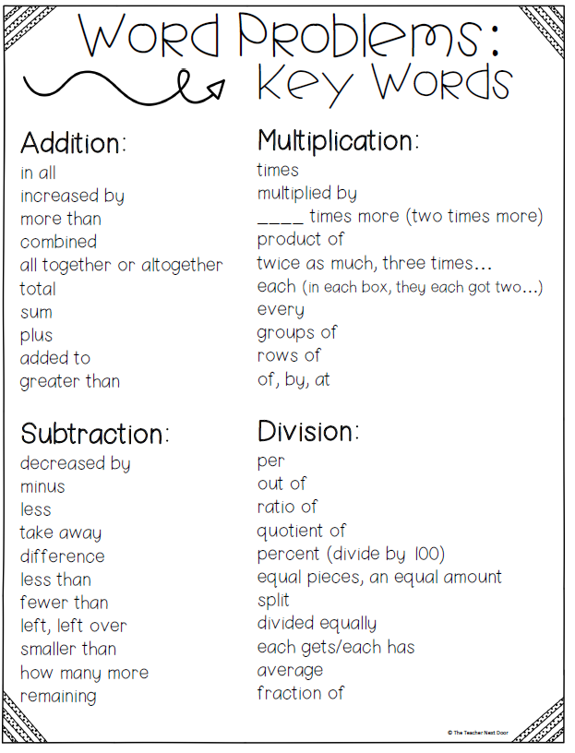
How does a math student solve word problems?

Slide 4
Step 1:
Step 2:
Step 3:
Step 4:
Step 5:

Slide 5
Step 1:
Step 2:
Step 3:
Step 4:
Step 5:

Slide 6
Step 1:
Step 2:
Step 3:
Step 4:
Step 5:

Slide 7
Day 2: Standard:
MGSE5.NBT.5 Fluently multiply multi-digit whole numbers using the standard algorithm (or other strategies demonstrating understanding of multiplication) up to a 3 digit by 2-digit factor.

Slide 8
How does a math student solve word problems?

Slide 9
Step 1:
Step 2:
Step 3:
Step 4:
Step 5:

Slide 10
Step 1:
Step 2:
Step 3:
Step 4:
Step 5:

Slide 11
Step 1:
Step 2:
Step 3:
Step 4:
Step 5:

Slide 12
Day 3: Standard:
MGSE5.NBT.5 Fluently multiply multi-digit whole numbers using the standard algorithm (or other strategies demonstrating understanding of multiplication) up to a 3 digit by 2-digit factor.

Slide 13
How does a math student solve word problems?

Slide 14
Step 1:
Step 2:
Step 3:
Step 4:
Step 5:

Slide 15
Step 1:
Step 2:
Step 3:
Step 4:
Step 5:

Slide 16
Step 1:
Step 2:
Step 3:
Step 4:
Step 5:

