Slide 1
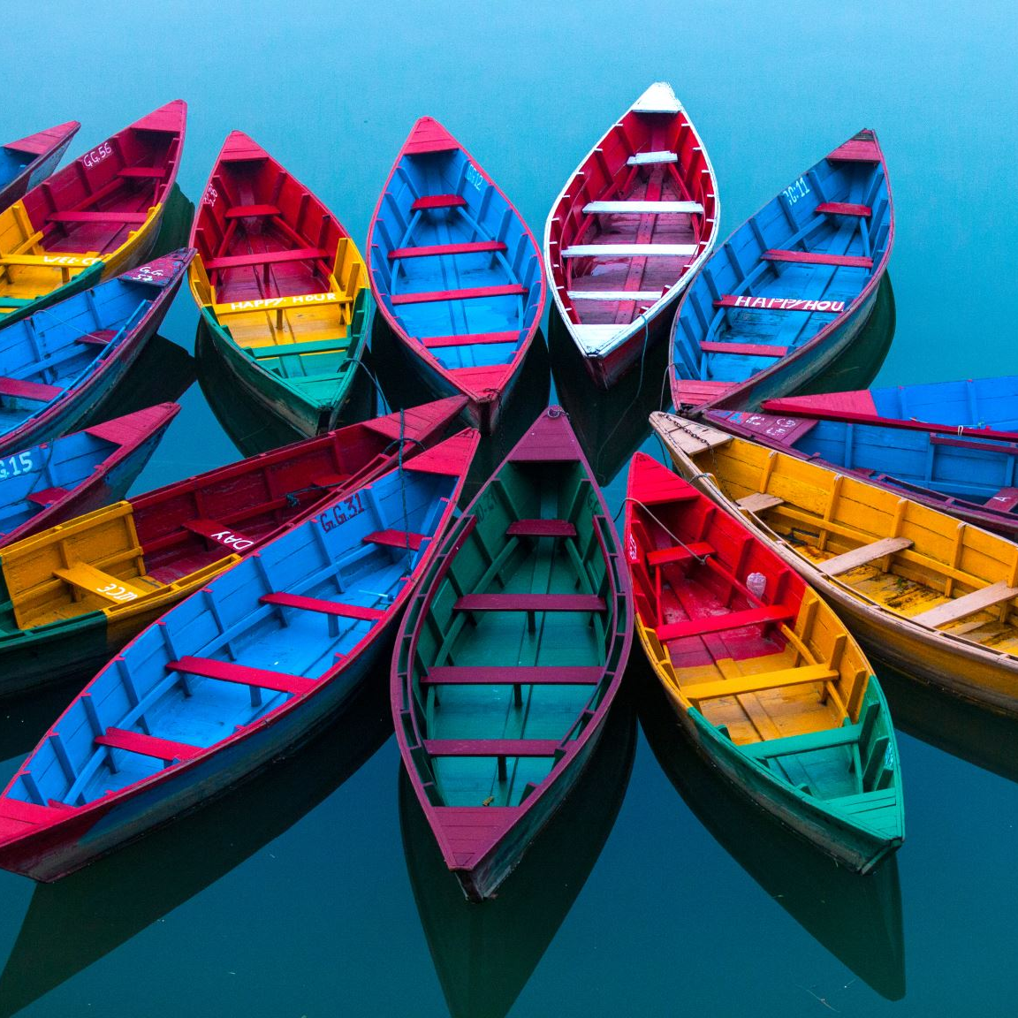
Narrative Writing
Week 1

Slide 2
Day 1: Intro to Personal Narrative
A personal narrative is a piece of fiction text that tells a sequence of events. Today I am going to ask you to plan and write a narrative on your own.
In this narrative, you will tell the reader about something that happened to you. It could be a story about something that happened to you at home or at school or anywhere. Think about all the things that happened. Then you can plan what you want to write. When you’ve finished the plan, you can start writing the story.

Slide 3
Day 2: Learning about Personal Narratives
Previously you wrote a narrative, or a story, to tell about a time you were jittery. There are different types of writing and a narrative is one type. Each type of writing has different elements or parts. Let’s think about the important parts that you included in your story. Turn and talk to your partner about what needs to be included when you tell a story.
Let’s share what you think are the important parts of a narrative.

Slide 4
Day 2: Parts of a Narrative
Establish the situation and introduce the narrator and/or characters
Description and pacing
Use transition words and phrases to manage the sequence of events
Organize an event sequence
Use concrete words and phrases and sensory details
Provide a conclusion
Use dialogue

Slide 5
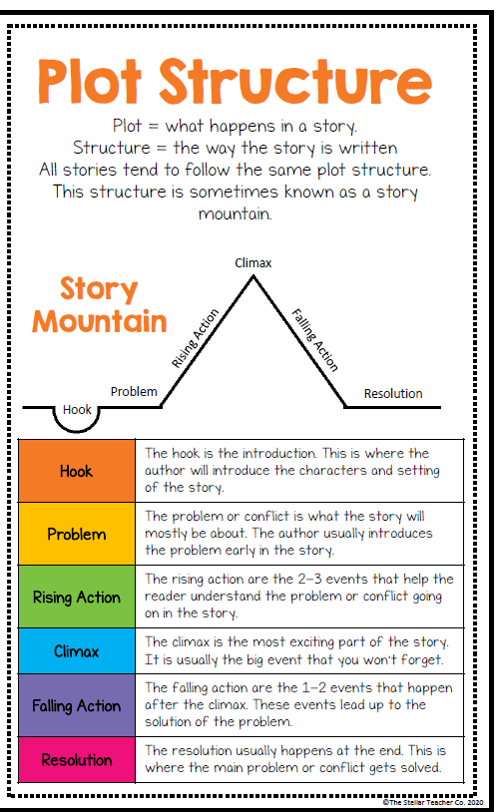
Anchor Chart

Slide 6
Day 2: Looking at Text
Now that we have created a list of the parts of a narrative we are going to look at different texts and decide whether each is a narrative or not a narrative. Let’s practice together first. We will read each text together and then we will decide whether it is a narrative or not based on our list of elements.

Slide 7
Day 2: Looking at Text – A Fabulous Friday
It was the night before the field trip that every fifth grader looks forward to since first grade, and I could hardly sleep. I couldn’t stop thinking of all of the cool things that we were going to get to do tomorrow. My sister, who is a seventh grader now, couldn’t stop telling me all about the trip. She was still so excited to think about it. I knew it was going to be the best day ever! Usually mornings in my house are rough, because I never want to get up on time, and my mom gets so upset that I may miss the bus. But not that morning. I was the first one up. I dressed in my comfiest clothes just perfect for a day in nature. My mom said, “You must be excited! I have never seen you up this early on a school day.” “Yeah mom, I said, It’s the day I have been looking forward to for four years.” Thank goodness, the sun was shining, and the temperature was supposed to be a balmy, seventy-five degrees. I couldn’t wait to get the day started!

Slide 8
Day 2: Looking at Text – A Fabulous Friday
When we first arrived at the nature park, we had to listen to a lot of instructions. Do you know how hard it is to think that standing between you and the best day ever is someone explaining what not to do all day? Finally, we were divided into groups. My fingers were crossed, because I was hoping to be the first group on the canoes. Yes! Canoeing is what I was looking forward to the most. We were in two man canoes, and my best friend Brian and I were partners. We saw tons of fish, turtles, and ducks. Brian shouted, “Look! It’s a bald eagle. Let’s try to take his picture.” “Cool! I have only seen them in books and magazines.” We found out that canoeing is not as easy as it looks. We almost tipped over a couple of times, but thankfully we managed to keep upright. Just when we were really getting the hang of it, the guide blew the whistle to signal that it was time to move to the next activity.

Slide 9
Day 2: Looking at Text – A Fabulous Friday
My group was headed to the scavenger hunt next. We had a list of items to look for as we walked along trails in the woods. These weren’t just ordinary items like leaves and sticks. We had to find specific kinds of leaves like maple and oak and take rubbings of them to prove we found them. We also had to look for animal prints on the ground and holes bored in trees and take pictures of them with a digital camera. My partner and I found the leaves and the tracks right away, but the holes in the trees took forever to find. “Finally!” I hollered! “There is a hole right there. I think it must have been a woodpecker. It’s very small.” One of the last items on our list was a spider web. We thought that would be so easy too, but we were wrong. We had to look so carefully since they are difficult to see, and after what seemed like an hour we finally spied one and took the picture. “Let’s run, so we can beat everyone else,” Brian shouted over his shoulder. We rushed back to our group leader hoping there would be prizes for the first group finished and there were. However, our friends, Susie and Jill, beat us. Oh well, it was still so much fun being on the trail and searching for everything

Slide 10
Day 2: Looking at Text – A Fabulous Friday
The last activity for our group was a ropes course. Everyone was so excited about this activity, but I wasn’t sure if I would like it at all. I whispered to Brian, “I don’t think I am going to try this.” “You can do it,” Brian assured me. “Just don’t look down at first. You are connected to a safety harness, so there is no way you will fall to the ground.” “I’ll trust you,” I said. “But I’m not sure that I will like it.” First, we were hooked up to harnesses just like Brian said. Next, we were led up a twenty-five-foot tower. That was the part that I was not looking forward to. I am not scared of heights, but I sure would have rather been on the ground. However, there was no way I was going to miss this opportunity. First, we went through a twisted, wooden ladder. It was swaying back and forth, and I was taking baby steps hoping not to make it move too much. I actually made it across without any issues. “That was a piece of cake,” I hollered back to Brian. “See, I told you,” he said with a smile. Some of my friends were not so lucky. The ladder rolled on them and began to sway, so it was not easy for them to stand up and get going again. On the final section of the ropes course, we felt as if we were Tarzan. We got to swing from rope to rope until we reached the platform on the other side. I got a little nervous when I looked down, but I only had two more ropes to go, so I quickly conquered my fear.

Slide 11
Day 2: Looking at Text – A Fabulous Friday
The trip I had been looking forward to since we started school didn’t disappoint. The weather was awesome, and I enjoyed every activity. It is so hard for me to choose my favorite, but I think it has to be the ropes course. I didn’t think I would be able to do it, but I surprised myself. Canoeing was definitely my second favorite activity. I am so glad we didn’t flip over. The scavenger hunt was fun, too. Coming in second place was a pretty good feeling. I am sad that the trip was over so quickly, but I am so glad it turned out to be just what I was expecting…the best day ever!
After reading this story, do you think this is a narrative?

Slide 12
Day 2: Looking at Text – A Fabulous Friday
It was the night before the field trip that every fifth grader looks forward to since first grade, and I could hardly sleep. I couldn’t stop thinking of all of the cool things that we were going to get to do tomorrow. My sister, who is a seventh grader now, couldn’t stop telling me all about the trip. She was still so excited to think about it. I knew it was going to be the best day ever! Usually mornings in my house are rough, because I never want to get up on time, and my mom gets so upset that I may miss the bus. But not that morning. I was the first one up. I dressed in my comfiest clothes just perfect for a day in nature. My mom said, “You must be excited! I have never seen you up this early on a school day.” “Yeah mom, I said, It’s the day I have been looking forward to for four years.” Thank goodness, the sun was shining, and the temperature was supposed to be a balmy, seventy-five degrees. I couldn’t wait to get the day started!
Establishes
Character and
situation

Slide 13
Day 2: Looking at Text – A Fabulous Friday
When we first arrived at the nature park, we had to listen to a lot of instructions. Do you know how hard it is to think that standing between you and the best day ever is someone explaining what not to do all day? Finally, we were divided into groups. My fingers were crossed, because I was hoping to be the first group on the canoes. Yes! Canoeing is what I was looking forward to the most. We were in two man canoes, and my best friend Brian and I were partners. We saw tons of fish, turtles, and ducks. Brian shouted, “Look! It’s a bald eagle. Let’s try to take his picture.” “Cool! I have only seen them in books and magazines.” We found out that canoeing is not as easy as it looks. We almost tipped over a couple of times, but thankfully we managed to keep upright. Just when we were really getting the hang of it, the guide blew the whistle to signal that it was time to move to the next activity.
Event Sequence

Slide 14
Day 2: Looking at Text – A Fabulous Friday
My group was headed to the scavenger hunt next. We had a list of items to look for as we walked along trails in the woods. These weren’t just ordinary items like leaves and sticks. We had to find specific kinds of leaves like maple and oak and take rubbings of them to prove we found them. We also had to look for animal prints on the ground and holes bored in trees and take pictures of them with a digital camera. My partner and I found the leaves and the tracks right away, but the holes in the trees took forever to find. “Finally!” I hollered! “There is a hole right there. I think it must have been a woodpecker. It’s very small.” One of the last items on our list was a spider web. We thought that would be so easy too, but we were wrong. We had to look so carefully since they are difficult to see, and after what seemed like an hour we finally spied one and took the picture. “Let’s run, so we can beat everyone else,” Brian shouted over his shoulder. We rushed back to our group leader hoping there would be prizes for the first group finished and there were. However, our friends, Susie and Jill, beat us. Oh well, it was still so much fun being on the trail and searching for everything.
Descriptive Details
Dialogue

Slide 15
Day 2: Looking at Text – A Fabulous Friday
Transition Words and phrases
Descriptive Words & Sensory Details
The night before
When we first arrived
Finally
The next activity
The last activity
First
Hardly sleep
Mornings are rough in my house
Balmy seventy-five degrees
Beat everyone else
Twenty-five-foot tower
Swayed back and forth
We felt as if we were Tarzan

Slide 16
Day 2: Looking at Text – A Fabulous Friday
Is this a conclusion?
The trip I had been looking forward to since we started school didn’t disappoint. The weather was awesome, and I enjoyed every activity. It is so hard for me to choose my favorite, but I think it has to be the ropes course. I didn’t think I would be able to do it, but I surprised myself. Canoeing was definitely my second favorite activity. I am so glad we didn’t flip over. The scavenger hunt was fun, too. Coming in second place was a pretty good feeling. I am sad that the trip was over so quickly, but I am so glad it turned out to be just what I was expecting…the best day ever!

Slide 17
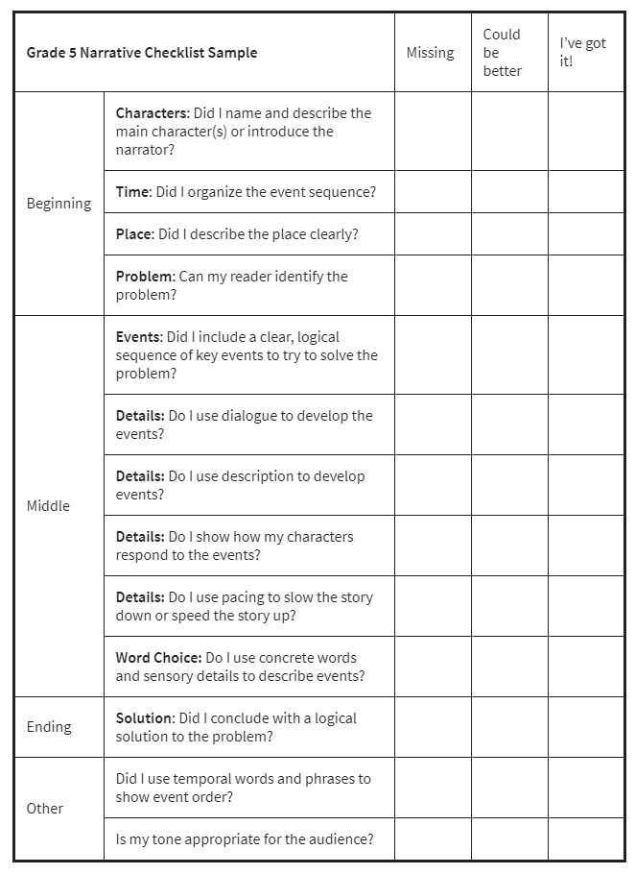
Day 3: Learning to Evaluate Narratives
Listen to this portion of walk two moons and check off on your narrative checklist the details you hear.

Slide 18
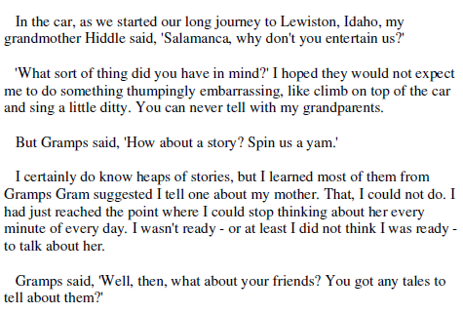
Day 3: Evaluate Narratives
Walk Two Moons

Slide 19
Day 3: Evaluate Narratives Walk Two Moons

Slide 20
Day 3: Evaluate a Narrative
Look for Narrative Features!
My teacher, Mr. Johnson, assigned us a writing assignment that had me stumped. What do I want to be when I grow up and why? How am I supposed to know what I want to be when I grow up when I am only ten years old? Sure, I could make something up, but he said to be as real as possible. I have been sitting at my desk for an hour now. Three sheets of paper with a word or two each are crumpled on the floor. I just want to scream.
I glanced at the clock. It was already 7:00 p.m., and I had to write at least two pages. Maybe I’ll write about becoming a doctor. I put my pen to the paper and started to write “When I grow up I want to be a doctor.” Now what do I write? I don’t know why I would want to be a doctor. I crumpled another piece of paper and added it to the pile. I was so frustrated. I heard a knock on my door. My brother says, “Can you please help me with my math homework?” “Yes, I need a break.” It only took ten minutes to make my little brother smile from ear to ear, because I had helped him figure out every problem.
Then I had to finish my paper or actually get started. I sat and thought and all of a sudden it came to me. I love helping kids learn. I want to be a teacher. Writing those two pages was easy once I figured out the plan for my future.

Slide 21
Day 3: Evaluating a Narrative
Now it’s your turn! Read through your passage and check of features of a narrative that you have found!

Slide 22
Day 4 & 5: Learning to Write a Narrative

