Slide 29
Notes:
Flamingos get their pink color from eating shrimp.

Slide 40
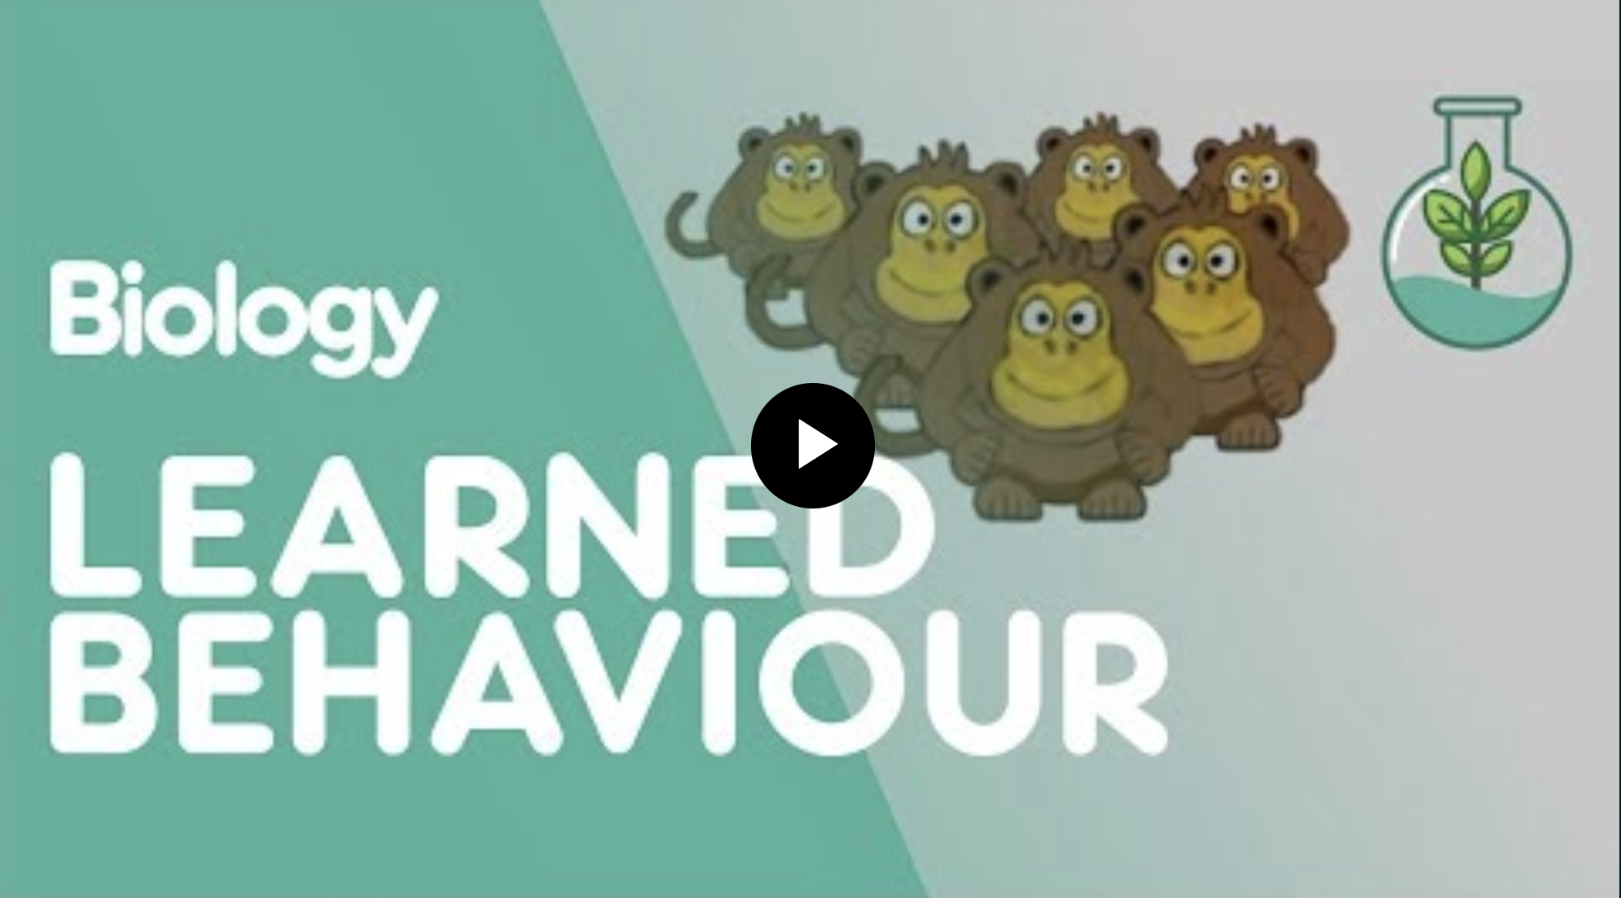
Notes:
Click on the image in slideshow mode to take you to the video.

Slide 41
Notes:
Students should come up with their own examples of each.

Slide 49
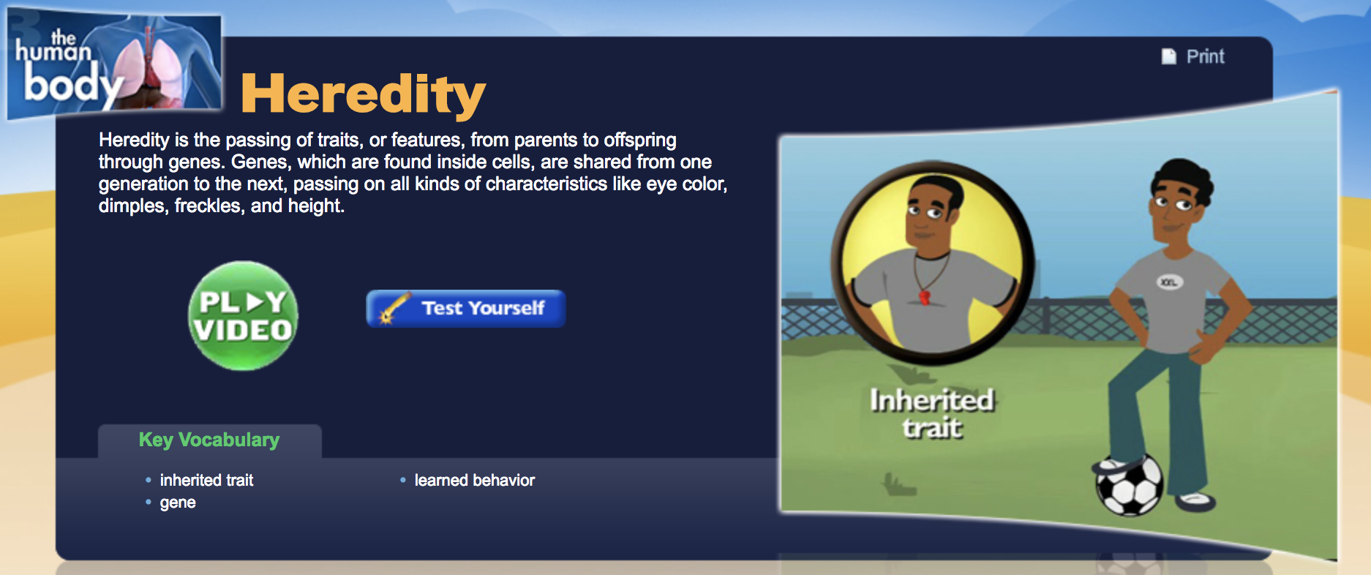
Notes:
Click on the picture in slideshow mode to access the video.

Slide 51
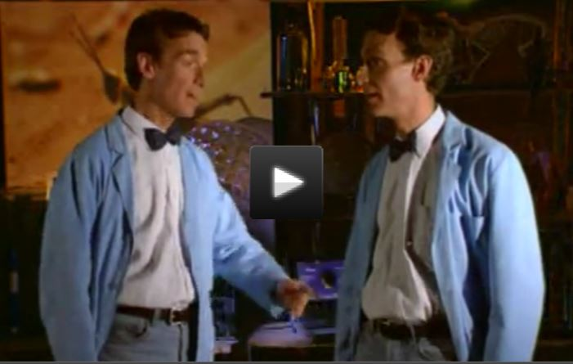
Notes:
Teachers – if the video is not available, it may have been taken down. Simply search “Bill Nye Genes” to find it again on YouTube.

Slide 53
Click here to access my store

Slide 54
Thank you to the following talented artists:

