Slide 5
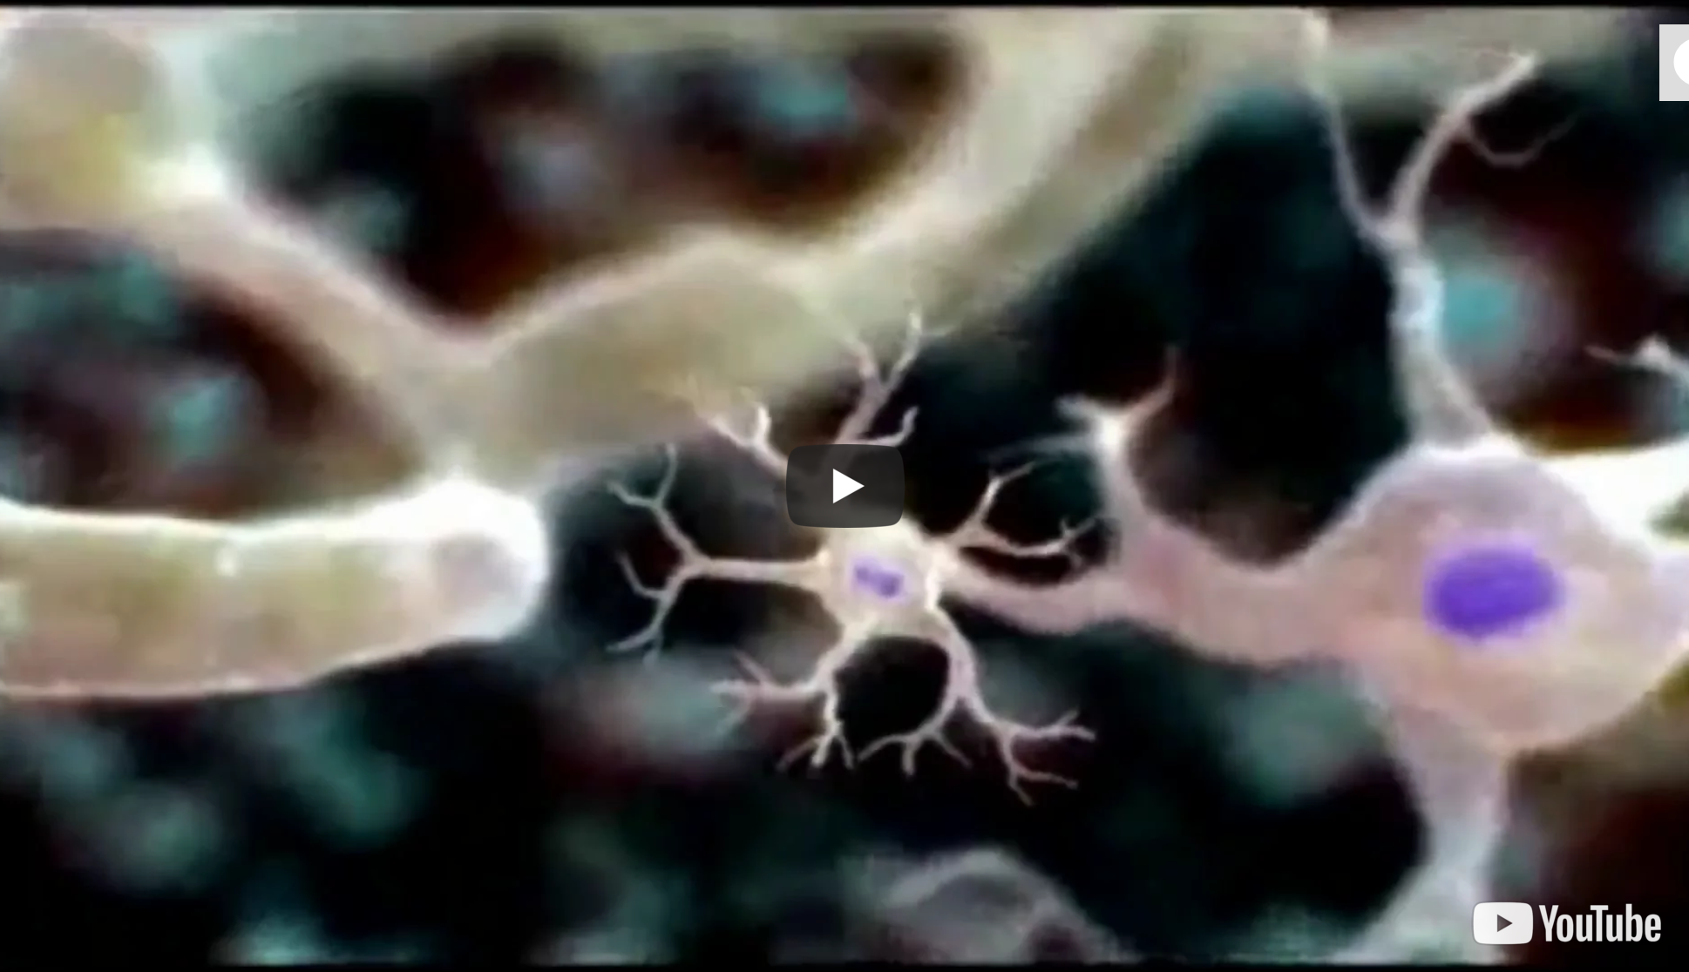
http://viewpure.com/gFuEo2ccTPA?start=0&end=0
If the video doesn’t work, here is the original: https://www.youtube.com/watch?v=gFuEo2ccTPA
Notes:
Click on the image in slideshow mode to watch the video.

Slide 7
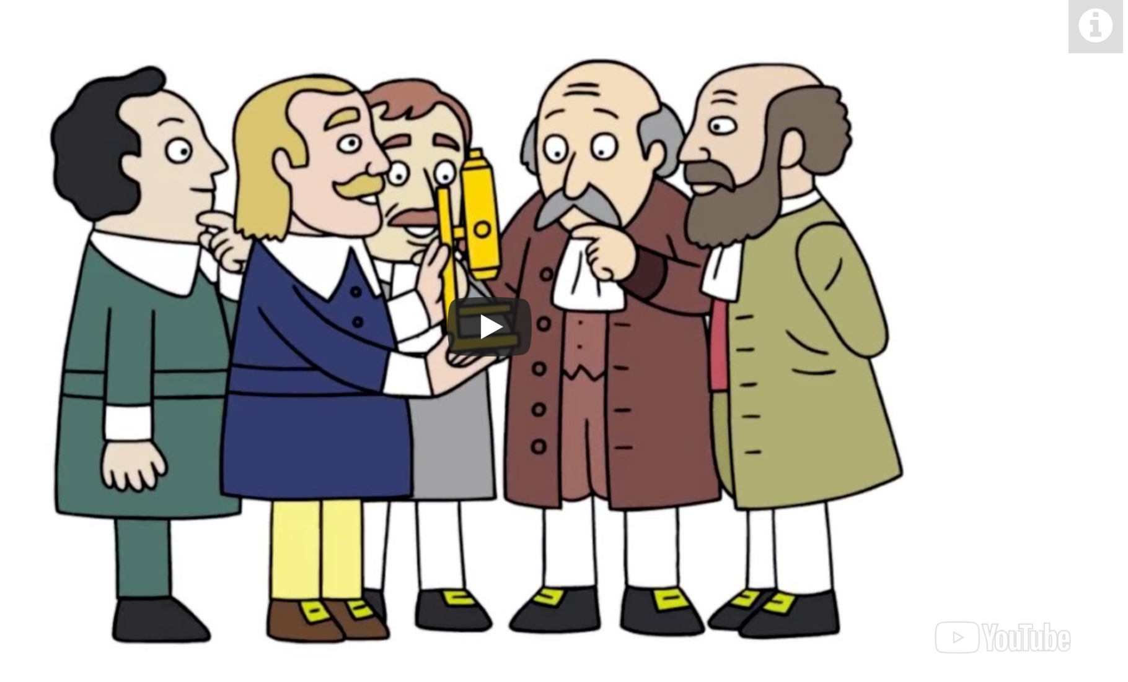
How were cells discovered?
https://safeshare.tv/x/ss5c86e24d2d338#
Notes:
Click on the image in slideshow mode to watch the video.

Slide 27
http://studyjams.scholastic.com/studyjams/jams/science/plants/plant-cells.htm
Notes:
Click on the image in slideshow mode.

Slide 34
http://studyjams.scholastic.com/studyjams/jams/science/animals/animal-cells.htm
Notes:
Click on the image in slideshow mode to go to the website.

Slide 37
https://www.cellsalive.com/cells/cell_model_js.htm
Notes:
Click on the image in slideshow mode.

Slide 49
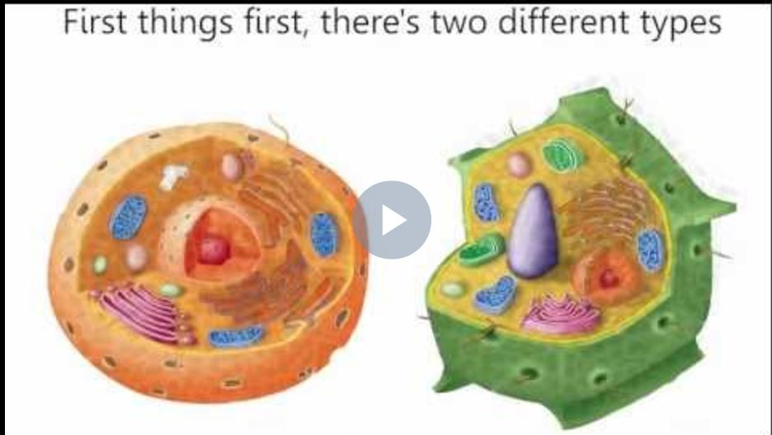
https://safeshare.tv/x/eEreniRASI
Notes:
Click on the image in slideshow mode to listen to the song.

Slide 51
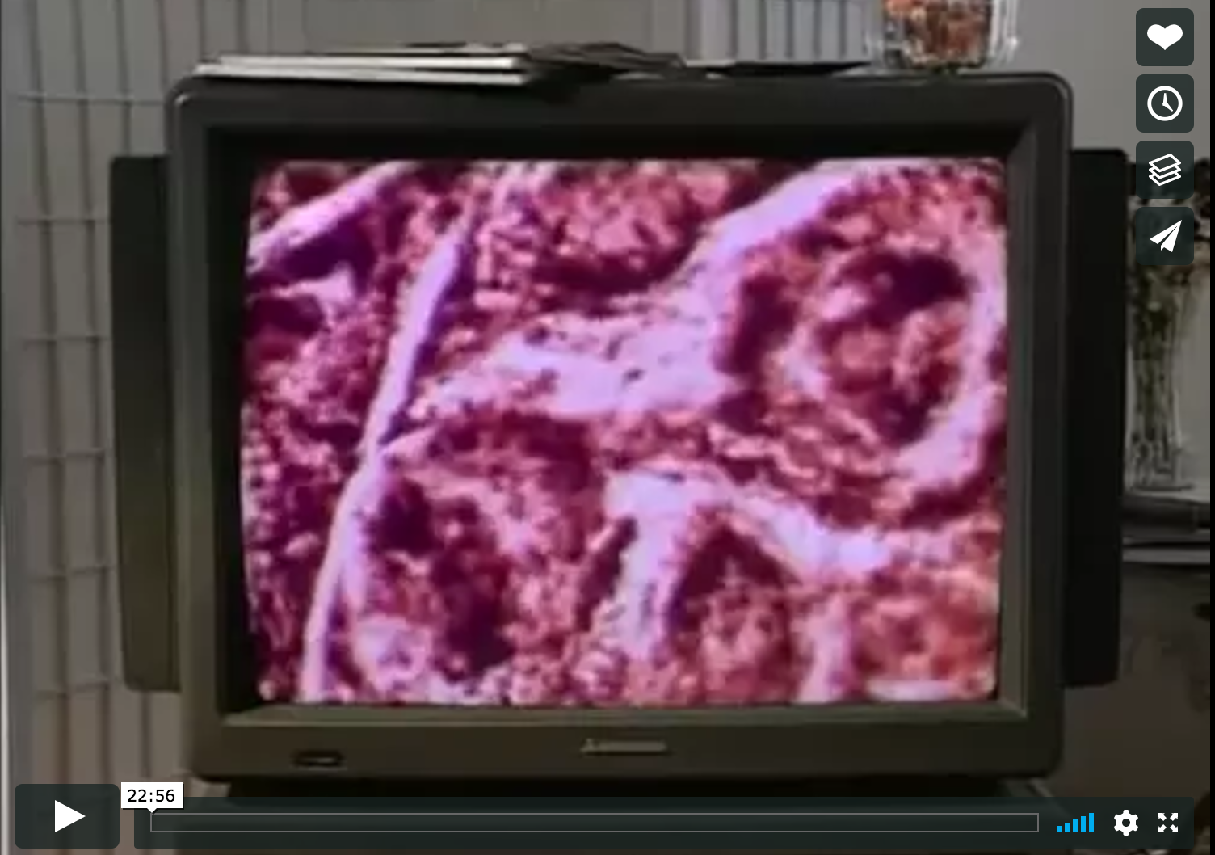
https://safeshare.tv/x/ss5c7da3c24492d#
Notes:
Teachers – if the link is no longer active, the video may have been removed from YouTube. Search it and you should find it again.

