Slide 1
Read and Write Decimals
5.NBT.3

Slide 2
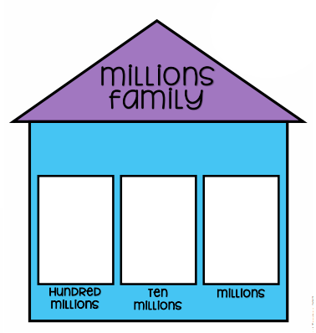
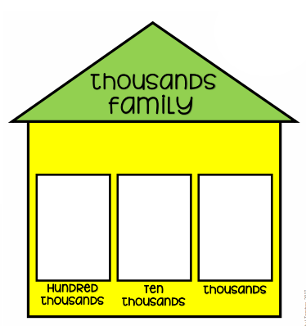
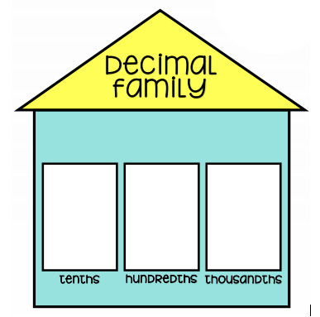
In 4th grade, you learned how to read and write whole numbers.
4
3
2
9
7
6
5
Word Form: Forty-three thousand, two hundred ninety-seven
Word Form: Forty-three thousand, two hundred ninety-seven and sixty-five hundredths

Slide 3
Example 2
8
7
6
5
8
2
3
4
Word Form: Eighty-seven thousand, six hundred fifty-eight and two hundred thirty-four thousandths

Slide 4
Example 3
4
6
5
9
7
0
3
1
Word Form: four million, six hundred fifty-nine thousand, seven hundred three and one tenth

Slide 5
Example 4
1
0
3
6
8
5
0
2
Word Form: one hundred three thousand, six hundred eighty-five and two hundredths

Slide 6
Example 5
4
9
9
2
6
3
0
0
5
Word Form: four hundred ninety-nine thousand, two hundred sixty-three and five thousandths

Slide 7
Example 6
2
5
8
6
0
4
1
3
Word Form: twenty-five thousand, eight hundred sixty and four hundred thirteen thousandths

