Slide 1
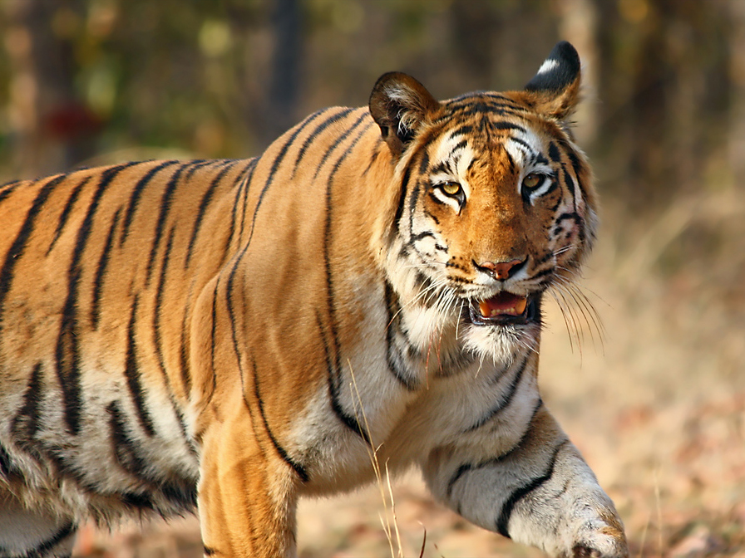
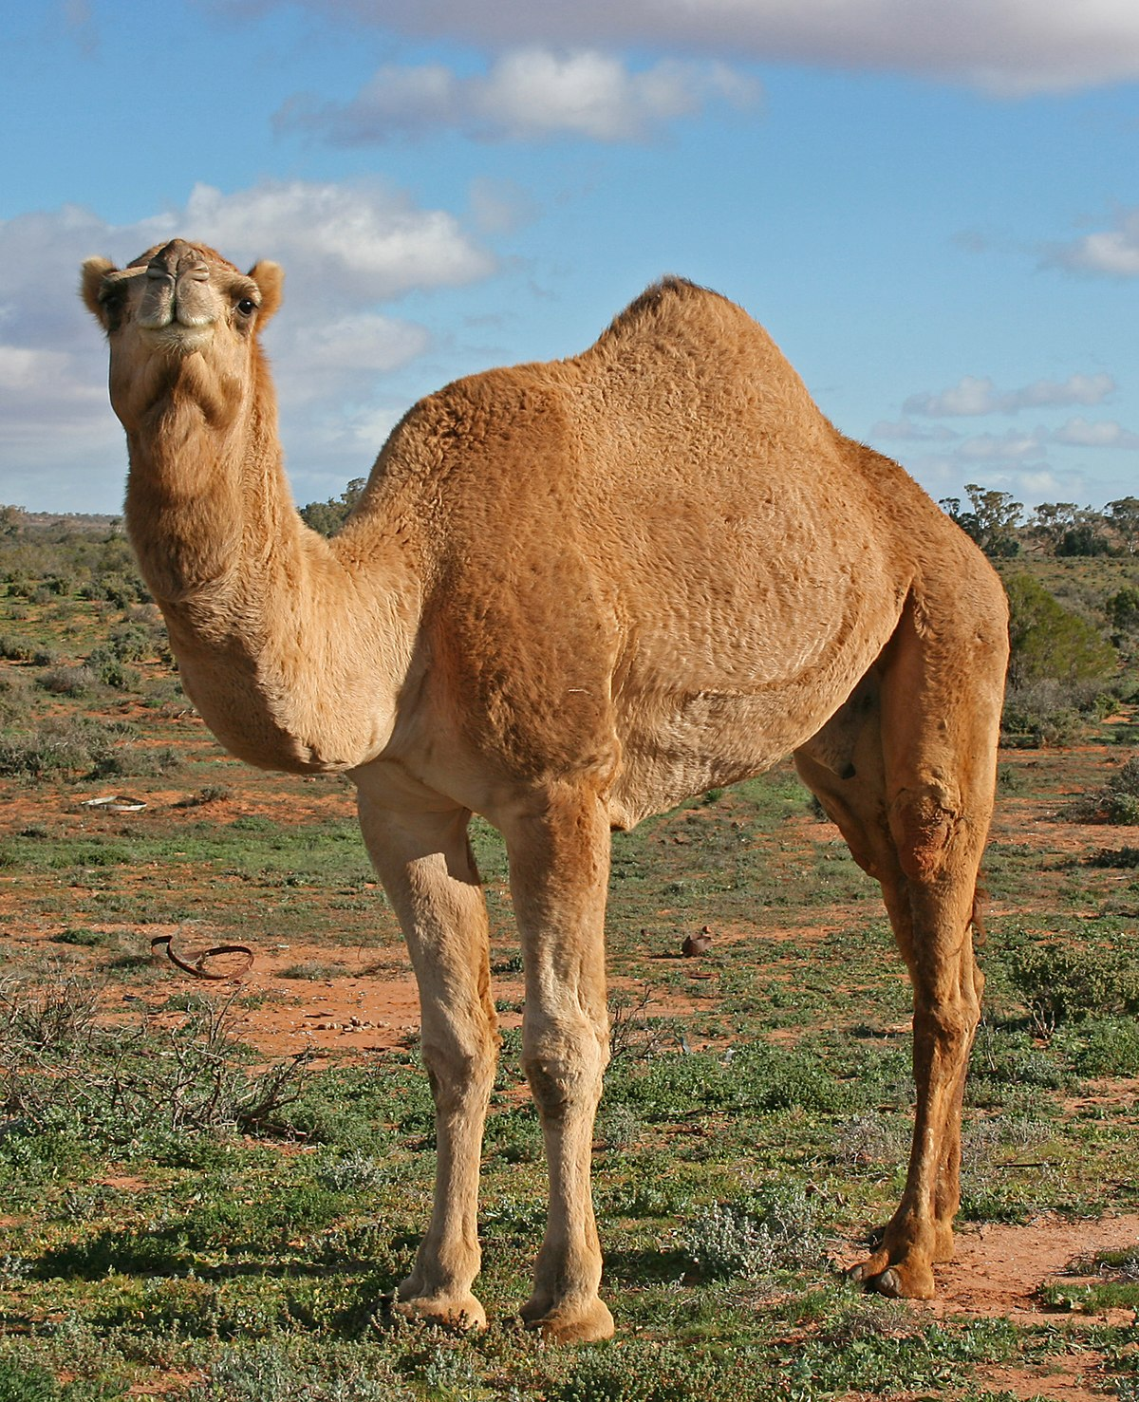
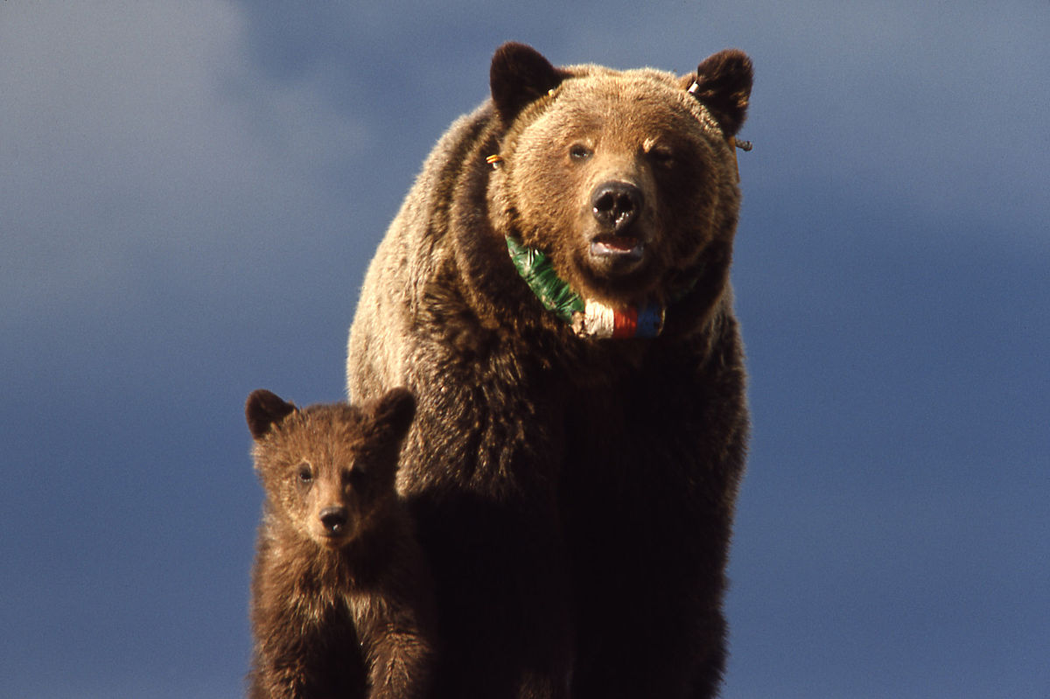
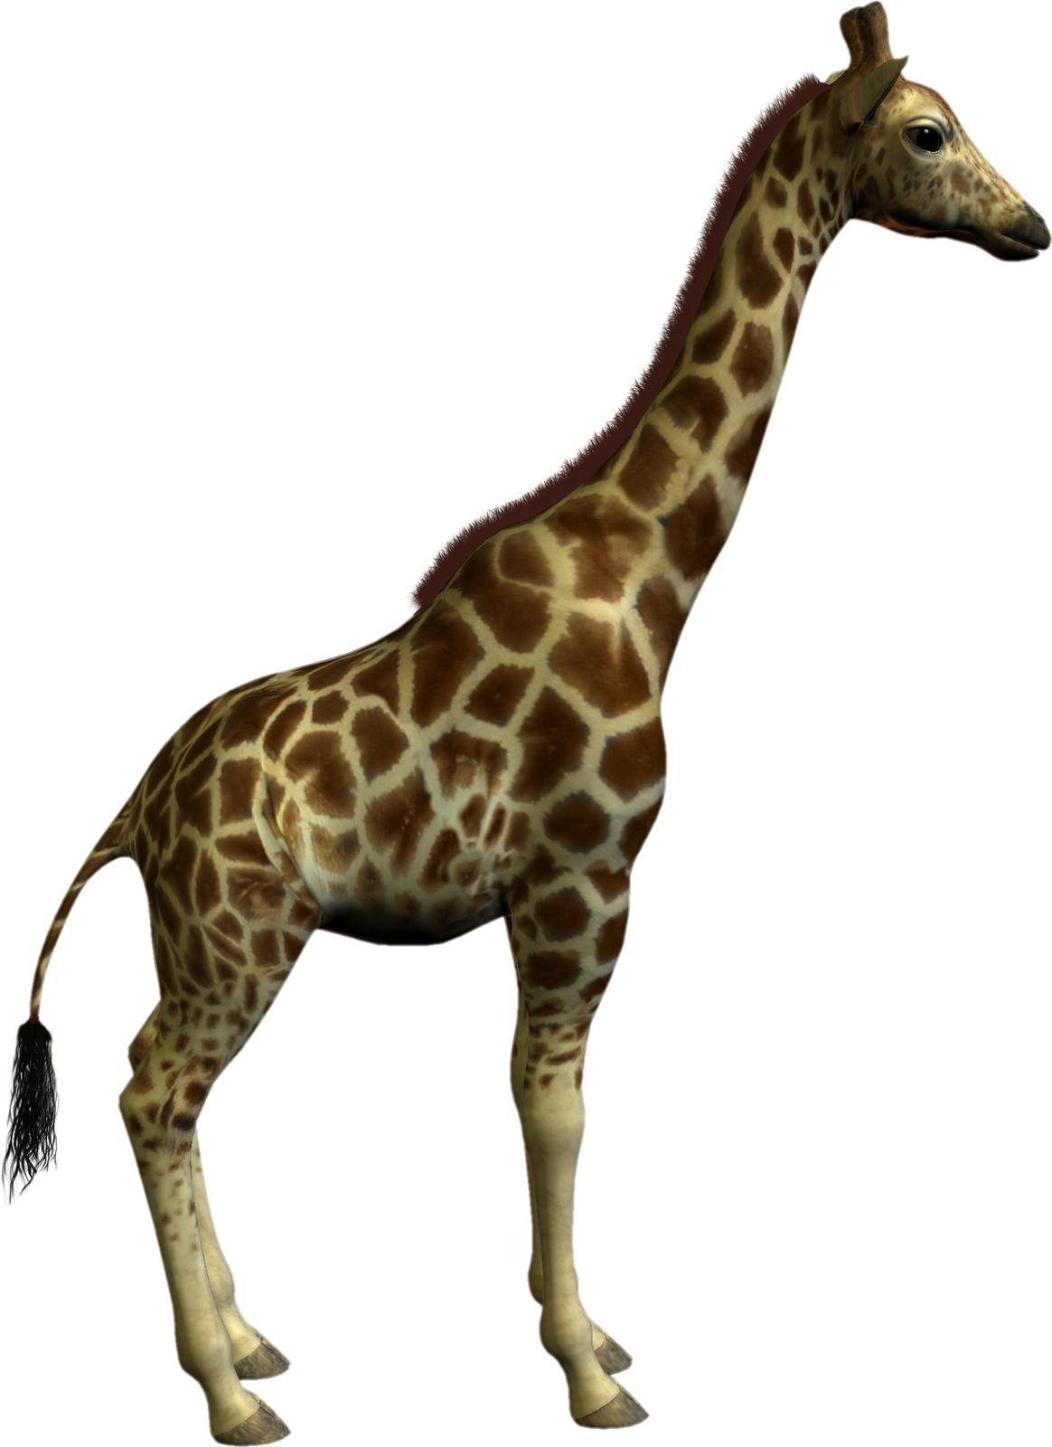
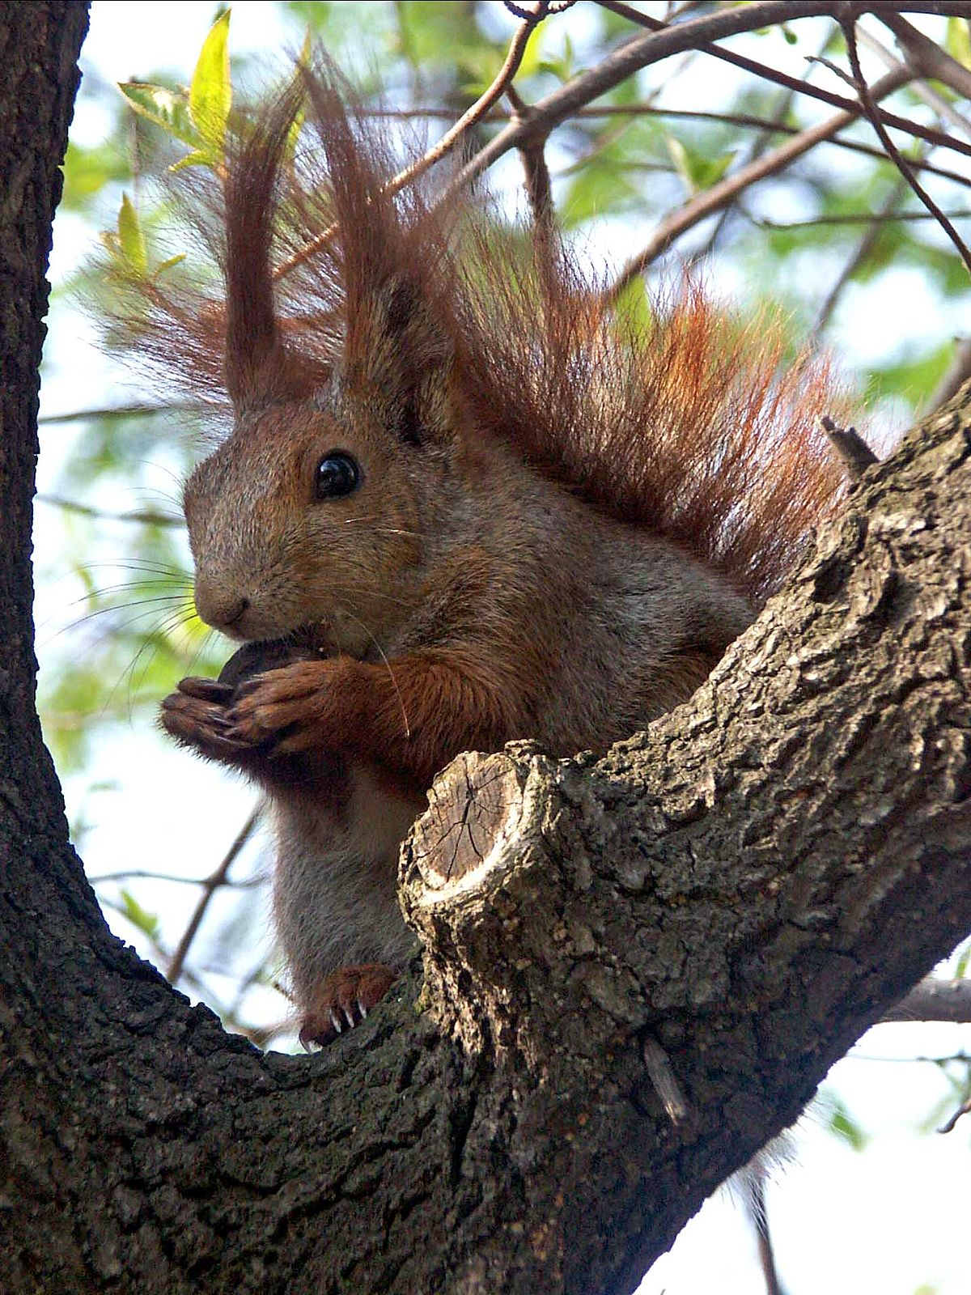
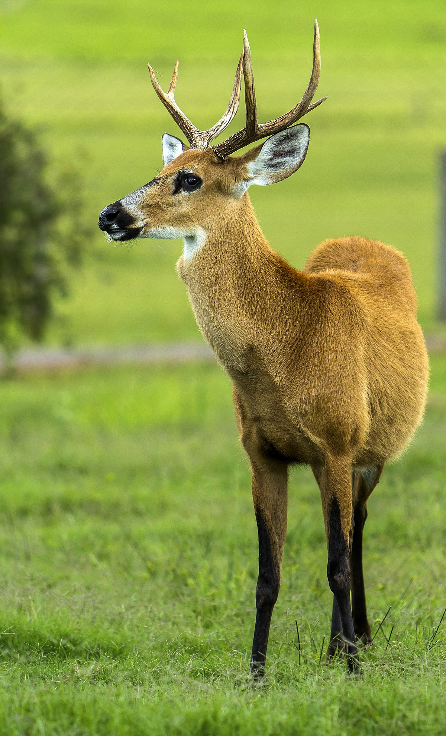
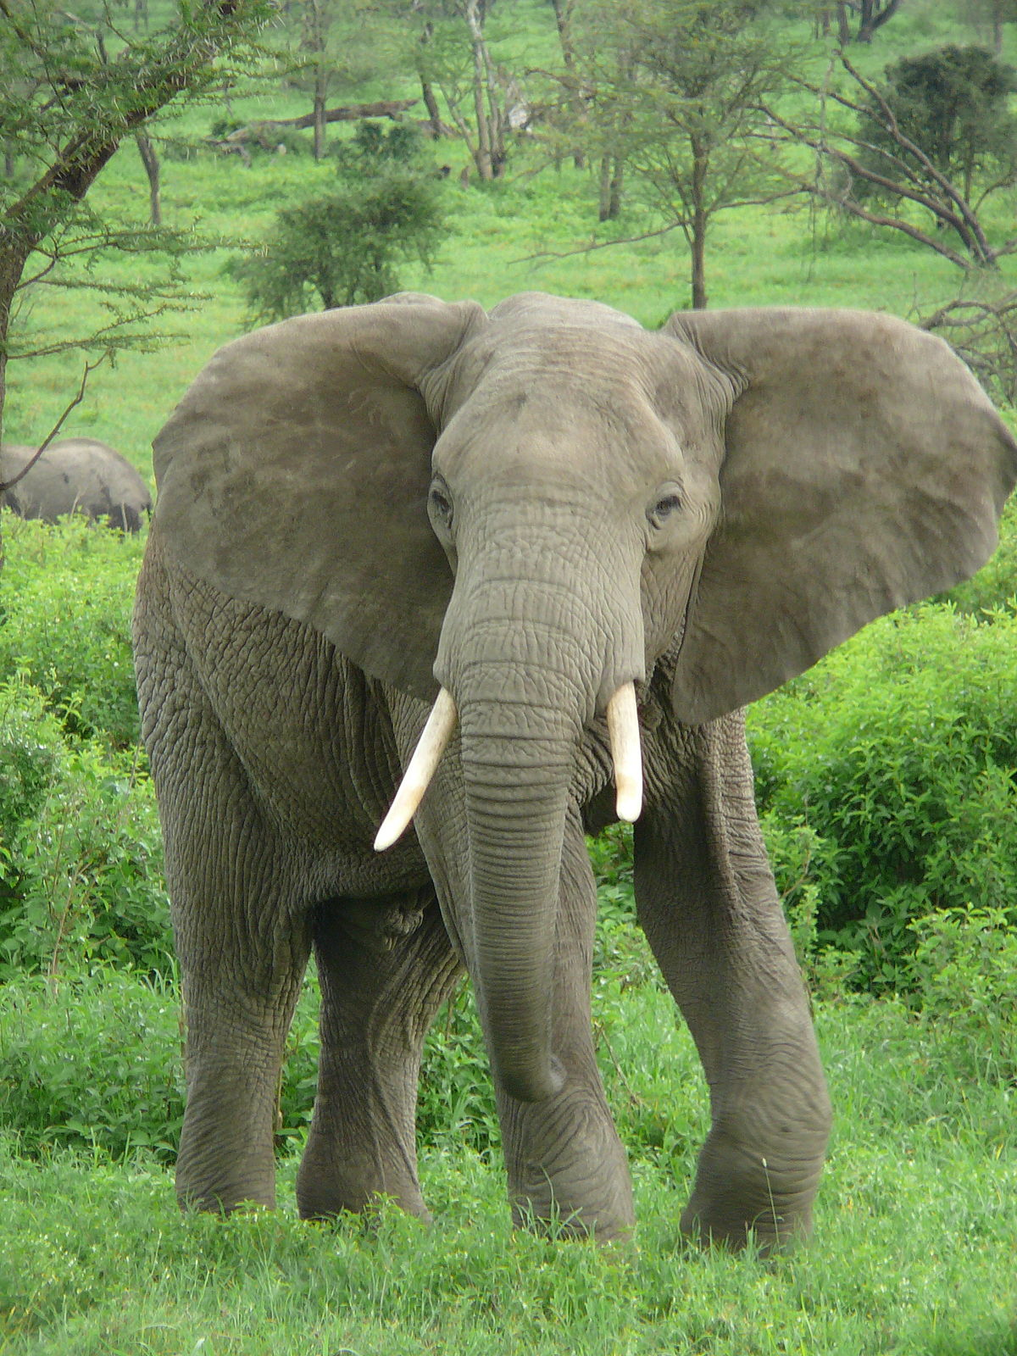
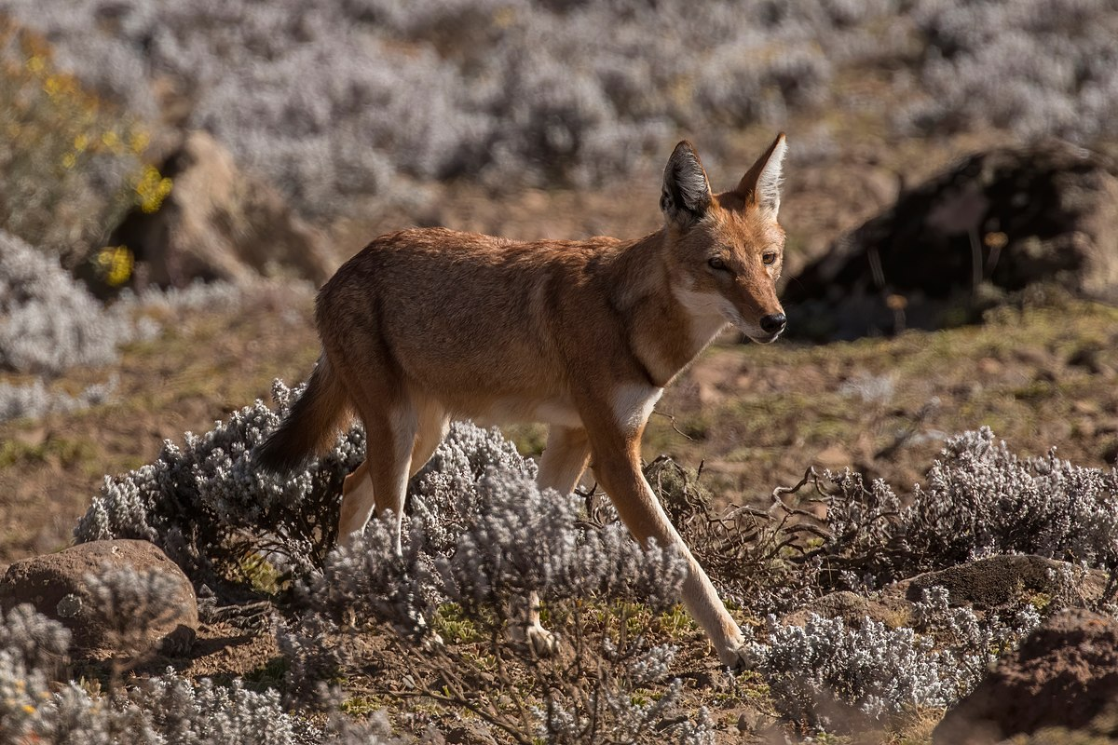
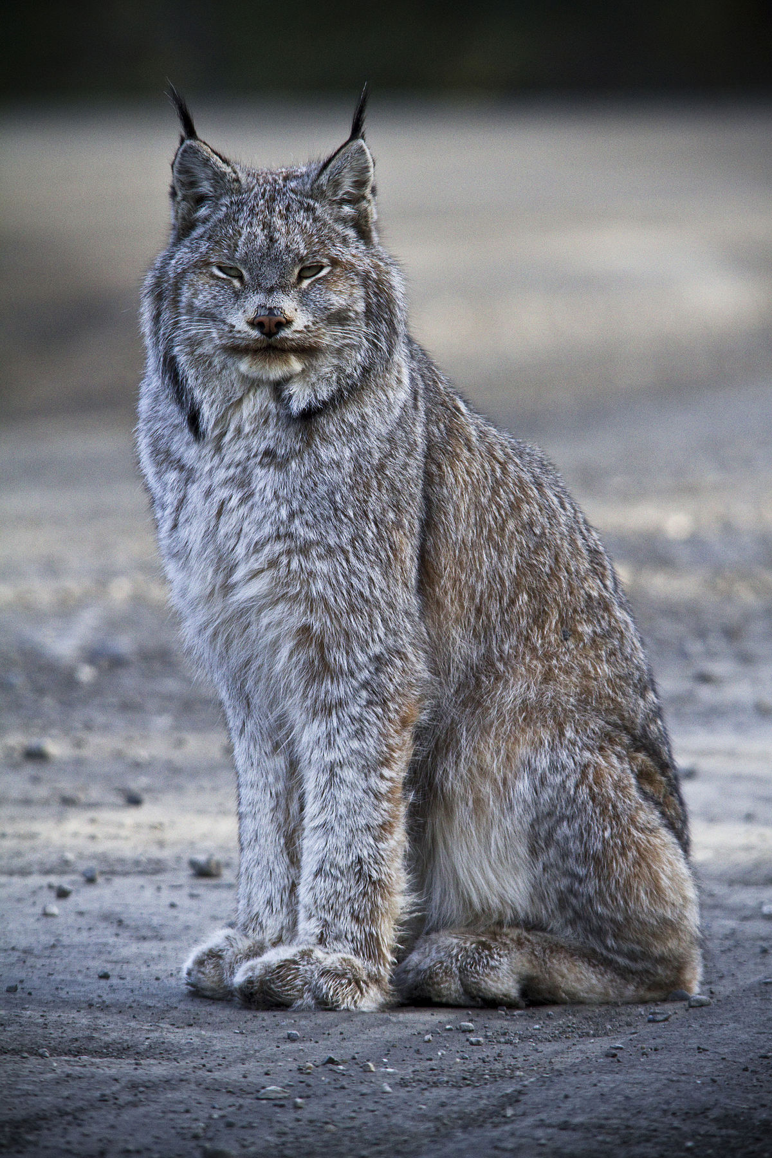
Informational Writing:
Endangered Animals
This Photo by Unknown Author is licensed under CC BY-SA
This Photo by Unknown Author is licensed under CC BY-SA
This Photo by Unknown Author is licensed under CC BY-SA
This Photo by Unknown Author is licensed under CC BY-NC-ND
This Photo by Unknown Author is licensed under CC BY-SA
This Photo by Unknown Author is licensed under CC BY-SA
This Photo by Unknown Author is licensed under CC BY-SA
This Photo by Unknown Author is licensed under CC BY-SA
This Photo by Unknown Author is licensed under CC BY-SA

Slide 2
Check out this great example!
Chameleons are Cool!
By Martin Jenkins

Slide 3
Day 6: Revise & Edit
Today we are going to REVISE and EDIT our paper. Have your draft and be prepared to look over your paper for things you can do to make it better!

Slide 4
Interesting Verbs
Verbs are the engine of your sentence – they’re what makes it GO! Look at my sentences below:
Monkeys go from limb to limb.
Monkeys swing from limb to limb
Monkeys swing swiftly from limb to limb.
Look at your writing, see if you can replace some of your verbs with more detailed ones!

Slide 5
Voice
Voice is adding your own personal style – it’s what makes your topic exciting and interesting.
Think about what you can add from your own personal experiences.
Can you involve your reader by asking questions and offering ideas or suggestions?
Example: If you write about electricity – offer ways to conserve electricity at school.
Have someone else read your paper out loud to you.. This is useful because you already know how you want your writing to sound. When you read it, you read it the way you want it to sound, but when someone else reads it, you can see areas that are confusing, weak, or leave the reader questioning.
Stop and try some of these strategies to add voice to your paper.

Slide 6
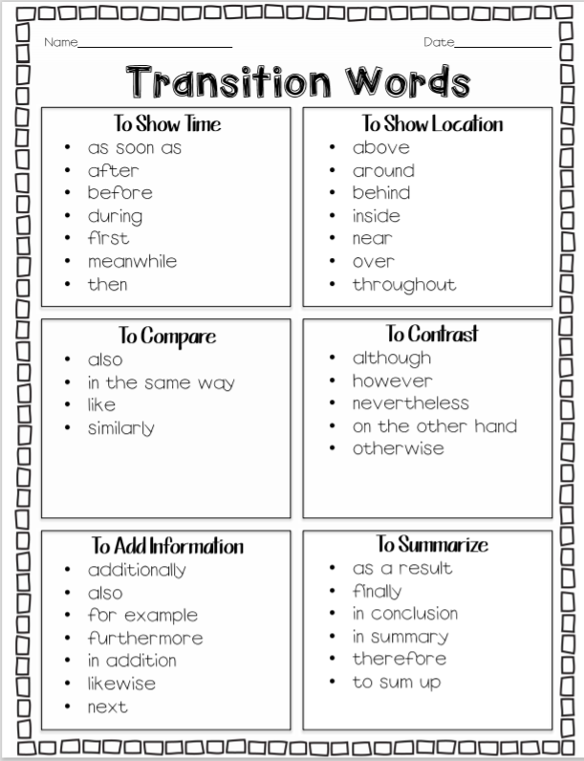
Transition Words
Sentences need to flow together to create a smooth sounding paragraph. You don’t want your wtiting to sound choppy like a list! Transition words are words that connect or link the sentences in a paragraph.
Pause the video and look for transition words in your writing.

Slide 7
Sentence Variety
Have you ever read a text that sounded dull and boring? There wasn’t anything necessarily wrong with the writing, but it was missing its SPARK?
Example:
There are many different types of animals that live in the swamp. Alligators live in the swamp. Bobcats live in the swamp. There are eagles that live in the swamp. Cypress trees grow in the swamp.
There are many different types of animals that live in the swamp. Alligators and bobcats live there. You can even find eagles making the swamp their home. Not only animals live in the swamp, but trees such as the cypress tree are found in the swamp too.

Slide 8
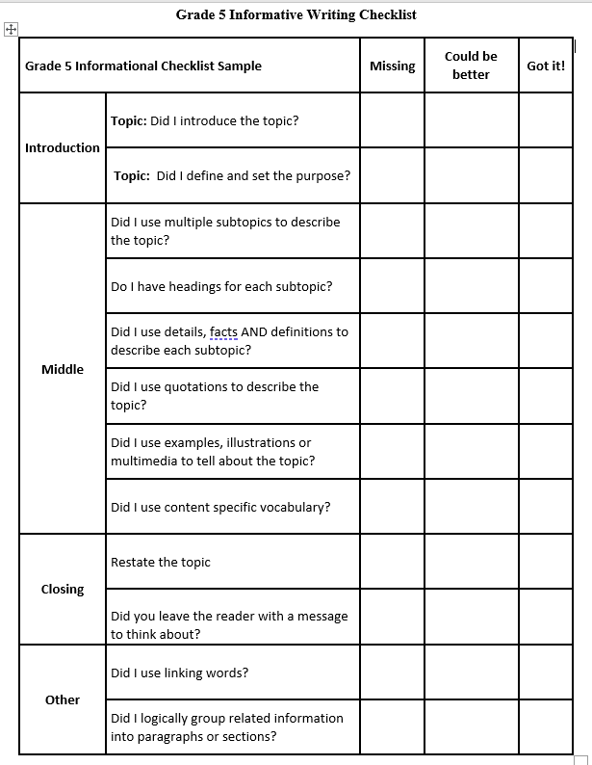
Revision Checklist
Pause the video and look through the revision checklist. Have you added to your paper to make sure you have completed the tasks we talked about today?

Slide 9
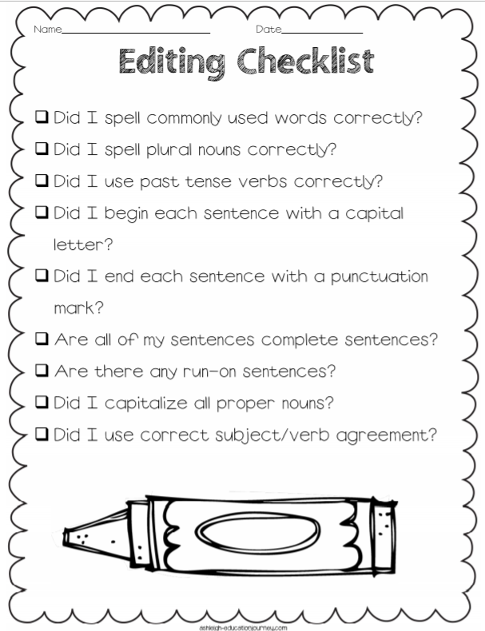
Editing
Before you are completely finished, look over your paper for editing mistakes:
Spelling
Capitalization
Complete/Run-on sentences
Subject/verb agreement
She gone to the store. – She went to the store.

Slide 10
Formatting
The dolphin is a unique and interesting animal. It’s traits and behaviors help it to survive in its habitat. Let’s explore what makes the dolphin so unique and why it’s habitat varies so much.
The bottle nose dolphin is a mammal like humans, but has so many amazing inherited traits to make them unique. ​According to Ocean today, one trait dolphins have are one row of about 75-100 teeth which are only used to catch prey, then they swallow the fish whole. ​Another inherited trait that makes the dolphin unique is it's dorsal and tail fin. The dorsal fin is located on the dolphin's back and helps the mammal with stability and steering. The tail fin is also used for movement, but also used to communicate with others. ​The inherited trait that makes them mammals is their blow hole because this means they breath air. Dolphins instinctually know to go to the surface after they are born to get their first breath. ​A dolphin's teeth, fins, and blow hole make the dolphin unique and allow it to eat, swim, and breath in the ocean to survive!​
The habitat of the dolphin can vary. Dolphins live in open oceans, coastal waters, river basins, seas, gulfs, and in channels. Dolphins don’t tolerate cold well, therefore many species migrate or travel to warmer climates. Dolphins eat a lot of food, so they tend to travel to different parts of the ocean to follow their food supply. Climate change, commercial whaling, and fishing operations are all threatening the ocean. As you can see, dolphins travel through many bodies of water and we need to protect their habitat to keep dolphins from becoming endangered or extinct.

