Slide 1
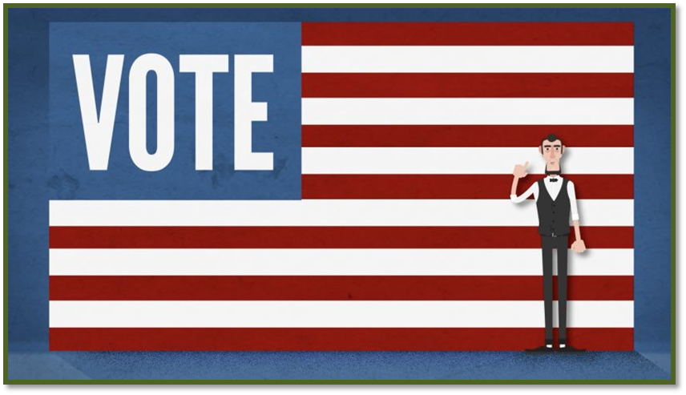
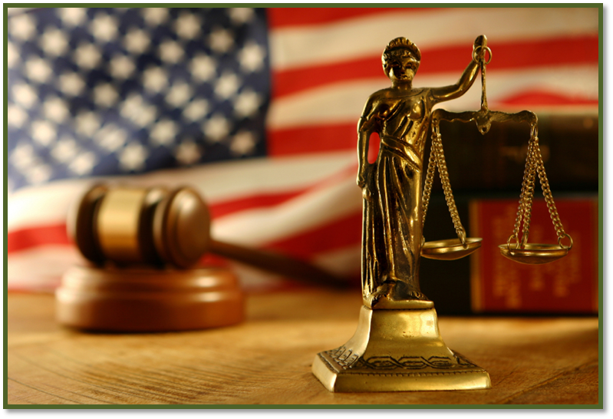
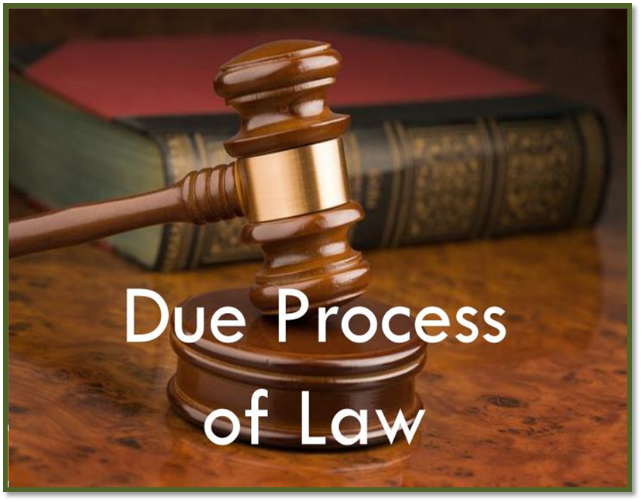
citizen’s rights
SS5CG1ab

Slide 2
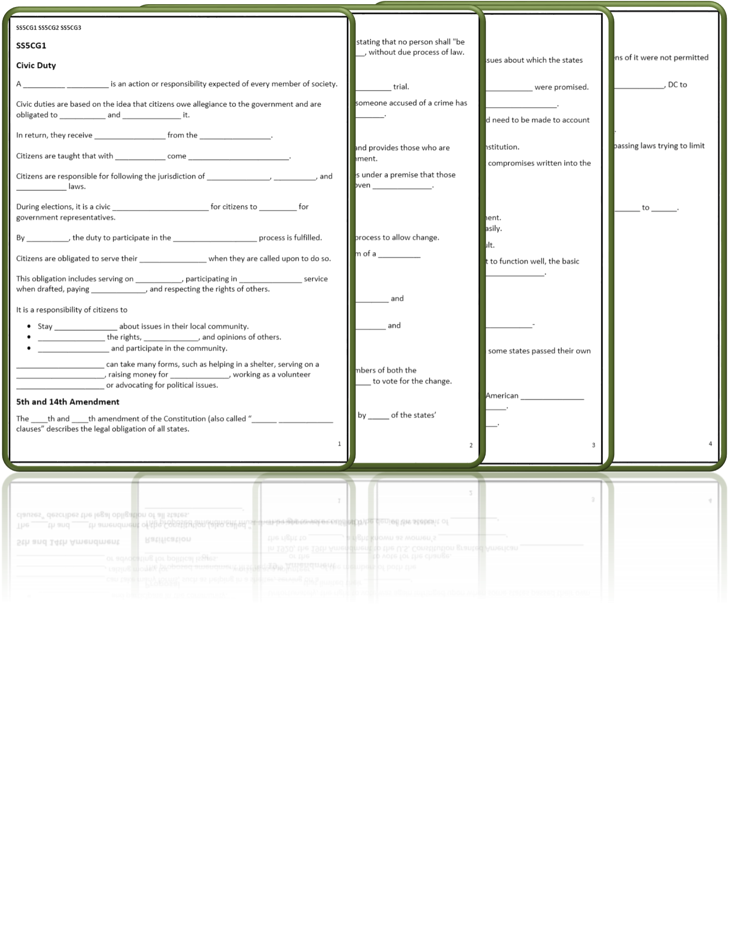
Slotted Notes
Words in a box like this are commentary and not for slotted notes.

Slide 3
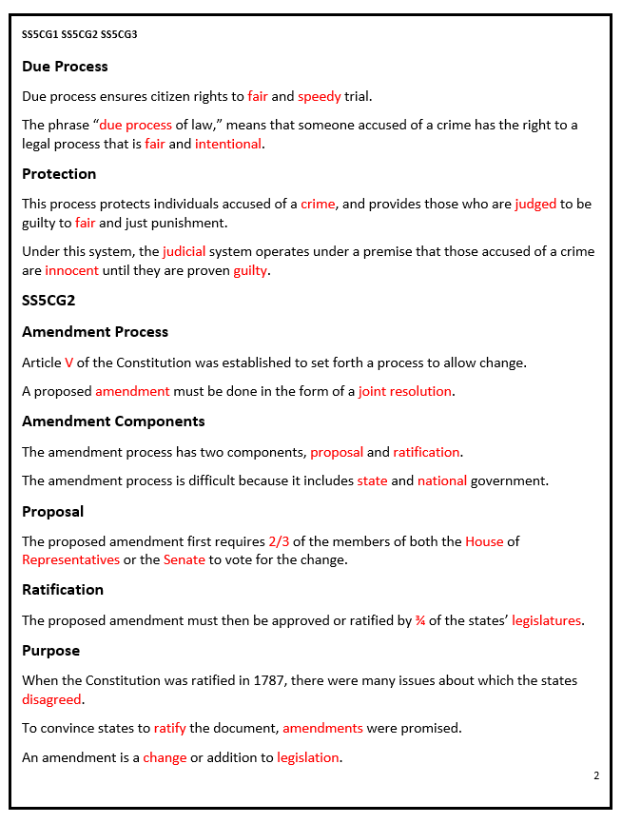
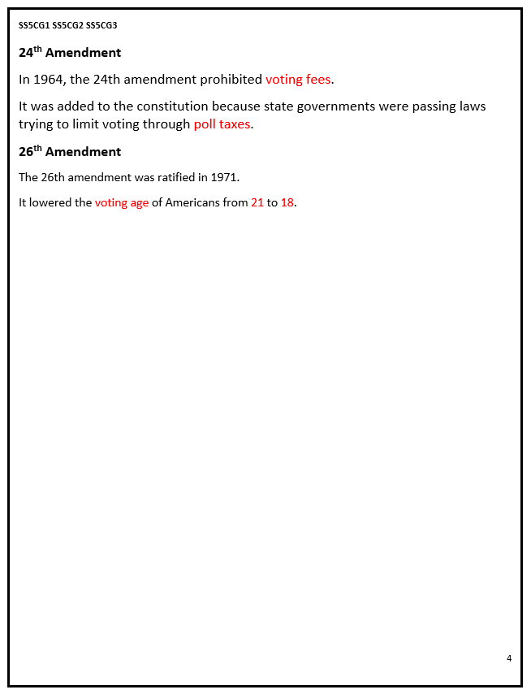
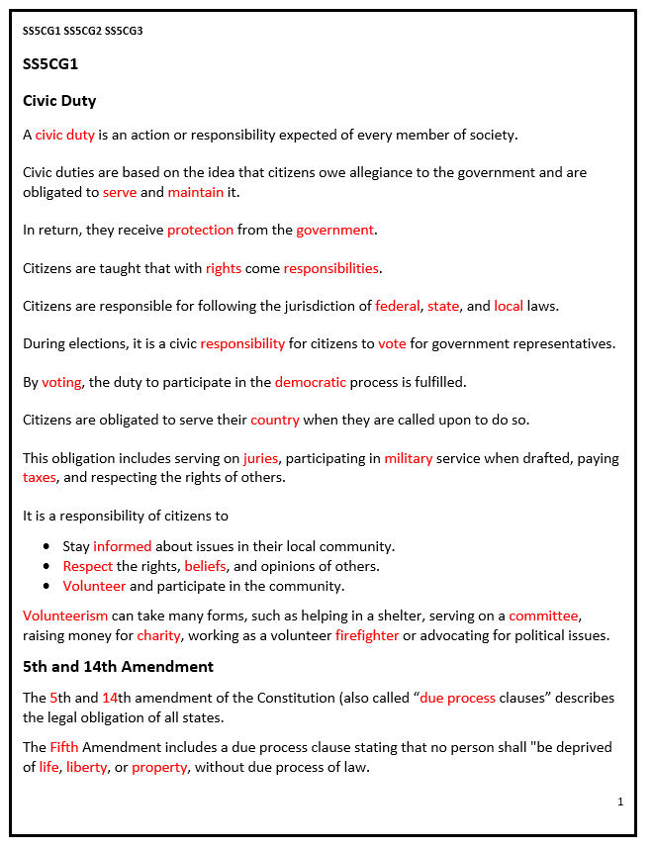
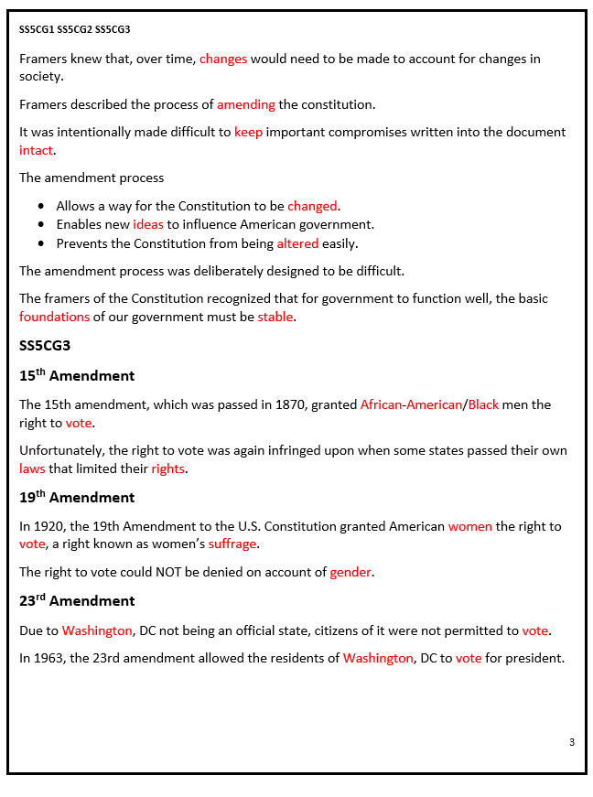
Slotted Notes Answer Key
Words in a box like this are commentary and not for slotted notes.

Slide 4
SS5CG1 Explain how a citizen’s rights are protected under the U.S. Constitution.
a. Explain the responsibilities of a citizen.

Slide 5
Civic Duty
A civic duty is an action or responsibility expected of every member of society.
Civic duties are based on the idea that citizens owe allegiance to the government and are obligated to serve and maintain it.
In return, they receive protection from the government.

Slide 6
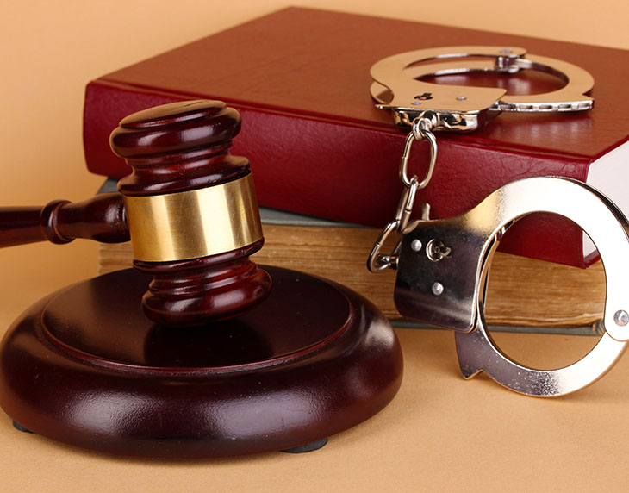
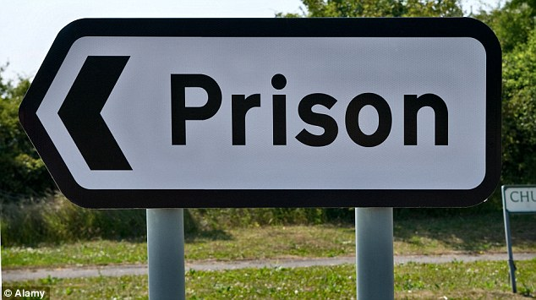
Civic Duty
The government protects the citizens with the enforcement of laws. Everyone is subject to the law, even those who don't agree with it. Though the U.S. Constitution states that citizens have a right to resist laws they consider unjust, dissenters must accept the consequences.

Slide 7
Civic Duty
Citizens are taught that with rights come responsibilities.
Citizens are responsible for following the jurisdiction of federal, state, and local laws.
While some indigenous cultures have a history of belief in civic responsibility, ancient Rome generally gets credit for originating the concept. The founders of the United States featured the concept of civic duty prominently in the U.S. Constitution.

Slide 8
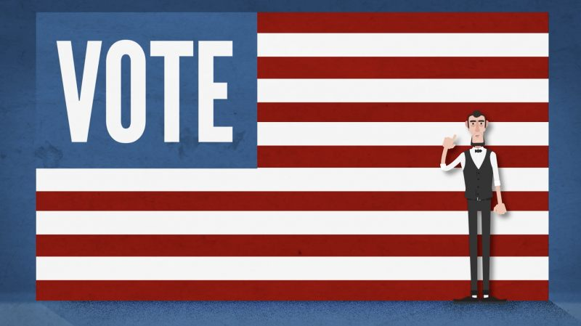
Civic Duty
During elections, it is a civic responsibility for citizens to vote for government representatives.
By voting, the duty to participate in the democratic process is fulfilled.
Voter turnout in the United States fluctuates in national elections. In recent elections, about 60% of the voting eligible population votes during presidential election years, and about 40% votes during midterm elections.

Slide 9
Civic Duty
Citizens are obligated to serve their country when they are called upon to do so.
This obligation includes serving on juries, participating in military service when drafted, paying taxes, and respecting the rights of others.
All citizens must pay taxes, and by doing so, contribute their fair share to the health of the government and national economy. The federal taxes you pay are used by the government to invest in technology and education, and to provide goods and services for the benefit of the American people.

Slide 10
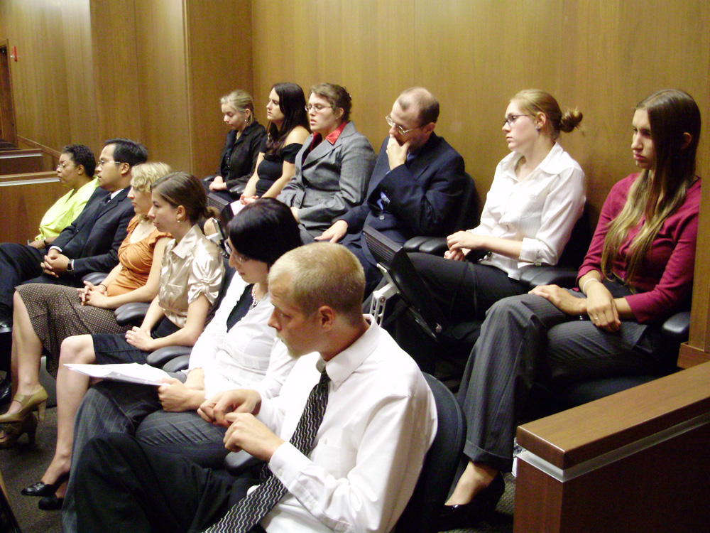
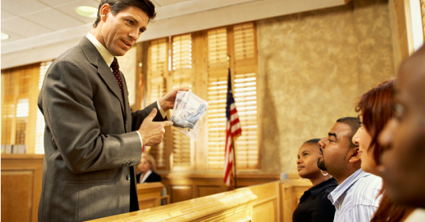
Civic Duty
Each district court randomly selects citizens’ names from lists of registered voters and people with drivers licenses who live in that district. The people randomly selected complete a questionnaire to help determine if they are qualified to serve on a jury. Those qualified are randomly chosen to be summoned to appear for jury duty.

Slide 11
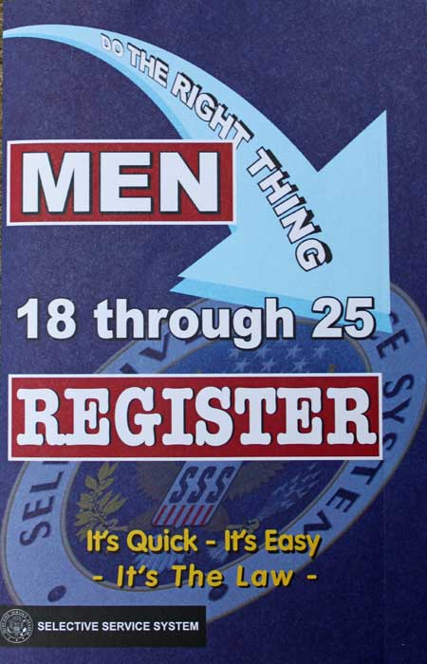
Civic Duty
It is a Civic Duty that all male citizens between the ages of 18 and 25 to register for the selective service within 30 days of their 18th birthday. In a crisis requiring a draft, those registered in the selective service would be called in a sequence determined by random lottery numbers and year of birth.

Slide 12
Civic Duty
It is a responsibility of citizens to
Stay informed about issues in their local community.
Respect the rights, beliefs, and opinions of others.
Volunteer and participate in the community.

Slide 13
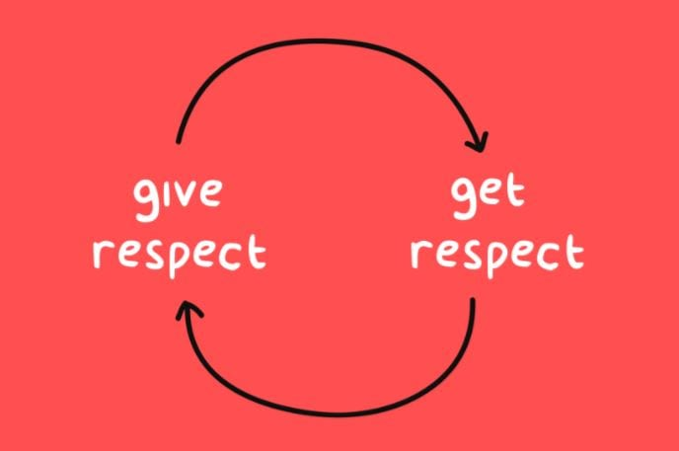
Civic Duty
As Americans, we all share the same rights, responsibilities, and duties. We're all connected not simply by citizenship - but by the love of freedom. Americans should respect the rights of others' as well because other people respect our rights as US citizens. Protecting those rights that we have is important because we should rely on nobody to do what we can do ourselves.

Slide 14
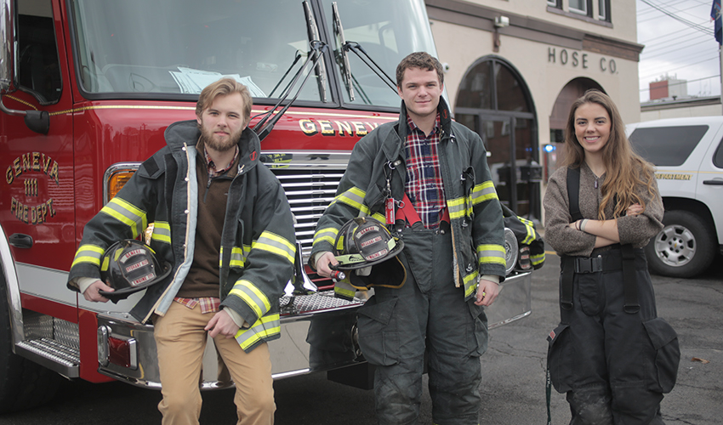
Civic Duty
Volunteerism can take many forms, such as helping in a shelter, serving on a committee, raising money for charity, working as a volunteer firefighter or advocating for political issues.
One recent survey found that only between 25 and 28 percent of Americans volunteer in their community.

Slide 15
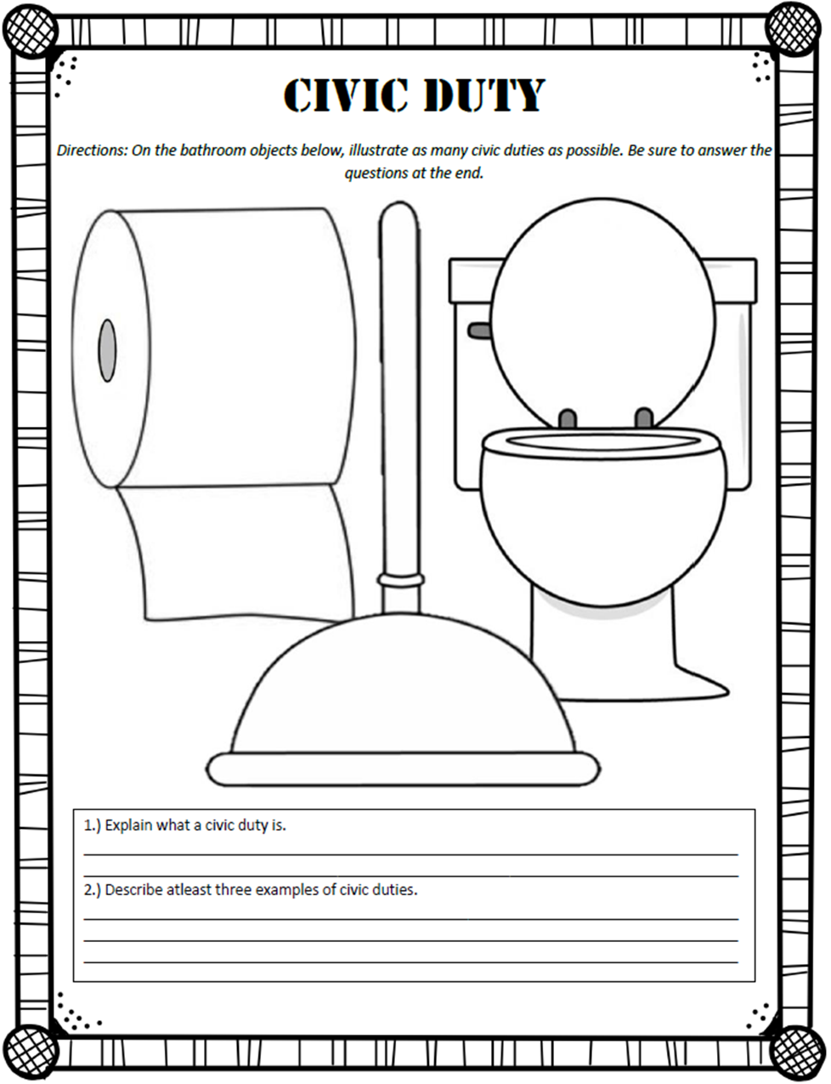
Civic Duty

Slide 16
SS5CG1 Explain how a citizen’s rights are protected under the U.S. Constitution.
b. Explain the concept of due process of law and describe how the U.S. Constitution protects a citizen’s rights by due process.

Slide 17
5th and 14th Amendment
The 5th and 14th amendment of the Constitution (also called “due process clauses” describes the legal obligation of all states.
The Fifth Amendment includes a due process clause stating that no person shall "be deprived of life, liberty, or property, without due process of law.

Slide 18
5th and 14th Amendment
The Due Process Clause serves two basic goals. One is to produce, through the use of fair procedures, more accurate results: to prevent the wrongful deprivation of interests. The other goal is to make people feel that the government has treated them fairly by, say, listening to their side of the story.

Slide 19
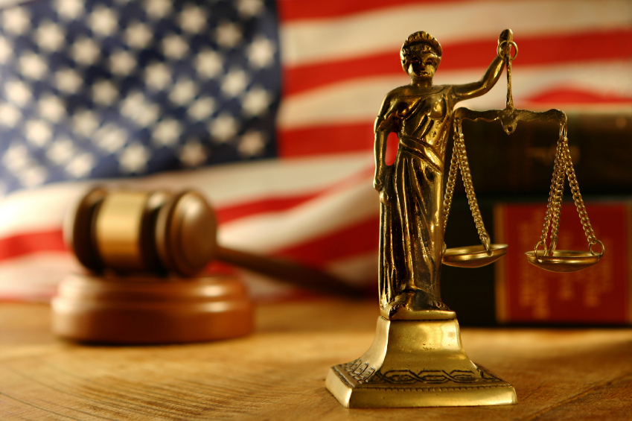
Due Process
Due process ensures citizen rights to fair and speedy trial.
The phrase “due process of law,” means that someone accused of a crime has the right to a legal process that is fair and intentional.

Slide 20
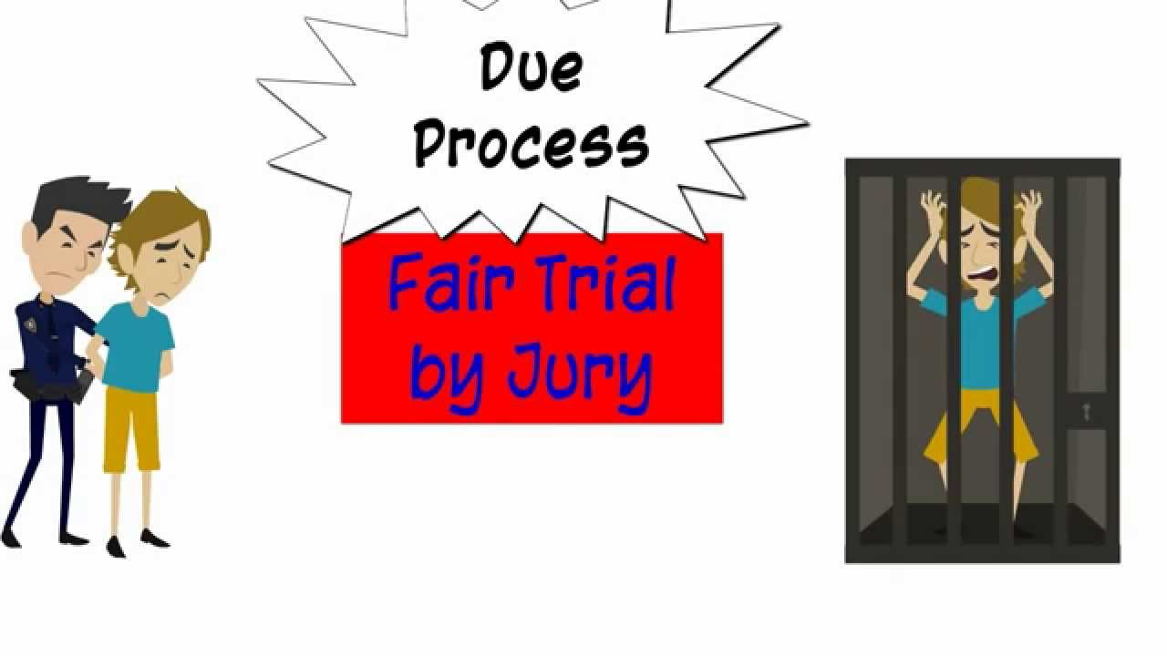
Protection
This process protects individuals accused of a crime, and provides those who are judged to be guilty to fair and just punishment.

Slide 21
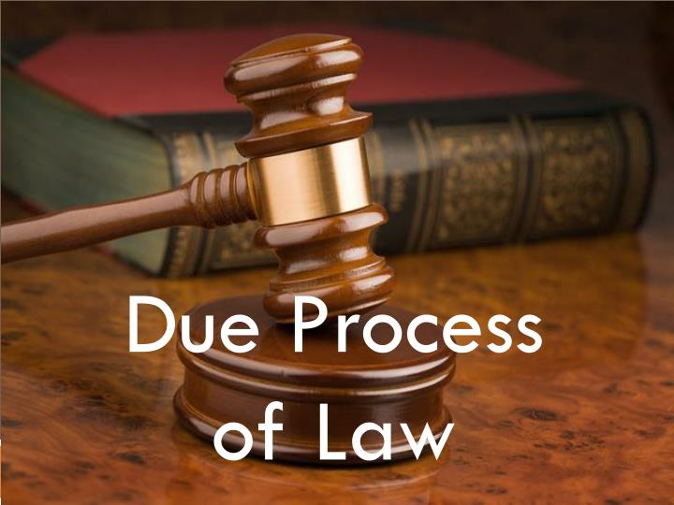
Protection
Under this system, the judicial system operates under a premise that those accused of a crime are innocent until they are proven guilty.
The Due Process Clause is essentially a guarantee of basic fairness. Fairness can, in various cases, have many components: notice, an opportunity to be heard at a meaningful time in a meaningful way, a decision supported by substantial evidence, etc.

Slide 22
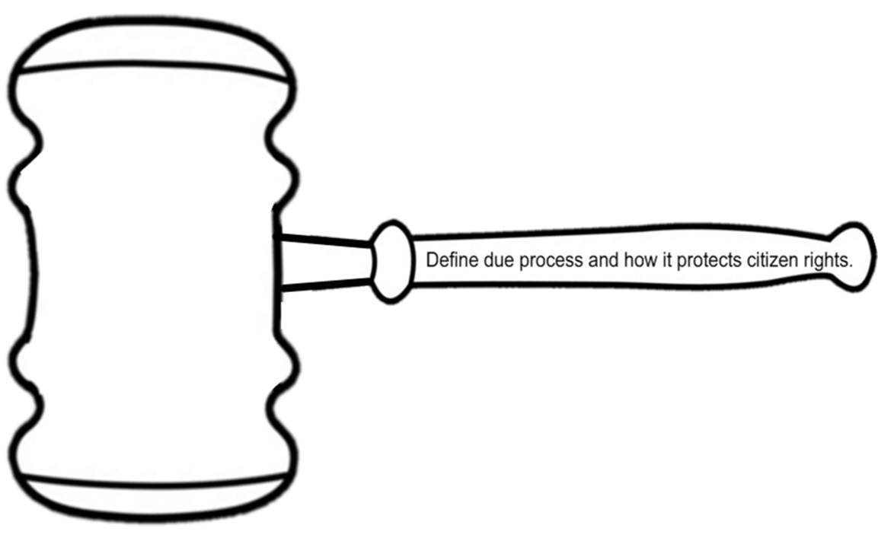
Gavel Out the Door

Slide 23
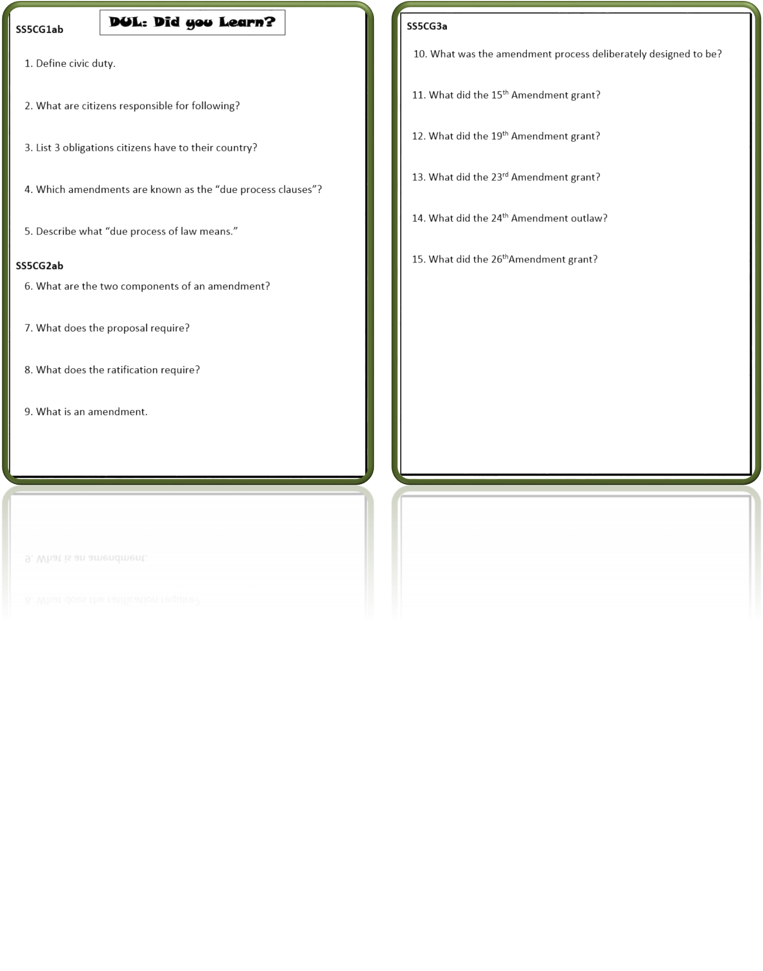
DUL

Slide 24
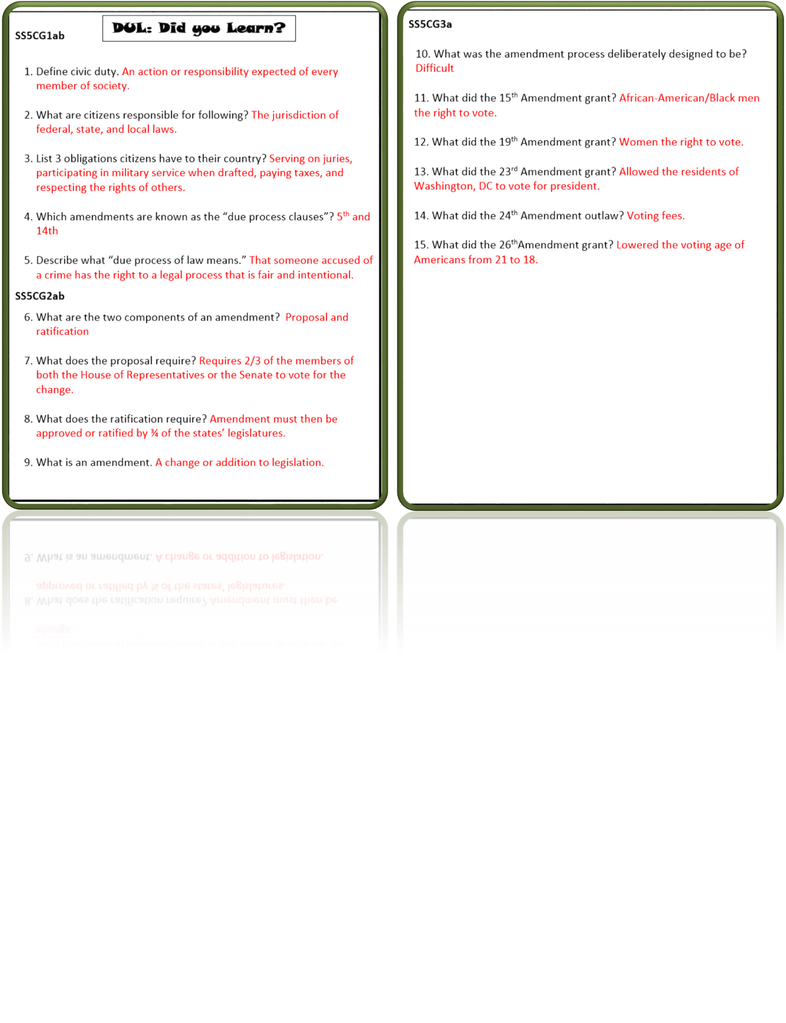
DUL Answer Key

Slide 25
Terms of Use
© Brainy Yak. Your download includes a limited use license from Brainy Yak. The purchaser may use the resource for personal classroom use only. The license is not transferable to another person. Other teachers should purchase their own license through my store.
This resource is not to be used:
By an entire grade level, school, or district without purchasing the proper number of licenses. For school/district licenses at a discount, please contact me.
As part of a product listed for sale or for free by another individual.
On shared databases.
Online in any way other than on password-protected website for student use only.
© Copyright Brainy Yak. All rights reserved. Permission is granted to copy pages specifically designed for student or teacher use by the original purchaser or licensee. The reproduction of any other part of this product is strictly prohibited. Copying any part of this product and placing it on the Internet in any form (even a personal/classroom website) is strictly forbidden. Doing so makes it possible for an Internet search to make the document available on the Internet, free of charge, and is a violation of the Digital Millennium Copyright Act (DMCA).
Thank you,
James at Brainy Yak

