Slide 1
The Bill of Rights: Scenarios
Know your rights!

Slide 2
Lesson Objective and Essential Question
Day 1
Objective: By the end of this lesson students, will be able identify their rights that were protected by the Bill of Rights. Essential Questions: Describe the various amendments that protect the rights of Americans under the Constitution.

Slide 3
Think about it….
Often we hear people complain because of how they feel they have been treated unfairly. They might complain because someone skipped them in the lunch line, someone says an unkind word because they are mad at them, or others might slug them in the arm because they are mad at them. Maybe your talking in class and you get into trouble.
Yes, this makes you have a bad day, you might be upset but this is just a “normal” experience that we all go through.

Slide 4
We are going to talk about the right or rights belonging to a person by reason of citizenship
What rights do we have as Americans because we are citizens?
How does the Bill of Rights protect your rights as a citizen?

Slide 5
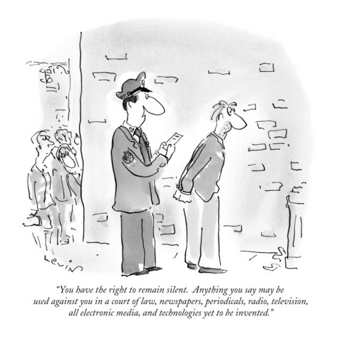
Highlight clues
Scenario – #1 | Amendment Violation Clue
Sara, an eighteen-year old college student, is arrested for stealing a classmate’s term paper and selling it on the Internet. When she appears before the judge, she asks for a lawyer to help defend her. The judge tells her if she is smart enough to be in college, she is smart enough to defend herself. Besides, she is not being charged with a felony, so the stakes are not very high QUESTIONS: Is this a rights violation? Which amendment(s) are being violated?
#1 – RESPONSE / ANSWER
Use the cartoon
as a hint
Read the scenario
Rights were violated. This is an example of a person’s 5th and 6th amendment rights were being violated. This was because she was not allowed a lawyer she was not treated fairly by the judge.

Slide 6
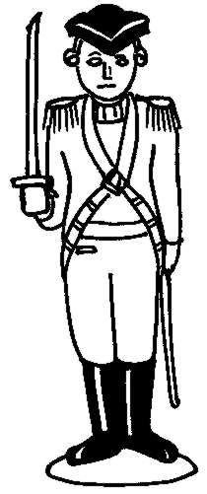
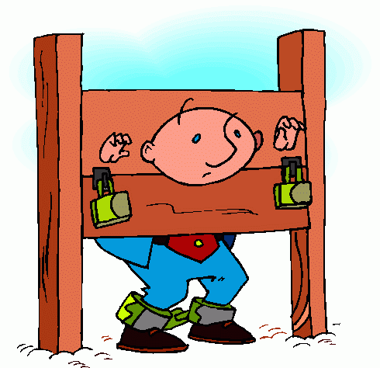
Scenario –#2 | Amendment Violation Clues
A war breaks out in the United States of America. The government is running out of money, so they decide to allow the soldiers to live in the house of the citizens. The people are outraged. McShirley and her mother refuse to allow the soldier to move in, so they are put in jail for 10 years. QUESTIONS: Is this a rights violation? Which amendment(s) are being violated?
#2 – RESPONSE / ANSWER

Slide 7
Lesson Objective and Essential Question
Day 2
Objective: By the end of this lesson students, will be able identify their rights that were protected by the Bill of Rights. Essential Questions: Describe the various amendments that protect the rights of Americans under the Constitution.

Slide 8
Use the cartoon
as a hint
Scenario –#3 | Amendment Violation Clue
A neighbor is suing the Joneses because a tree in the Joneses’ yard fell on their roof during a hurricane. The neighbors want the Jones family to pay $850 to have their roof repaired. Mr. Jones requests that a jury be present to hear this case. The judge says it is not necessary since the amount of the repairs is so small. The Jones family lives in Washington D.C. QUESTIONS: Is this a rights violation? Which amendment is being violated?
#3 – RESPONSE / ANSWER
Highlight clues
Read the scenario

Slide 9
Highlight clues
Scenario –#4 | Amendment Violation Clue
Carolyn is arrested for shoplifting a candy bar from a neighborhood convenience store. At trial, she is found guilty. The judge decides that the appropriate punishment is to cut off Carolyn’s hands so that she will not be able to shoplift again. QUESTIONS: Is this a rights violation? Which amendment is being violated?
#4 – RESPONSE / ANSWER
Use the cartoon
as a hint
Read the scenario

Slide 10
Lesson Objective and Essential Question
Day 3
Objective: By the end of this lesson students, will be able identify their rights that were protected by the Bill of Rights. Essential Questions: Describe the various amendments that protect the rights of Americans under the Constitution.

Slide 11
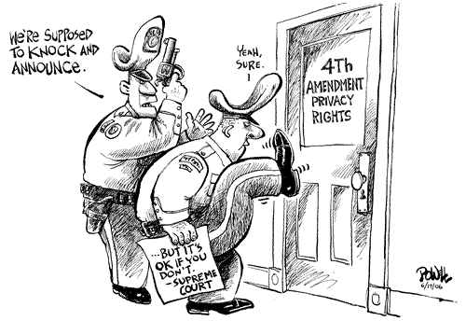
Highlight clues
Scenario –#5 | Amendment Violation Clues
Mr. Jefferson, an avid or frequent hunter, opens the door of his home one day to find agents from the Bureau of Alcohol, Tobacco, and Firearms outside. They inform him that certain provisions of a new federal law allow them to confiscate his rifles so that he may not engage in terrorist activities or plot against the United States government. They have no evidence that he is connected to any such activities. QUESTIONS: Is this a rights violation? Which amendment(s) are being violated?
#5 – RESPONSE / ANSWER
Use the cartoon
as a hint
Read the scenario

Slide 12
Highlight clues
Scenario –#6 | Amendment Violation Clue
A known drug dealer is arrested for suspected connections to an inner city murder. The police do not inform him of his rights and immediately begin to interrogate him. They continue until he admits he knows the victim of the crime and was in the neighborhood where the murder took place. QUESTIONS: Is this a rights violation? Which amendment(s) are being violated?
#6 – RESPONSE / ANSWER
Read the scenario
Use the cartoon
as a hint

