Slide 1
Constructive and Deconstructive Forces Study Guide

Slide 2
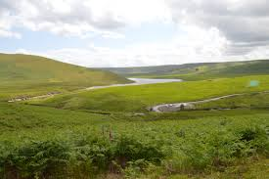
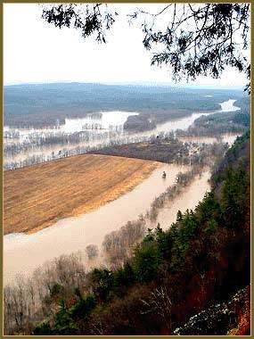
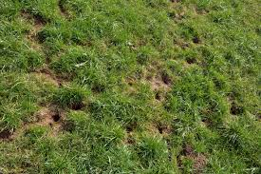
Deconstructive
This force breaks up the land
A river through a plain over time carves out a canyon with steep walls.
Animals burrow into the side of a hill.
Flooding increases the speed of water and erodes sediment from the banks of a river.

Slide 3
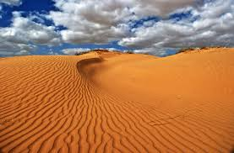
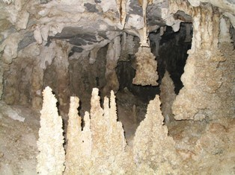
Constructive
This force builds up the land
Stalagmites form on the floor of a cave due to dripping water that has minerals in it.
Wind carries sand to create and move sand dunes.

Slide 4
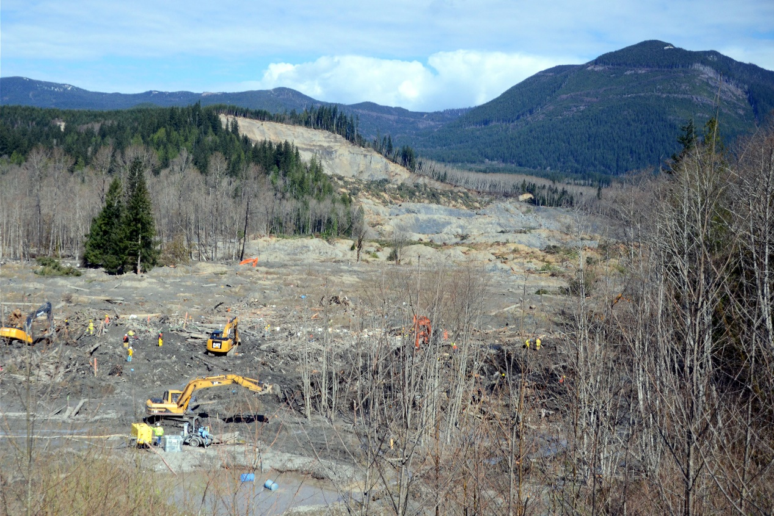
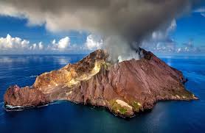
Both
This force breaks up the land and builds up the land
Volcano wipes out the landscape, but as the lava flows, it cools and creates new land.
A landslide carves out the side of a mountain, but deposits sediment in the valley to create a hill.

Slide 5
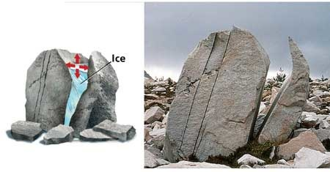
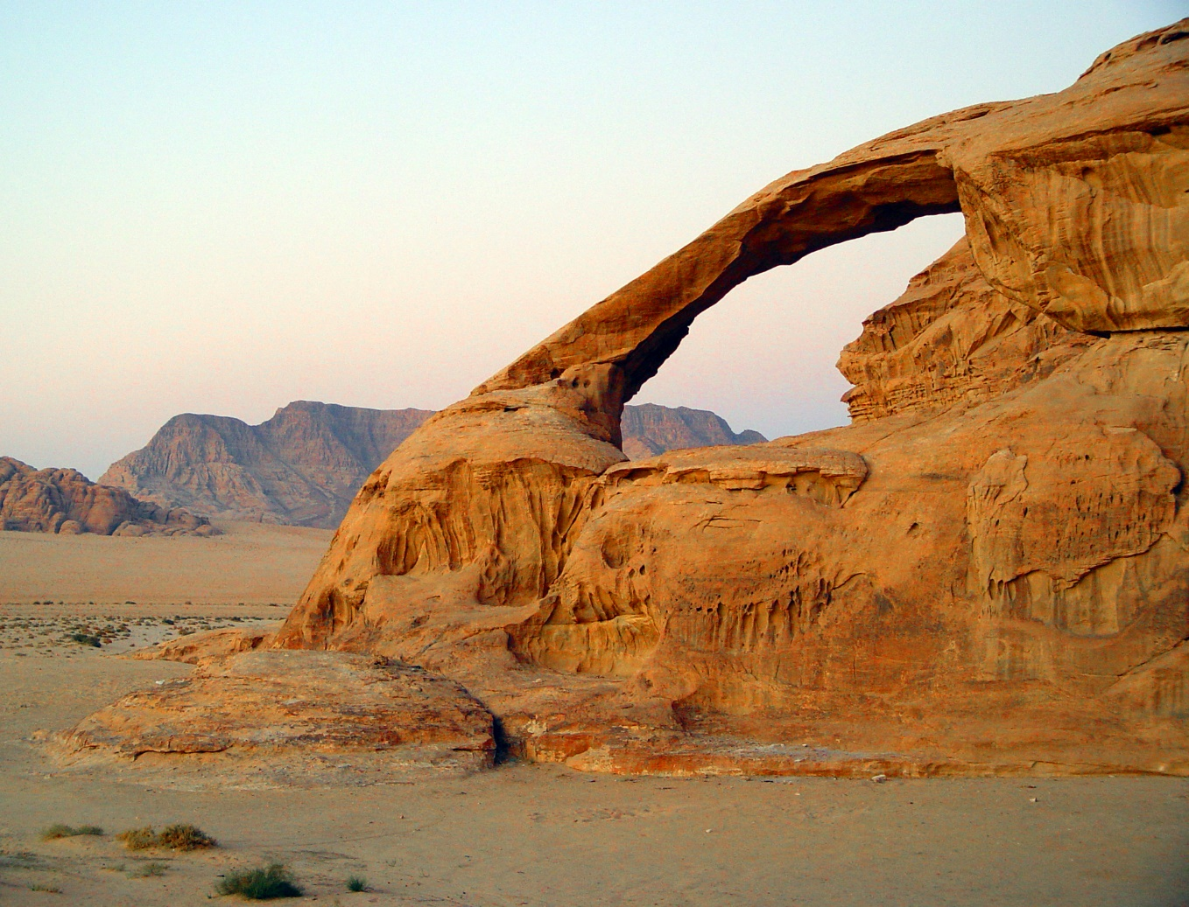
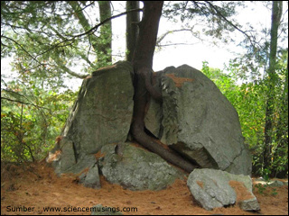
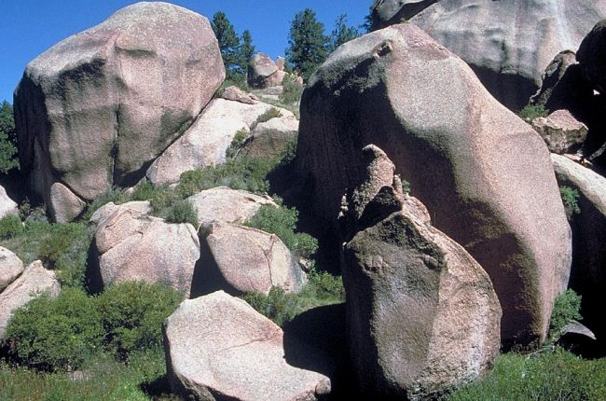
Constructive & Destructive Forces
_____________________can be changed or new ones formed by weathering, erosion and deposition. _____________________ is the breakdown of rocks into smaller pieces called sediments. This can be caused by many ____________________ things. Growing _____________________can cause cracks in rocks.
_________________________ can widen cracks in rocks. __________________ weathering can cause reactions to soften rocks or cause rust to form.
Landforms
Weathering
physical
tree roots
Freezing Water/ lce
Chemical

Slide 6
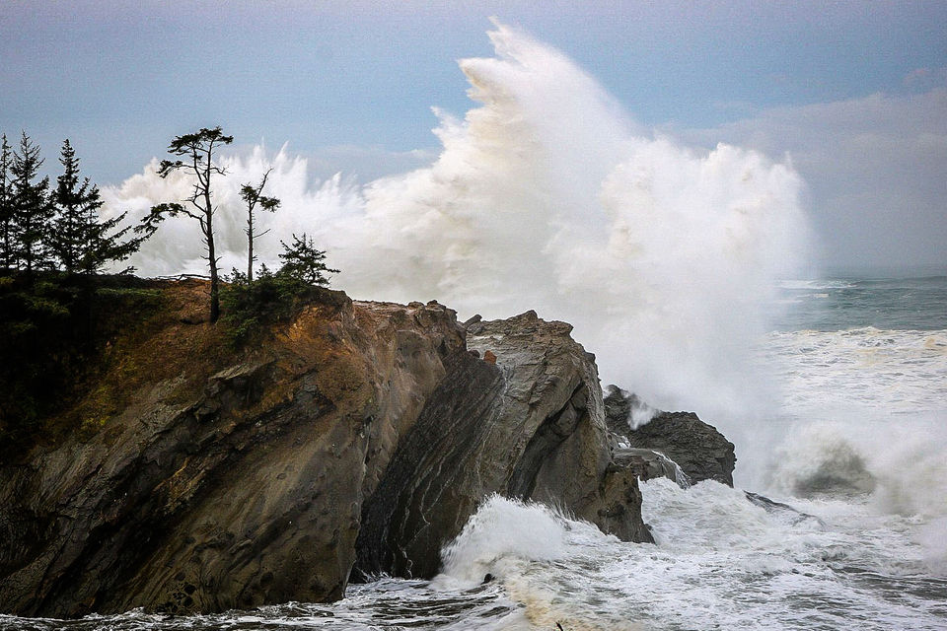
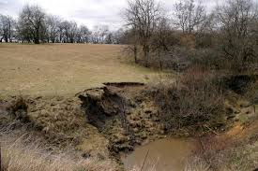
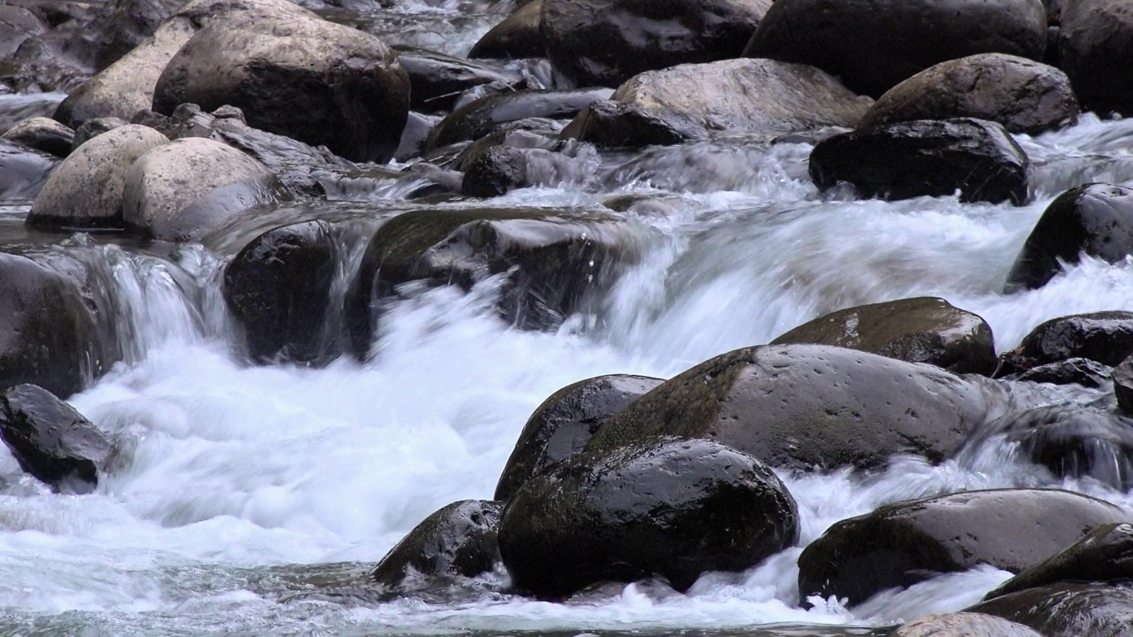
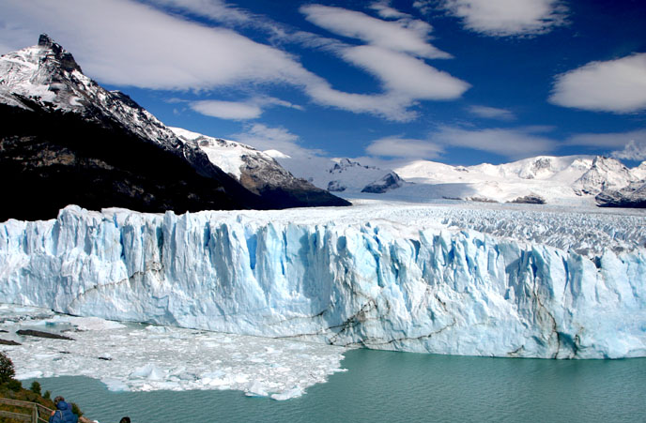
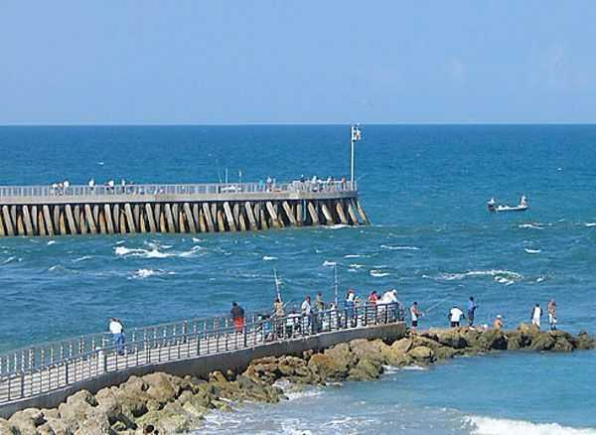
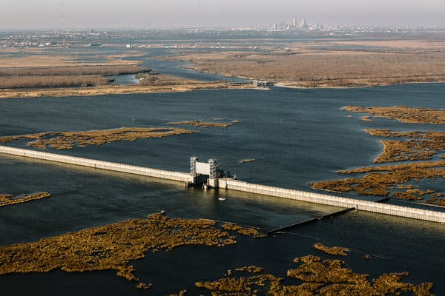
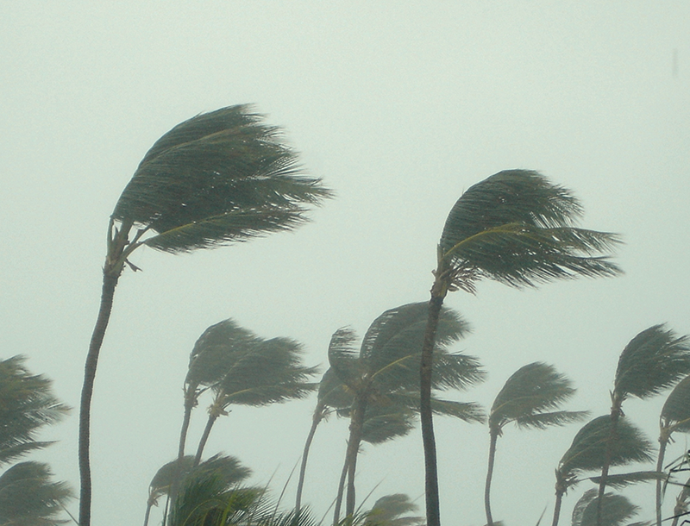
Erosion
_____________________ is the process of moving rock and soil from one location to another. This is caused by ________, _____________________,_____________________, and _____________________. The greatest force of erosion is _____________________. _____________________ can carry sand away from beaches. A _____________________ projects out into a body of water to protect the shoreline. Humans can restore the beach through the process of _____________________. (adding ___________________ back to the beaches). Lots of ____________ can cause soil erosion. _____________________ on a river can prevent flooding and erosion.
wind
moving ice
waves
running water
running water
Waves
jetty
beach reclamation
sand
rain
Levees

Slide 7
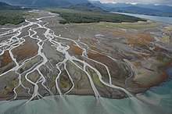
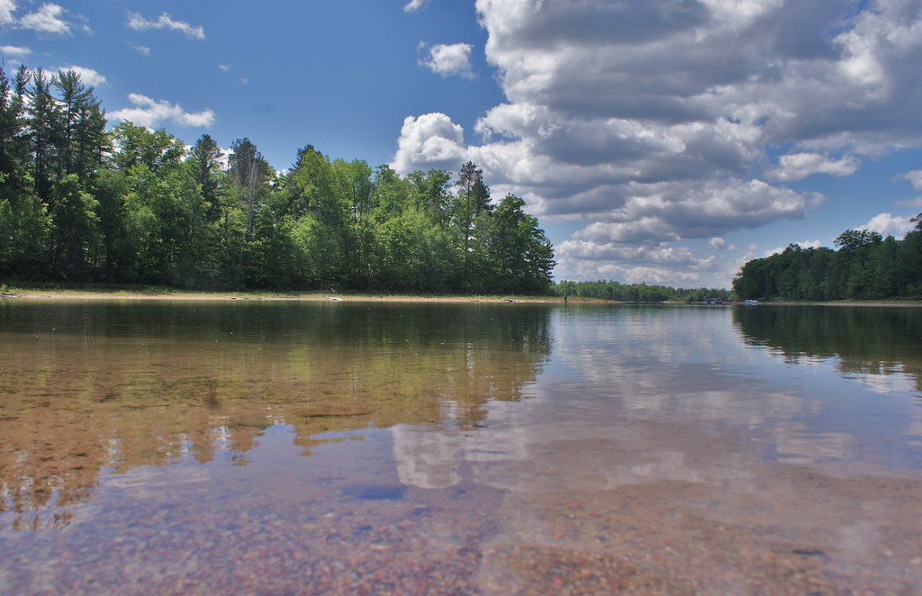
_____________________ is the process of rocks and soil being dropped (deposited) in a new location.
When sediments are deposited into a lake it can become more _____________________. A broad flat area of rich soil found where rivers empty into oceans, lakes, or other bodies of water is called a _____________________. These are found at the _____________________ and are often used for _____________________ because of the deposits of nutrient rich soil. _____________________can deposit sand onto beaches. Wind carries the sand and causes _____________________ to drift from their original positions.
Deposition
shallow
delta
mouths of rivers
farming
Waves
sand dunes

Slide 8
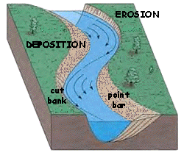
________________ occurs because of erosion:
As water flows quickly around a bend, it will erode the soil in that area and deposit it in another area where the river slows.
Deposition

Slide 9
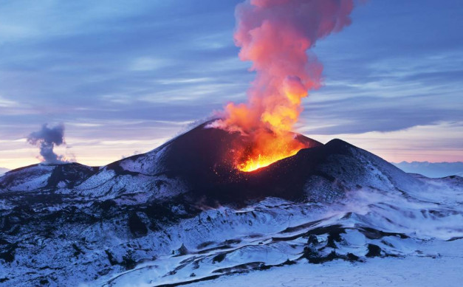
_____________________ are caused by magma rising to the surface of the earth, which causes bubbles of gas to appear in it. This gas can cause pressure to build up in the mountain, and it eventually _____________________. When the magma bursts out of the earth, it is called _____________________. _____________________ can be produced by volcanic eruptions because the _____________________ and ash collect.
Volcanoes
explodes
lava
Mountains
lava

Slide 10
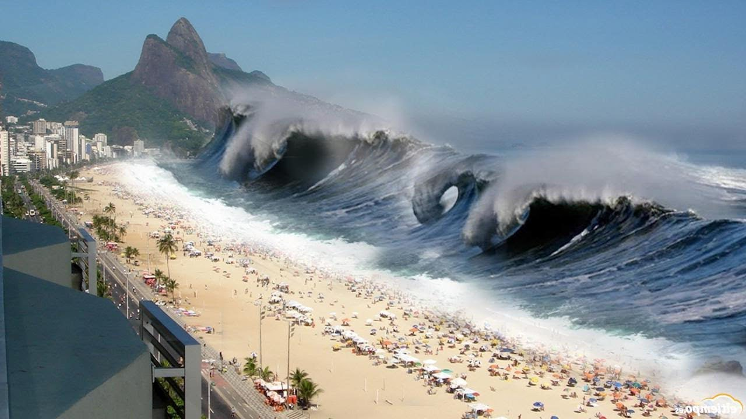
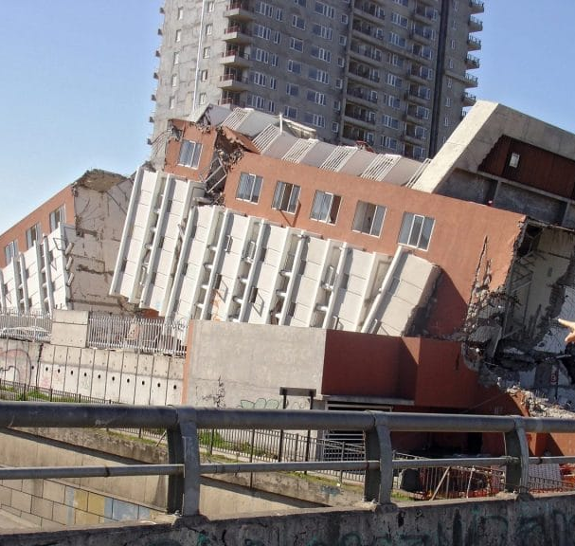
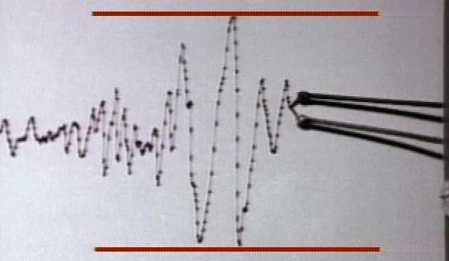
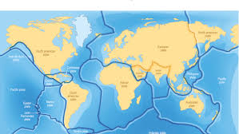
_____________________ are a sudden release of energy from the earth's crust that causes sudden movement. This is caused by _____________________sliding past each other. A _____________________ is used to measure earthquakes.
Tsunamis are caused by _____________________ or underwater _____________________.
Earthquakes
tectonic plates
seismograph
earthquakes
volcanic eruptions

