Slide 1
How to Write Informational Writing?
Rats Around Us

Slide 2
Day 1

Slide 3
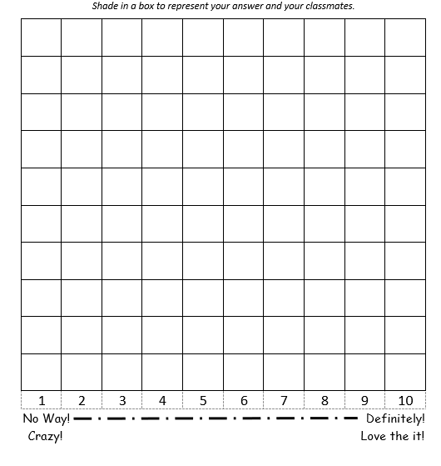
Focus Questions
On a scale of 1-10, Rats are dangerous creates who should be eliminated from the earth. Why or Why not? (Be able to explain your thoughts.)

Slide 4
Review: Introduction with a Lead

Slide 5
Teaching point
Writer’s organize their writing into sub-topics

Slide 6
Teaching point
Writers use interesting facts to support their writing and to gain the reader’s interest.

Slide 7
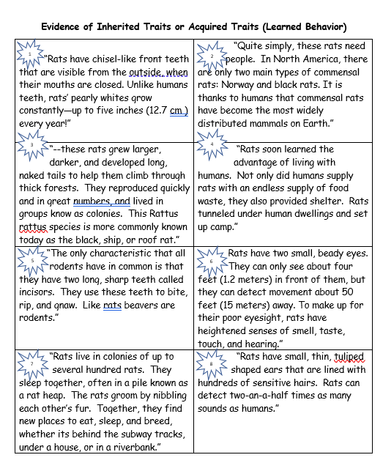
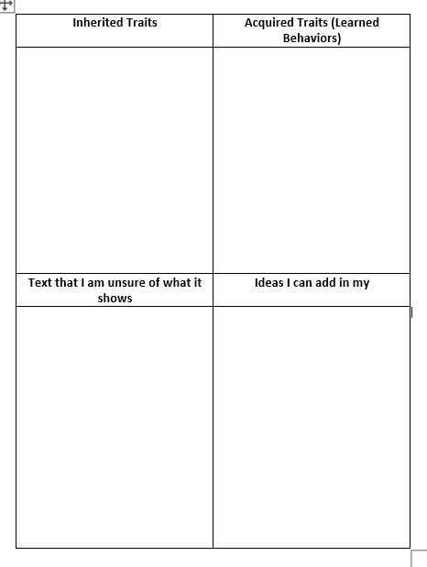
These are your facts.

Slide 9
Steps for the Sort Activity
Read and discuss the trait cards with your learning partner.
Discuss if you believe the quote is evidence of an inherited trait or an acquired trait/learned behavior

Slide 10
What is this text quote evidence of? Is it an inherited trait? Acquired trait?
Just a good idea?

Slide 11
Day 2

Slide 12
Let’s Write the Body

Slide 13
Teaching point
Writer’s design paragraphs with topic sentences and supporting details.

Slide 14
As you know, introductory paragraphs are composed of a lead with a topic sentence and supporting details.
Often they are written in threes.
Our introduction will have only two main points.

Slide 18
This is a lead!
Rats, creatures who have survived through out history have been looked upon by many as a scourge! These creatures wreck havoc everywhere, and they have caused millions of dollars in damage. As damaging as these animals can be, they are quite interesting. In fact, these unique mammals have survived millions of years due to the unique traits that they have inherited as well as the traits that they have acquired over time.
This is a topic sentence or a thesis

Slide 19
Now it’s Your Turn

Slide 20
Day 3

Slide 21
Teaching Point

Slide 25
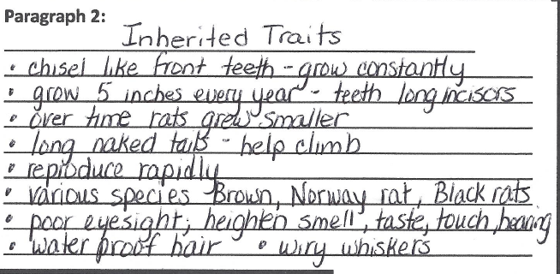
Use the facts in your graphic organizer to create the first paragraph is your body.

Slide 26
Topic Sentence/ Main Idea
Rats have survived billions of years due to the different inherited traits that they have. One example of traits that rats have that help them are their heighten sense of smell, taste, and touch. These senses are important to them because it helps them avoid danger In fact, rats can detect movement up to 5o feet away. This allows them to avoid contact with humans as well as many of their predators. Another inherited trait that rats possess is their teeth. These teeth grow quickly. In fact their chiseled front teeth grow so quickly
Supporting Detail
Supporting Details

Slide 27
Supporting Details
that rats are almost constantly chewing. This is
because their teeth grow 5 inches per year. A
third interesting inherited trait that rats possess
is a its tail. A rat’s tail is a very useful part of
its body. This is because it is used by the rat
to help it climb, and keep it balance.
Remarkably, a rat’s tail actually helps it
maintain its body temperature. In fact when a
rat is too hot the tail enlarges and fills up with
blood. When the rat cool back down its tail
returns to its normal size.

Slide 28
Now it’s Your Turn

Slide 29
Day 4

Slide 30
Let’s Write the Conclusion

Slide 31
Teaching Point

Slide 32
Paint a Picture

Slide 36
Topic Sentence/ Main Idea
As you have now seen, rats, overall, are interesting creatures with many traits. These traits, which are both inherited and acquired have resulted is creatures that are adaptable and able to survive. In fact, some might even argue that they are thriving. It is with this thought in mind, that I suggest that you stop and think when you are sitting in a quiet space. Listen. Can you hear anything? The sound of scurrying feet? The sound of gnawing? Are you really alone? One really does have to wonder.
Notice we are summarizing what we have already stated

Slide 37
Now it’s Your Turn
Continue to use your writing materials and create a conclusion for your writing.

