Slide 1
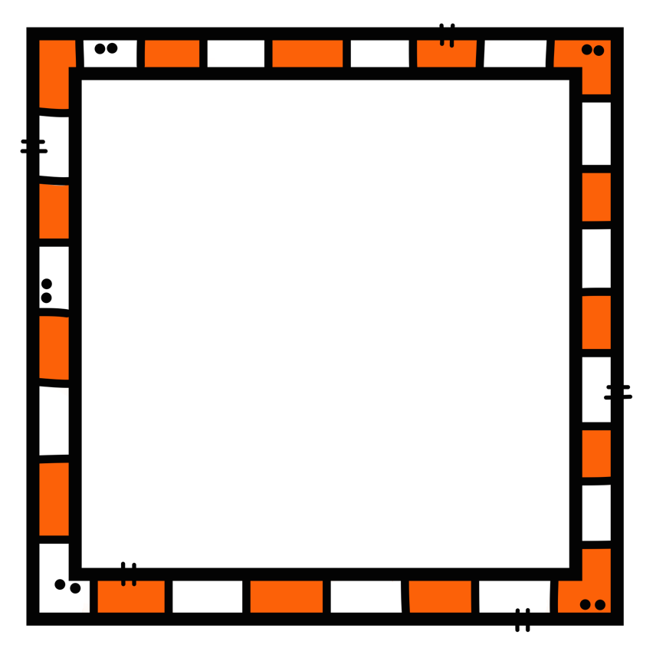
Grade 5 EnVisions Math 2.0 2016 Version Topic 3 Power Point Lessons

Slide 2
Multiply 3 digit by 2 digit numbers
Lesson 3-3
5.NBT.B.5

Slide 3
Multiplying multi-digit numbers
Multiply the ones, and regroup if needed.
9 x 8 = 72, regroup the 7.
9 x 4 = 36, plus 7 = 43, regroup 4.
9 x 7 = 63, plus 4 = 67
Bring down 0 in the ones place in the second addend. Now multiply the tens.
3 x 8 = 24, regroup the 2.
3 x 4 = 12, plus 2 = 14. Regroup the 1.
3 x 7 = 21, plus 1 = 22.
Now add. The sum is 29,172.

Slide 4
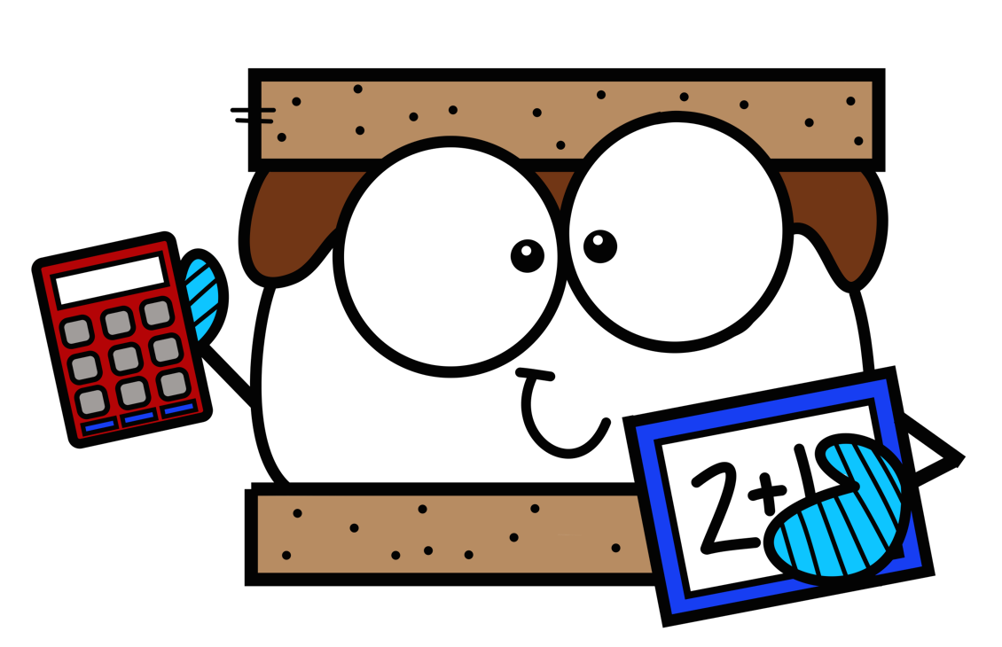
Practice!
Multiply. Regroup if needed.
372 x 48
216 x 85
422 x 19
789 x 67
631 x 54

Slide 5
Problem 1
Mrs. Sanchez is making s’mores for the third grade class barbeque. She buys 378 marshmallows. Mrs. Sanchez buys 18 times as many mini Hershey bars. How many mini Hershey bars does she buy?

Slide 6
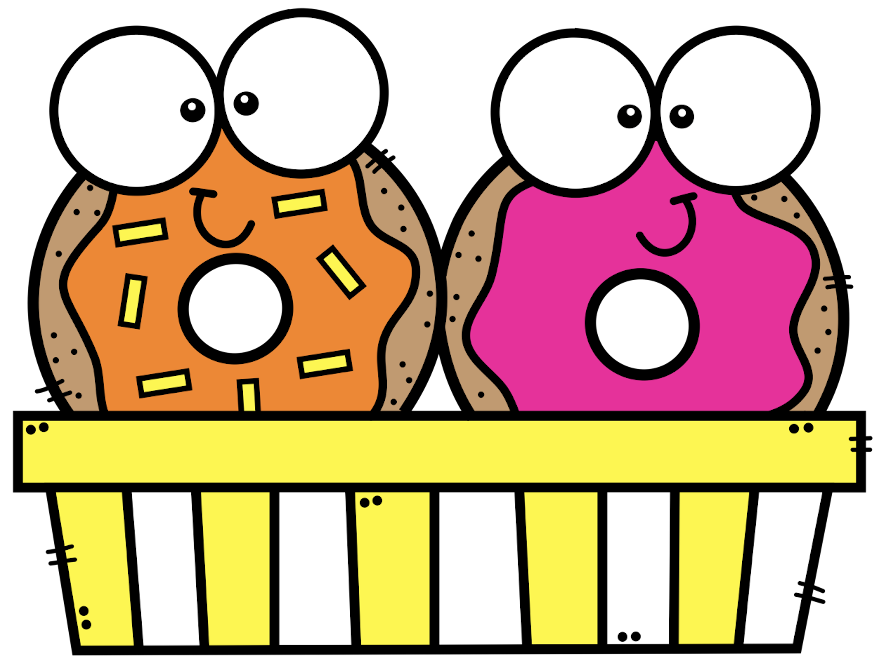
Problem 2
Juan has 225 orange cream donuts. He makes 15 times as many strawberry donuts. How many strawberry donuts does he make?

Slide 7
Multiply whole numbers with zeros
Lesson 3-4

Slide 8
Multiplying whole numbers with zeros
Example: 42 x 204
Multiply the ones. Regroup if needed.
Remember that when you multiply with a zero, the product is zero.
Multiply the tens. Regroup if needed.
Add the partial products.
Estimate to check for reasonableness. 40 x 200 = 8000

Slide 9
Practice!
309 x 56
201 x 63
790 x 18
530 x 72
107 x 25
620 x 91

Slide 10
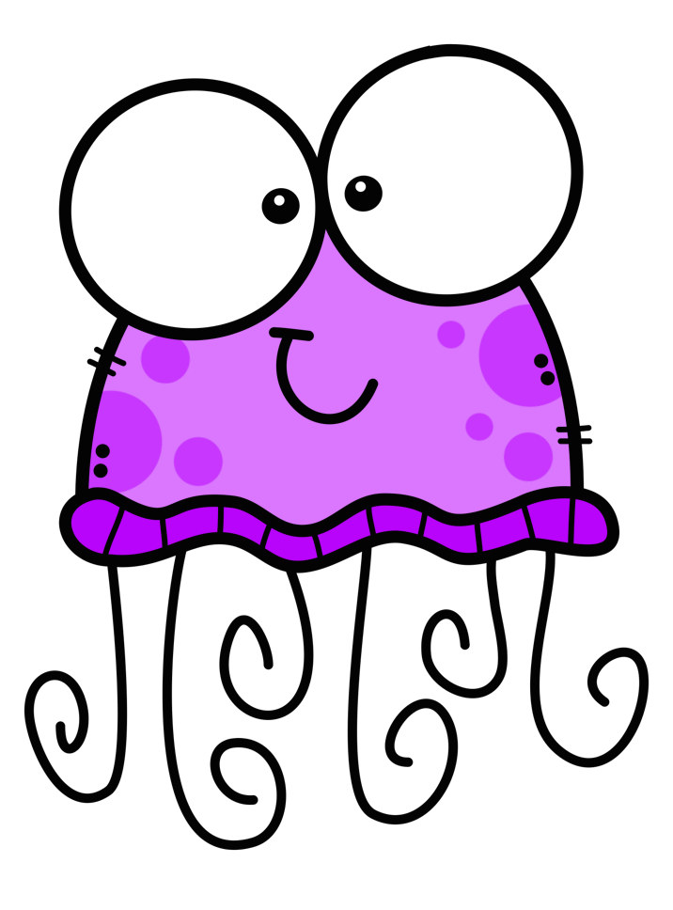
Problem 1
There are 103 blue jellyfish at the aquarium. The aquarium has 15 times as many purple jellyfish. How many purple jellyfish does the aquarium have?

Slide 11
Problem 2
Ocean scientists studied 203 yellow jellyfish in a small sea cove. They find 34 times as many orange jellyfish. How many orange jellyfish do the scientists study?

Slide 12
Multiply multidigit numbers
Lesson 3-5
5.nbt.b.5

Slide 13
Think and write
Why is knowing how to multiply multidigit numbers so important? What could happen if you don’t know how to do this skill correctly?

Slide 14
Strategies for Multiplying multidigit numbers
Remember to line up the numbers properly.
Multiply the ones first and regroup.
Multiply the tens and hundreds, regrouping if needed.
Add partial products.
You can use a bar diagram to show equal groups.
You can write an equation like 242 x 38 = n.
Estimate to see if your answer is reasonable.

Slide 15
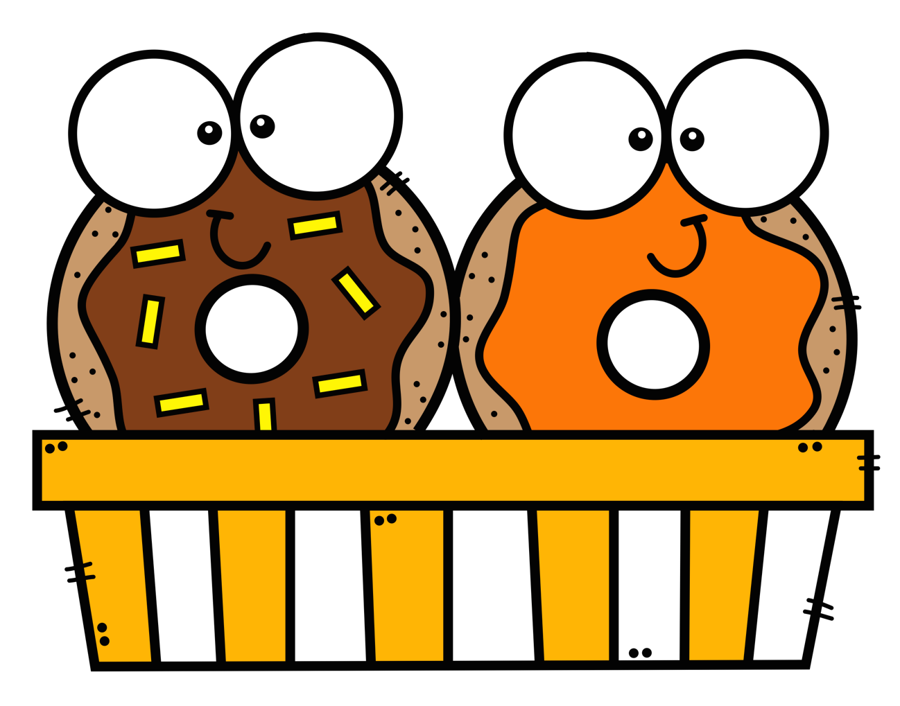
Practice!
478 x 34
319 x 71
586 x 45
924 x 63
257 x 86

Slide 16
Problem 1
The bakery sold 342 chocolate donuts a day for 15 days. How many donuts did they sell in all? Estimate to check if your answer is reasonable.

Slide 17
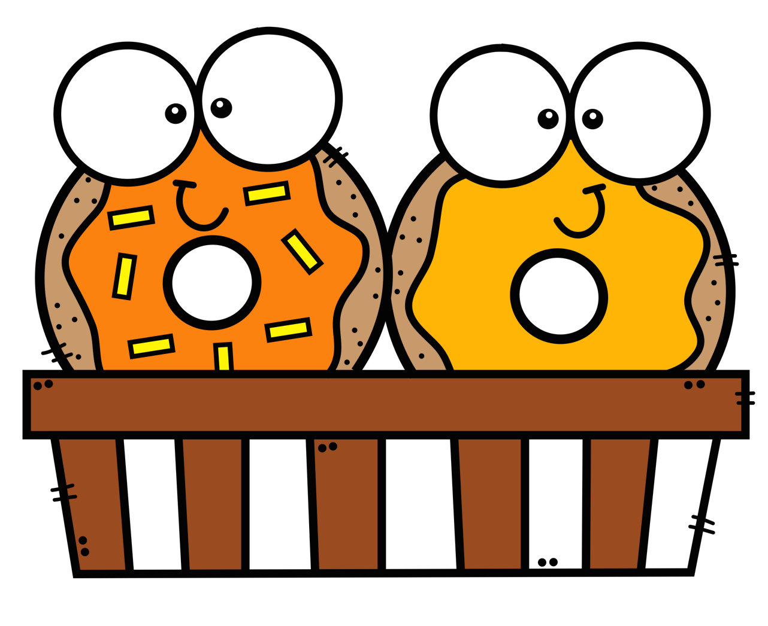
Problem 2
The bakery made 225 pumpkin donuts. They made 35 times as many chocolate donuts. How many vanilla donuts did they make? Estimate to check if your answer is reasonable.

Slide 18
Solve word problems using multiplication
Lesson 3-6
5.NBT.B.5

Slide 19
Warm up
342 x 91
406 x 22
298 x 64
517 x 35
654 x 78

Slide 20
Think and write
What strategies do you use to figure out how to solve a word problem?

Slide 21
Solving a word problem
An ice cream store served 154 customers on Friday night. They served 5 times as many customers on Saturday. How many customers did they serve Saturday?
First, what are you being asked to find?
What operation should you use?
Draw a bar diagram to represent the problem.
Write an equation to solve the problem.

Slide 22
Problem 1
The diner makes 128 orders of pancakes on Sunday morning. They make 12 times as many orders of eggs. How many orders of eggs do they make? Draw a bar diagram to model. Then write an equation and solve.
______ x ______ = _______

Slide 23
Problem 2
The diner makes 235 muffins on Monday morning. Each muffin has 14 blueberries. How many blueberries were used to make the muffins? Write an equation and solve.
_____ x _____ = ______

Slide 24
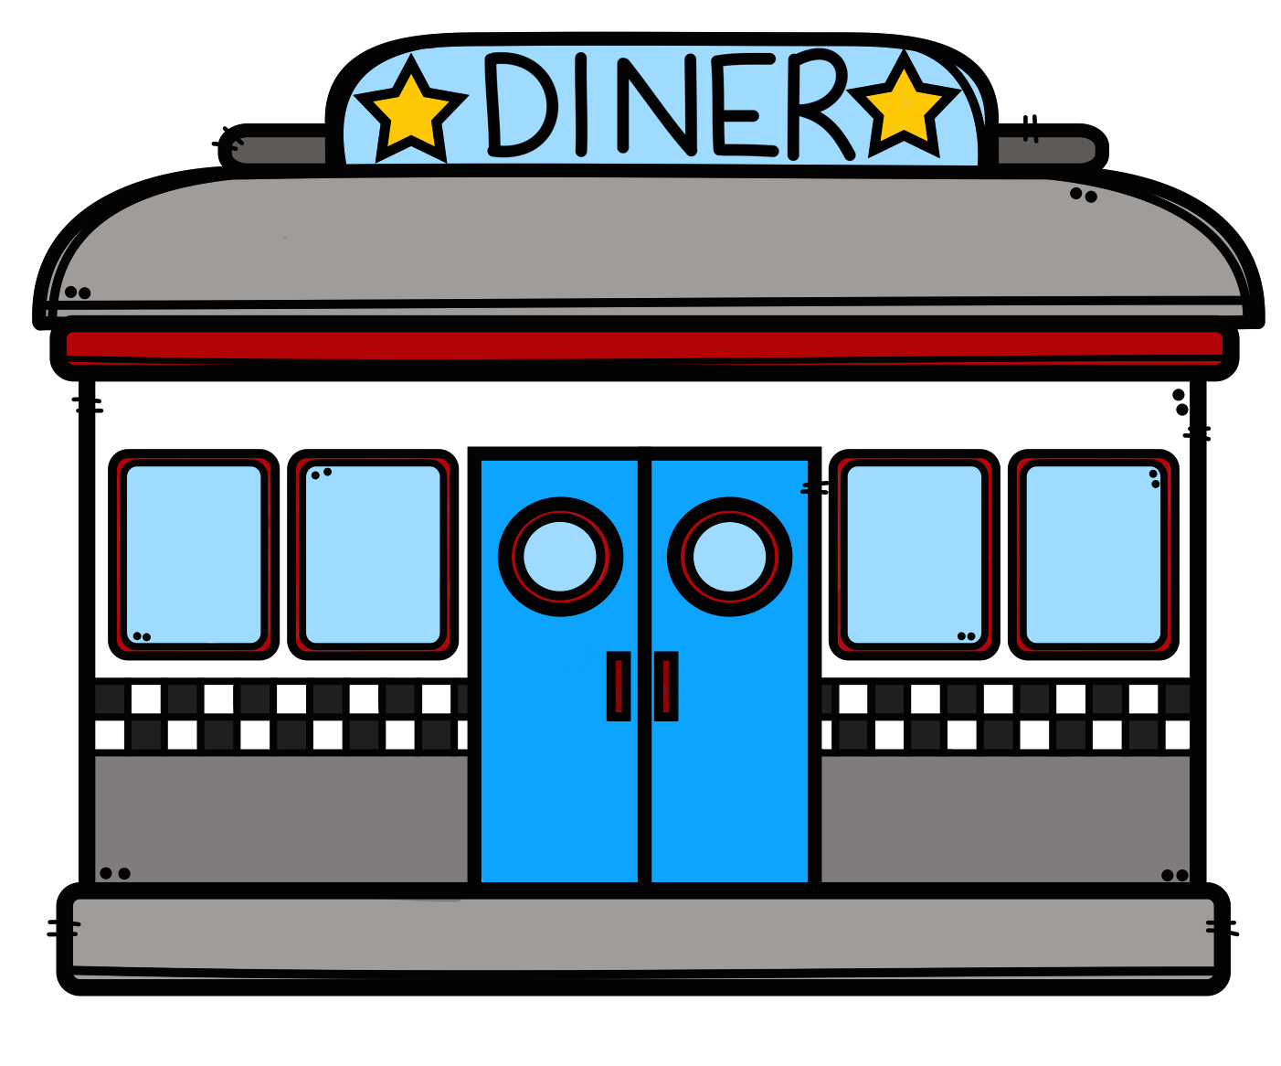
Problem 3
There are 14 diners in Monroe County. Each diner seats 118 people. If every diner is full, how many people are at all the diners? Draw a bar diagram and write an equation to solve.
_____ x ____ = _____

