Slide 1
NBT.1 Place Value
Understanding Place Value

Slide 2
NBT.1
Recognize that in a multi-digit number, a digit in one place value represents 10 times as much as it represents in the place to its right and 1/10 of what it represents in the place to its left.
For this standard, it is important to know:
how to determine the value of a digit
and
what happens to a number when it is multiplied or divided by 10

Slide 3
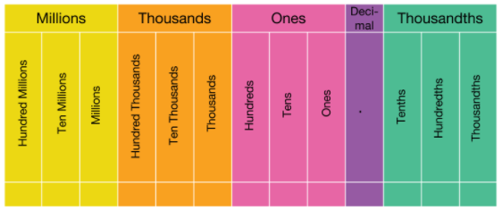
Place value chart

Slide 4
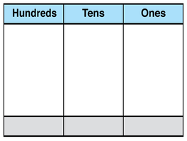
What does it mean to find the VALUE of a digit?
The VALUE of the digit is how much the digit is WORTH.
The VALUE of a digit depends on which place the digit is in.
Place “Value”
2
2
2
200
20
2

Slide 5
Remember from 4th grade…
When we multiply and divide by multiples of 10, the digit being multiplied or divided moves up or down in place value.
Example: 4 x 10
In this example, we are multiplying the digit 4 by 10. That means we now have 4 groups of 10, or 40.
The 4 moves one place value to the LEFT and is now in the tens place.
We use a zero as a place holder in the ones place.
This is why we add a zero to the end of a number when it is multiplied by 10.
4
0

Slide 6
Remember from 4th grade…
When we multiply and divide by multiples of 10, the digit being multiplied or divided moves up or down in place value.
Example: 40 ÷ 10
In this example, we are dividing 40 into 10 equal groups. There would be 4 in each group.
The 4 moves one place value to the RIGHT and is now in the ONES place.
We do not need the zero as a place holder in the ones place, so it is removed.
This is why we can remove a zero at the end of a number when it is divided by 10.
4
0

Slide 7
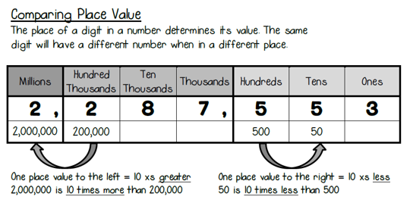
Remember from 4th grade…
value

Slide 8
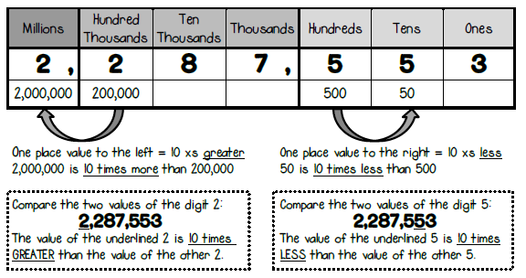
In 5th grade…
Remember, when we are dividing by 10, the digit moves one place value to the RIGHT and the value of the digit is now 10 times less.
We can also use a fraction with a denominator of 10 to show 10 times less. The fraction bar can represent division.
In this example, another way to say 50 is 10 times less than 500, is:
50 is “$\frac{1}{10}$ of” 500.

Slide 9
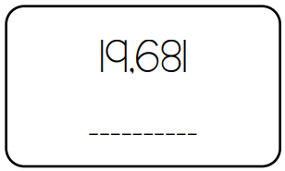
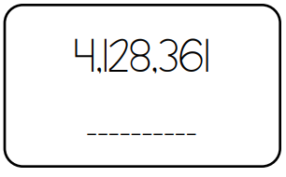
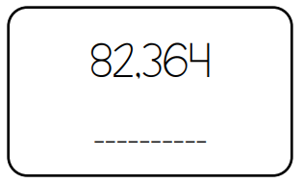
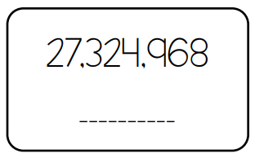
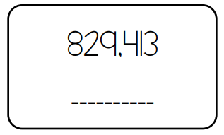
Let’s review!
Determine the value of the 8 in each number.
80
8,000
80,000
8
800,000

Slide 10
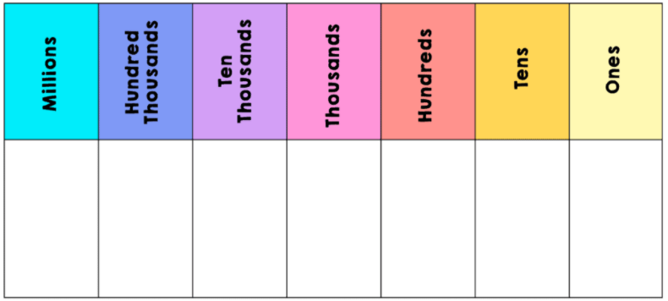
Let’s practice!
Compare the value of 8 in 4,123,861 and 19,681.
4
1
2
3
8
6
1
1
9
6
8
1

Slide 11
Compare the value of 8 in 4,123,861 and 19,681.
Let’s practice!
4
1
2
3
8
6
1
1
9
6
8
1

Slide 12
Compare the value of 8 in 4,123,861 and 19,681.
Let’s practice!
4
1
2
3
8
6
1
1
9
6
8
1
Since the 8 in the first number is one place value to the LEFT, we would say:
The 8 in the first number is 10 times the value of the 8 in the second number.
800 is 10 times the value of 80.

Slide 13
Let’s Look at ANOTHER example!
Compare the value of 5 in 32,850 and 2,961,538.
3
2
8
5
0
2
9
6
1
5
3
8

Slide 14
Let’s Look at ANOTHER example!
Compare the value of 5 in 32,850 and 2,961,538.
3
2
8
5
0
2
9
6
1
5
3
8

Slide 15
Let’s Look at ANOTHER example!
Compare the value of 5 in 32,850 and 2,961,538.
3
2
8
5
0
2
9
6
1
5
3
8
Since the 5 in the first number is one place value to the RIGHT, we would say:
The 5 in the first number is $\frac{1}{10}$the value of the 5 in the second number.
50 is $\frac{1}{10}$the value of 500.

Slide 16
Compare the value of the 4 in 2,483,109 and 48,567
2
4
8
3
1
0
9
Example 3
4
8
5
6
7

Slide 17
Compare the value of the 4 in 2,483,109 and 48,567
2
4
8
3
1
0
9
Example 3
4
8
5
6
7

Slide 18
Compare the value of the 4 in 2,483,109 and 48,567
2
4
8
3
1
0
9
Example 3
4
8
5
6
7

Slide 19
Compare the value of the 4 in 2,483,109 and 48,567
2
4
8
3
1
0
9
Example 3
4
8
5
6
7
Since the 4 in the first number is one place value to the LEFT of the 4 in the second number, we say:
The 4 in the first number is 10 times the value of the 4 in the second number.
400,000 is 10 times the value of 40,000

Slide 20
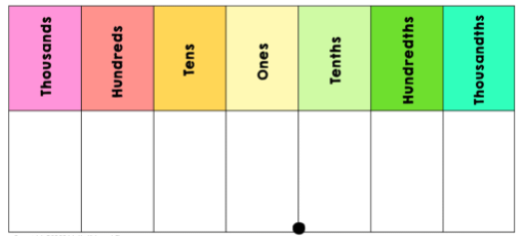
Compare the value of the 6 in 827.165 and 59.634
8
2
7
1
6
5
Example 4
(with decimals)
5
9
6
3
4

Slide 21
Compare the value of the 6 in 827.165 and 59.634
8
2
7
1
6
5
Example 4
(with decimals)
5
9
6
3
4

Slide 22
Compare the value of the 6 in 827.165 and 59.634
8
2
7
1
6
5
Example 4
(with decimals)
5
9
6
3
4
Since the 6 in the first number is one place value to the RIGHT of the 6 in the second number, we say:
The 6 in the first number is $\frac{1}{10}$the value of the 6 in the second number.
0.06 is $\frac{1}{10}$the value of 0.6

Slide 23
Now it is your turn to practice determining the value of a digit and comparing place values.
Please complete the quiz in your math assignment for today to show your understanding.
Your Turn!
You’ve got this!!

