Slide 1

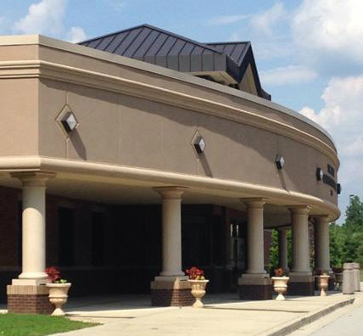
Fifth grade is going to be a Year to Soar!
Mrs. Stone’s FIFTH GRADE Class
School year 2023-2024
This presentation provides you with basic information you will need to know prior to the beginning of the new school year.

Slide 2

Welcome class of 2027
Mrs. Stone’s fifth
grade class. We are going to have great year!

Slide 3



WELCOME
This presentation may also be viewed on my web site.
  Complete digital registration forms
  Please feel free to ask questions
  Please go to my website for a supply list for fifth graders
  Transportation labels

Slide 4





Health Safety
-Social distance when needed
--Wash your hands
-Use hand sanitizer
-Keep your hands away from your face
-Stay Home if you are sick

Slide 5

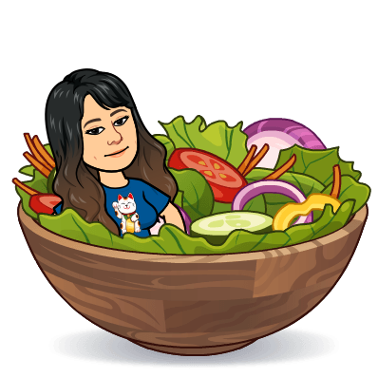
SNACK TIME
Students will have an opportunity to eat a snack each day.
Try to make the snack healthy, and one that will give your child energy for their lessons.

Slide 6
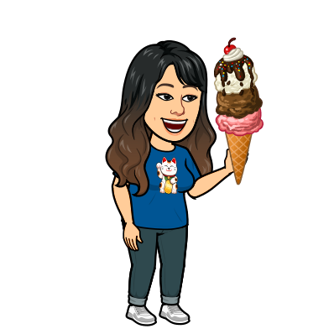
FROZEN FRIDAYS
You may prepay for ice cream for the year All ice cream purchases are online on Rev-Trak.
Check out the Birthday packs that are available!

Slide 7

Parents’ Responsibilities
Read and return the policy book acknowledgement form
Be sure to log-in and set up your DOJO account. This is new and an email will be sent home to explain.
Check my website on a consistent basis!!!!!! Its’ address is…
https://mrsstoneabney.weebly.com/

Slide 8
Communication
REMEMBER YOUR
NOTES HOME
FOLDER!!!!
Each Tuesday/Wednesday Mrs. Stone’s homeroom students will bring home their notes-home folder materials inside their binder. It will contain the following:
  Parent information
  Your child’s class work and test papers
READ, SIGN, and RETURN requested items on ASAP.
Check your DOJO and my website for needed information

Slide 9

Homework In Fifth Grade
You can expect Math homework if it is not completed in class.
You may also have homework in other subject areas.
Study for upcoming tests! You will know the dates of tests in advance. Use websites to help your children prepare for upcoming tests.
You may have work on special projects.
This information will be posted on my website also or sent through email.

Slide 10

School
supplies
Supply List:
1 subject notebook
(8) Composition notebooks
1- inch Binder
Scissors
Glue sticks
Kleenex
Loose leaf paper
Wipes
Pencils
Colored pencils
Crayons
Pencil Zipper Case
D. Stone 2022

Slide 11
FIFTH GRADERS PARTICIPATE IN 4H
Complete the 4H registration that is online form.
4H monthly meetings will be held in class.
We will let you know the dates of our club meetings.
Parents may attend meetings. Please contact your child’s teacher first, because meeting times vary each month.

Slide 12

Transportation
PLEASE make sure that you have registered for Learning Bridge if your child will attend.
Unless you make arrangements directly with LEARNING BRIDGE, your child cannot attend the after- school program.

Slide 13

PLEASE JOIN PTA
Your membership helps PTA help our kids!!!!!

Slide 14

FUN ACTIVITIES FOR 5TH GRADERS
4H- EACH MONTH
D.A.R.E. meets weekly for one semester
Chorus
Student Council.
Book Fair
Art Club
Science Olympiad
Safety Patrol
*Subject to change due to availability.

Slide 15


WELCOME TO FIFTH GRADE
I look forward to seeing you on
Tuesday, August 1, 2023
Our first day of fifth grade!!!
FIFTH GRADE !
Feel the Need…
the need to soar!

