Slide 1
To Give is Better Then to Receive
Social Studies Review Study Guide

Slide 2
Explain what rights are protected by the 15th and 19th amendments. Why were these amendments important?
The right protected by the 15th and 19th amendment is the right to vote.
The 15th Amendment confirms the right to vote and lists conditions that are illegal to deny people the right to vote based on race, color or being a former slave.
(Created after the Civil War)
The 19th amendment is a very important amendment to the constitution as it gave women the right to vote in 1920

Slide 3
The founding fathers created a way for the Constitution to be changed, this is called the _____________________ process. Below, list the steps in the amendment process to our Constitution.
Amendment Process
Two steps to change Constitution: Proposal
, Ratification (see notes)

Slide 4
The 5th amendment protects a citizen’s right for “due process.” What does the right of due process mean?
Due process of law is a legal concept that ensures the government will respect all of a person's legal rights.
People will be treated fairly when they are charged with a crime.
Due process means that if you are accused a crime you will receive your right of lawyer, you can remain silent, have a trial by jury, and you can not receive unfair punishment.

Slide 5
Name five activities that are considered responsibilities for a US citizen
Paying taxes
Obeying laws
Serve as a witness
Serve on a jury

Slide 6
What is a proposal?
A proposal is a plan or idea to change the Constitution

Slide 7
What is ratification?
Through a vote to approve a change to the Constitution

Slide 8
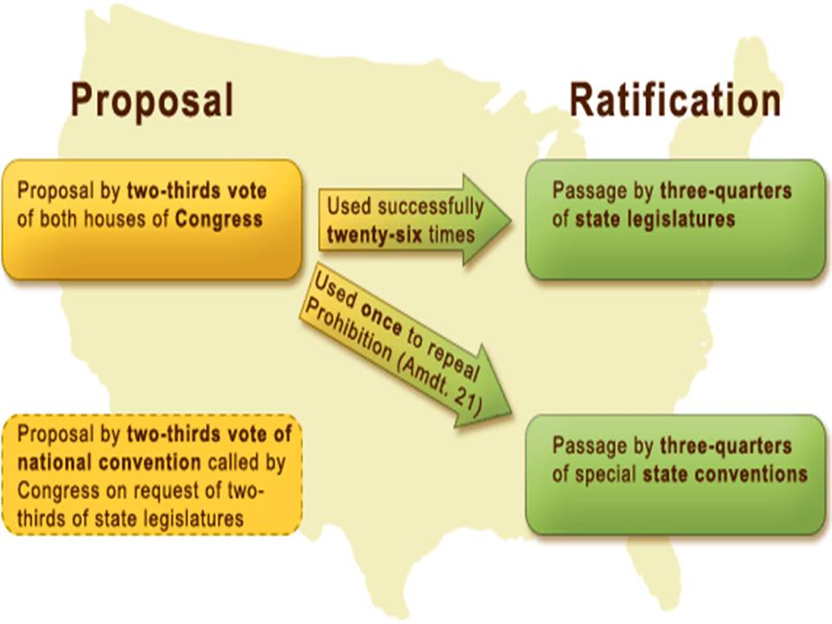
Describe the two methods for amending the Constitution.

