Slide 1
Interactive Read Aloud: Keep On! The Story of Matthew Henson
Co-discoverer of the North Pole

Slide 2
Co = Together

Slide 3
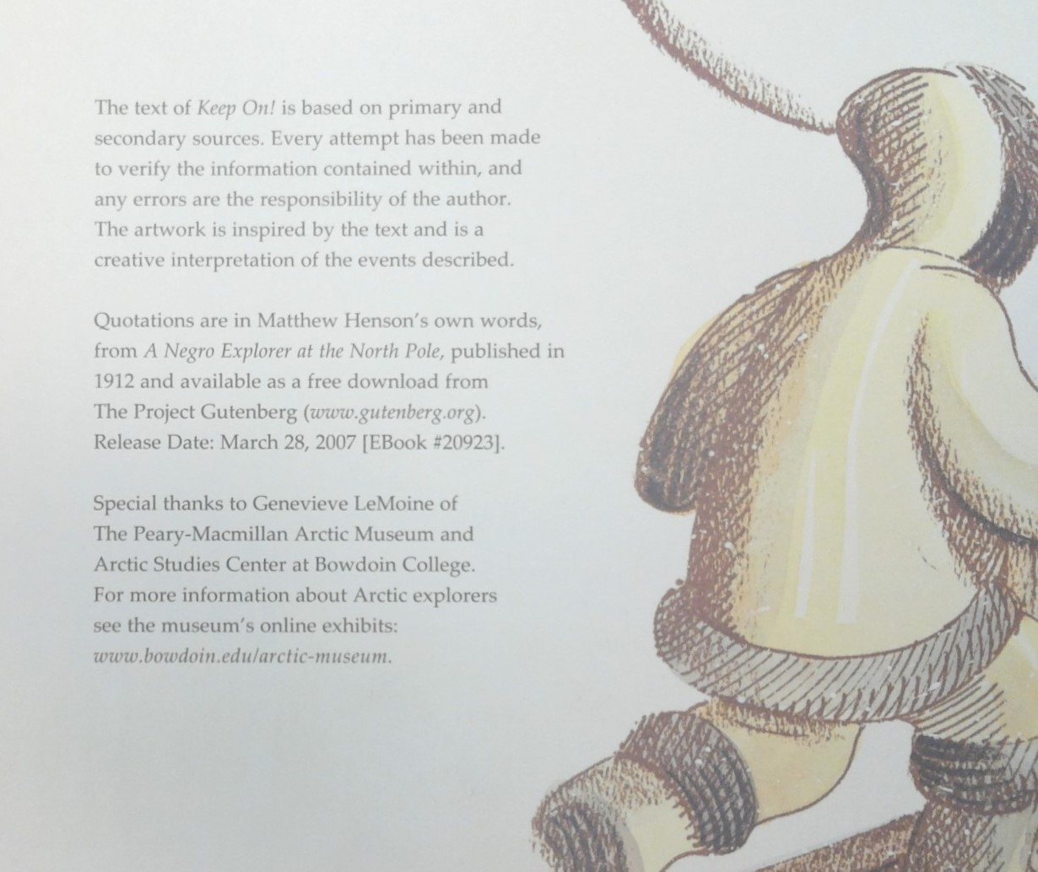
Day 1: Read First half of Keep On! The Story of Matthew Henson
Biography
Bio = life
Graph = writing

Slide 4
Text Feature: Chronological Order

Slide 5
What do you think this quote refers to?

Slide 6
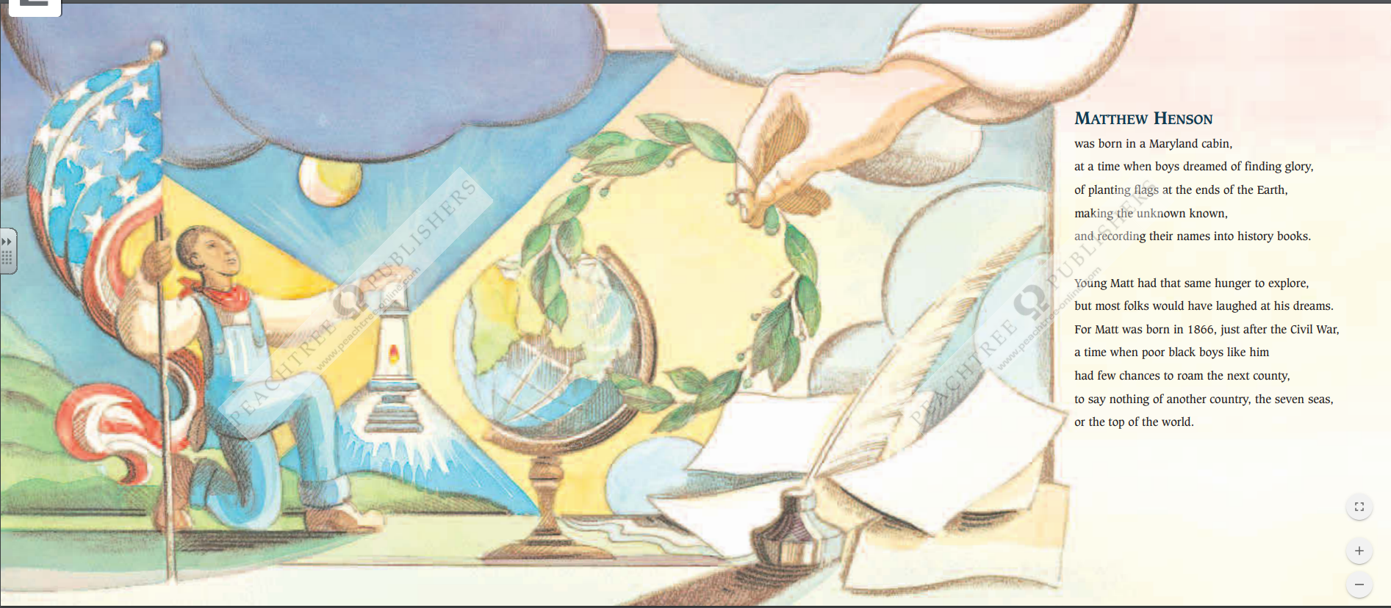
So why would people have laughed at his dreams?

Slide 7
Expanding Sentences:
Most folks would have laughed at his dreams.
Let’s expand this sentence by telling why? What about his life and the times would have caused people to doubt?
Let’s share some ideas!

Slide 8
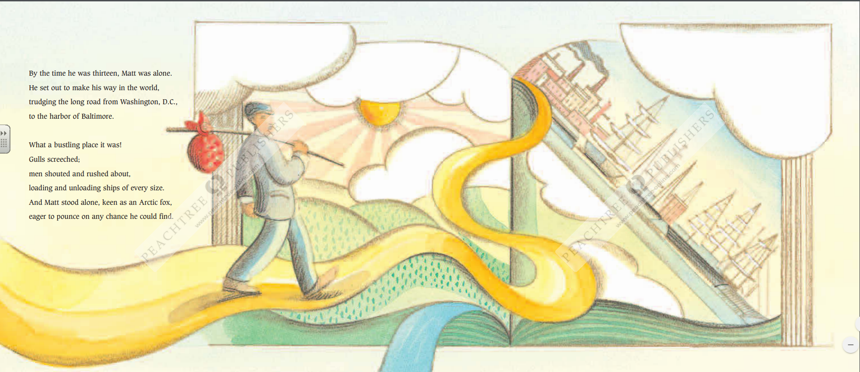
Can you imagine being alone at his age traveling the country?
What does the author mean when she says Matthew was “keen as an Arctic fox”

Slide 9
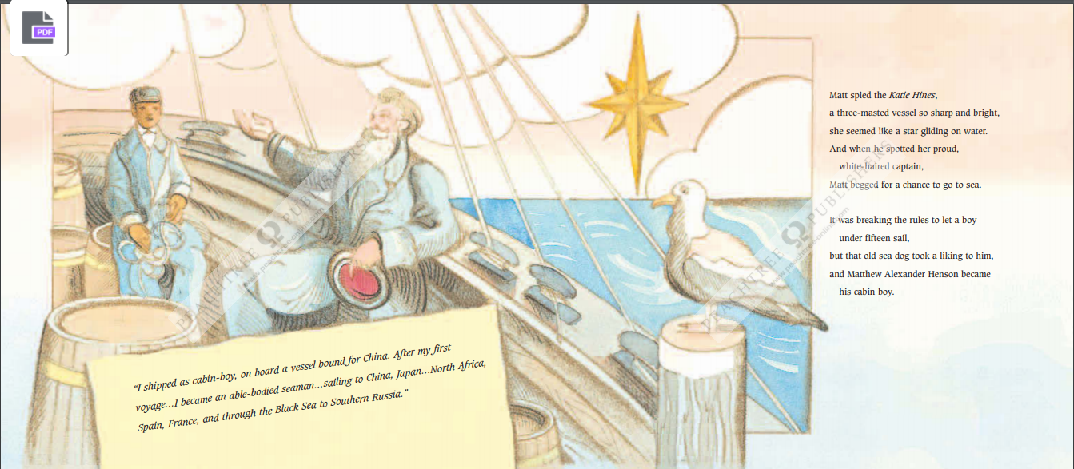
What does the author mean when she says “she seemed like a star gliding on water”? What is she referring to?
What did Matthew mean when he said
he was “an able-bodied seaman”?

Slide 10
Why do you think Matthew was able to learn so much without being in school?

Slide 11
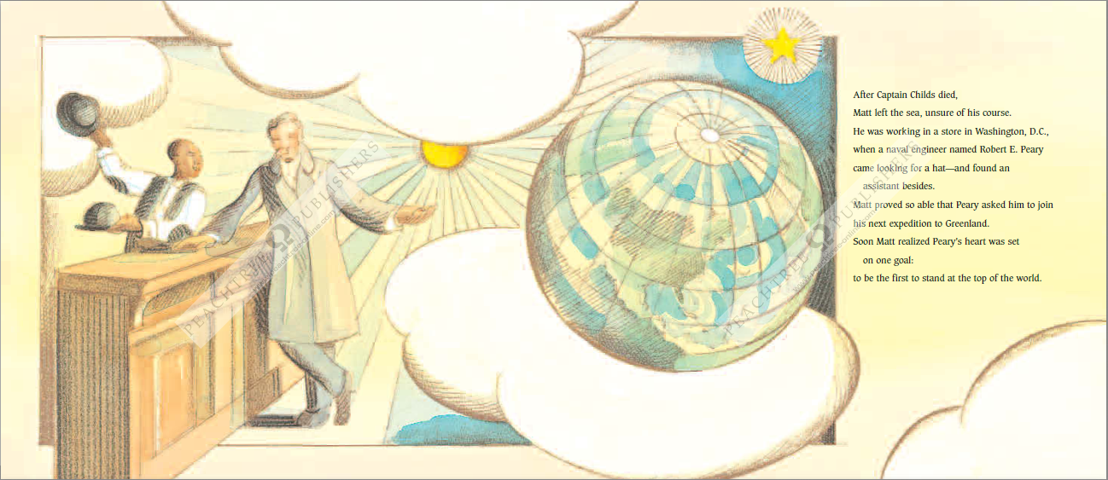
What does the author mean when she says “Matt proved so able”?

Slide 12
Where exactly is “the top of the world”?

Slide 13
Summarize Today’s Reading: Chronological Order
1866 Matthew Henson born in Maryland.
1879 At 13, left home to explore and was a cabin boy on a ship bound for China
1879-1884 Sails the world learning as he goes.

Slide 14
Vocabulary
Navigate
Definition: to plan and direct the route of a ship, aircraft or any form of transportation
Example: Today many people use a GPS system on their phone or in their car to help them navigate from one place to another. It is called a navigation system. In our book, the author says that “soon Matt could navigate by the stars.” Navigate is to plan and direct a route of direction.
Sentence: I help my mother navigate when _____. I like to navigate my way around _____.

Slide 15
Vocabulary
Course
Definition: the route or direction one follows. It can mean when driving or walking, but it can also mean what you are going to do next in your life.
Example: The author tells us that “Matt left the sea, unsure of his course.” A course can be a plan for your life.
Sentence: The course through the woods was full of ________. I am influenced by ____ when planning the course of my life.

Slide 16
Day 1: Let’s Learn about Correlative Conjunctions

Slide 17
Combining Sentences
How could we combine sentences using correlative conjunctions?
Matthew Henson could have stayed in Maryland.
Matthew could have left to start a life of adventure
Let’s combine them using correlative conjunctions. How can you combine using either and or?
Either Matthew Henson could have stayed in Maryland or he could have left to star a life of adventure.

Slide 18
Your Assignments:
Complete the Day 1 Correlative Conjunctions – identify the correlative conjunctions in each sentence
Write three questions you would ask Matthew Henson if you had the chance! Think about what you are curious to know!

Slide 19
Day 2: Keep On! The Story of Matthew Henson

Slide 20
Why was it important for the explorers to learn from the Inuit? What could the Inuit people teach the explorers?

Slide 21
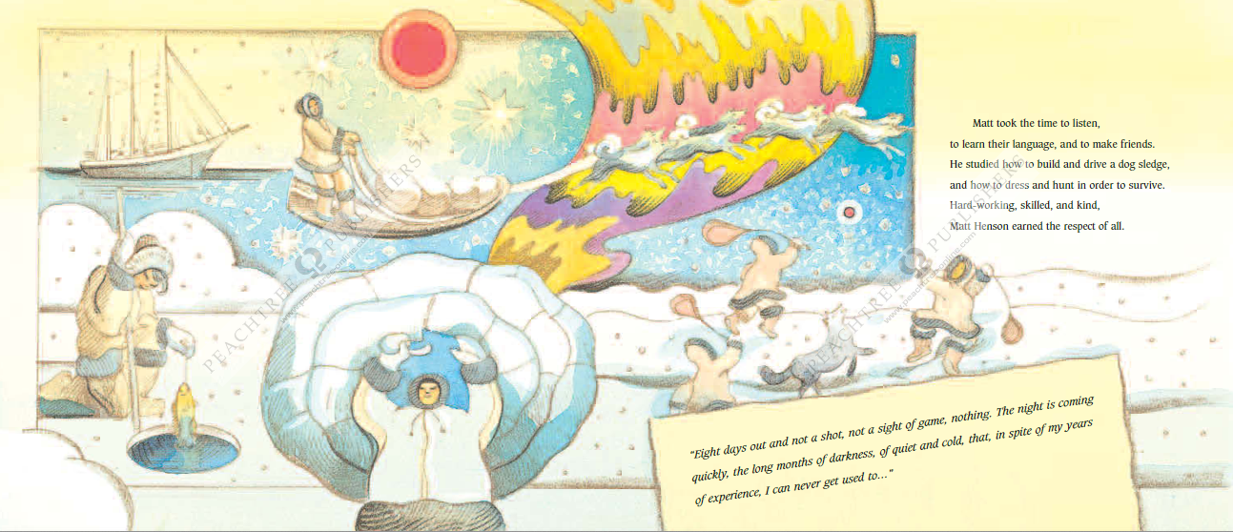
Matthew Henson is talking about the conditions near the North Pole. There are 24 hours of darkness from mid-October through the end of January when the sun is between 12 and 18 degrees below the horizon. Imagine what that would be like.

Slide 22
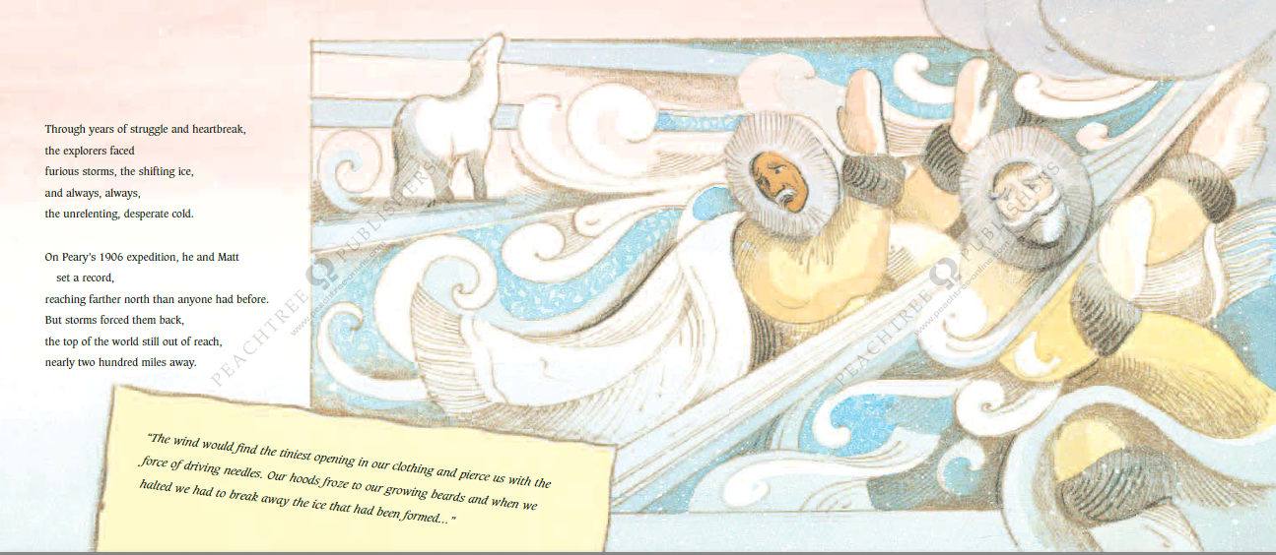
When we read the phrase “unrelenting, desperate cold” I thought about how cold it gets here.
How cold does it get in Georgia?
At the North Pole the temperature can be as cold as 40 degrees below zero, and the high is no greater than 32 degrees which is the temperature that water freezes.

Slide 23
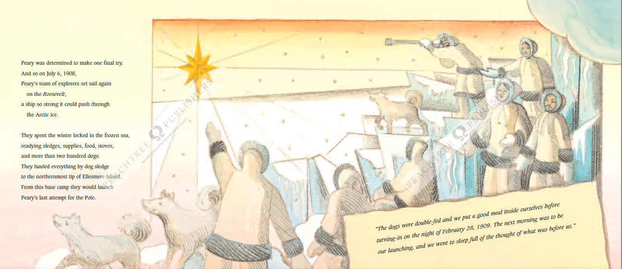
What do you think it means that they spent the winter locked in the frozen sea?

Slide 24
Why would the team only be inching forward each day?
Why do you think the dogs behaved this way?

Slide 25
Summarize Today’s Reading – Chronological Order
Matt and Peary explore and learn about the artic
1906 Reached farthest north than anyone before
1909 Set out for the North Pole

Slide 26
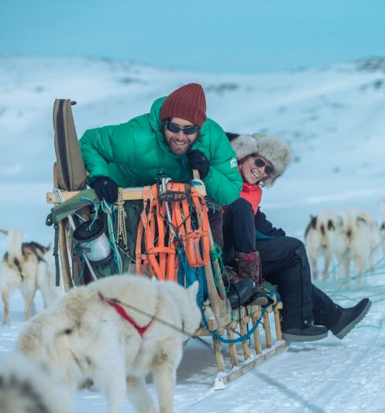
Vocabulary
Sledge
Definition: one kind of sled. It is used for carrying people and things.
Example: The author tells us that the team “hauled everything by dog sledge to the Northernmost tip of Ellesmere Island. A sledge is a sled for carrying people and things.
Sentence: I would like to ride in a sledge if _____. I would have to travel to _____ to see a real sledge.

Slide 27
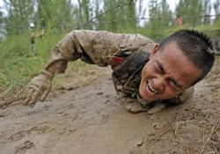
Vocabulary
Grueling
Definition: extremely tiring and challenging
Example: It is grueling to run a marathon. The explorers had to “make the fast and final dash of five grueling marches, one hundred thirty-three miles more.” Grueling means tiring and challenging..
Sentence: You can use that word: At school, I think _____ is grueling. My family went on a grueling trip to _____.

Slide 28
Day 2: Sentence Composing
Use punctuation to separate items in a series.

Slide 29
Day 2: Sentence Composing
How can I join sentences to make sense?
Matt took the time to listen.
Matt took the time to learn their language.
Matt took the time to make friends.
Think about the relationship of ideas. Are these similar things? Does one cause another? Are they in time order? Are they contrasting? Your choice of linking words has to be driven by meaning. You also want to be sure that you are not repeating information unnecessarily.
All things Matt took time to do
Matt took the time to listen, to learn their language, and to make friends.

Slide 30
Day 2: Sentence Composing
How can I join sentences to make sense?
The explorers faced furious storms.
The explorers faced the shifting ice.
The explorers faced the unrelenting, desperate cold.
Think about the relationship of ideas. Are these similar things? Does one cause another? Are they in time order? Are they contrasting? Your choice of linking words has to be driven by meaning. You also want to be sure that you are not repeating information unnecessarily.
The explorers faced furious storms, the shifting ice, and the unrelenting, desperate cold.
All things the explorers faced.

Slide 31
Day 2: Your Assignments
Comma Practice
Correlative Conjunction Practice
Writing: Imagine you were on the expedition with Matthew Henson. Pretend you are writing in a journal in your igloo each night. What would you write on the night before you reached the pole?

Slide 32
Day 3: Keep On! The Story of Matthew Henson

Slide 33
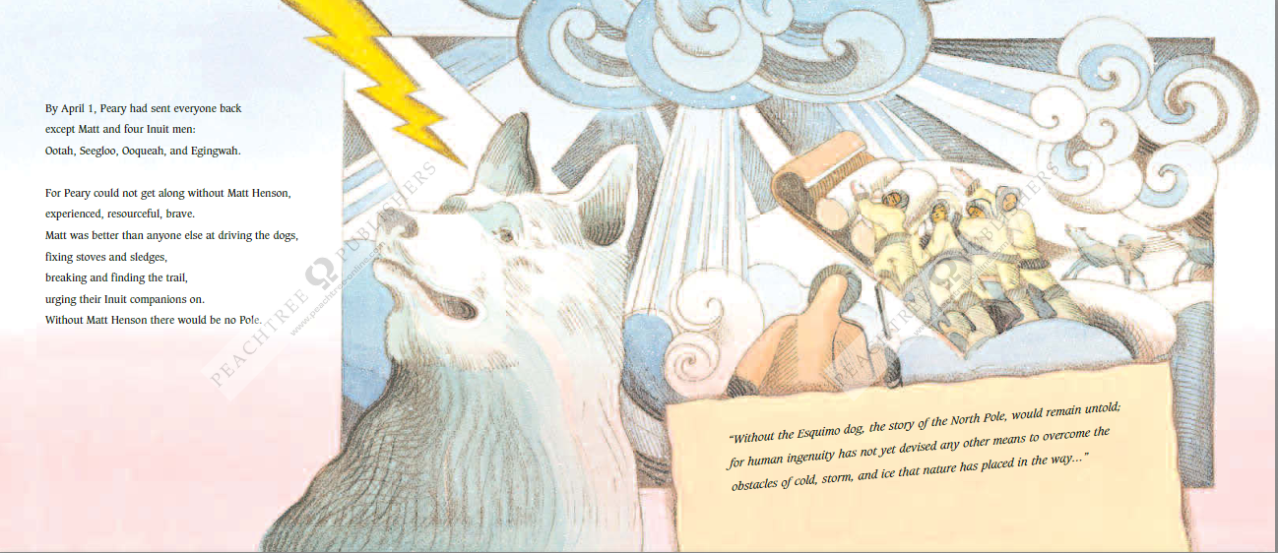
I’m going to make a connection here. I think Matthew’s training when he was at sea as a cabin-boy helped prepare him for hard work.

Slide 34
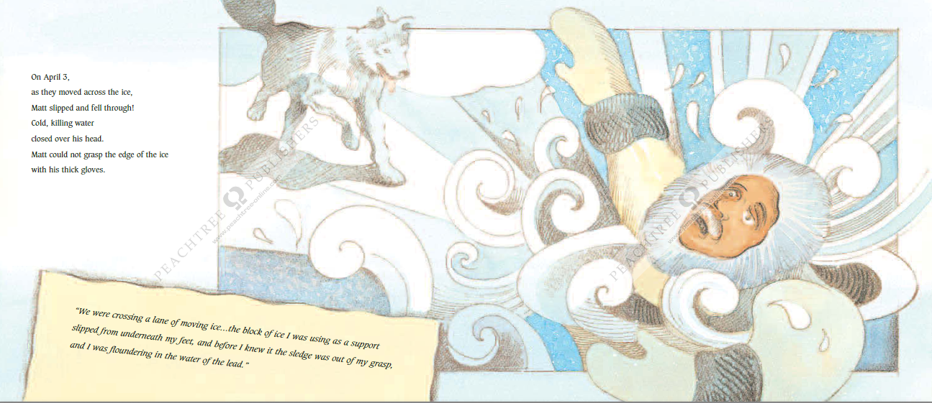
Do you think Matthew will survive? Make a prediction.

Slide 35
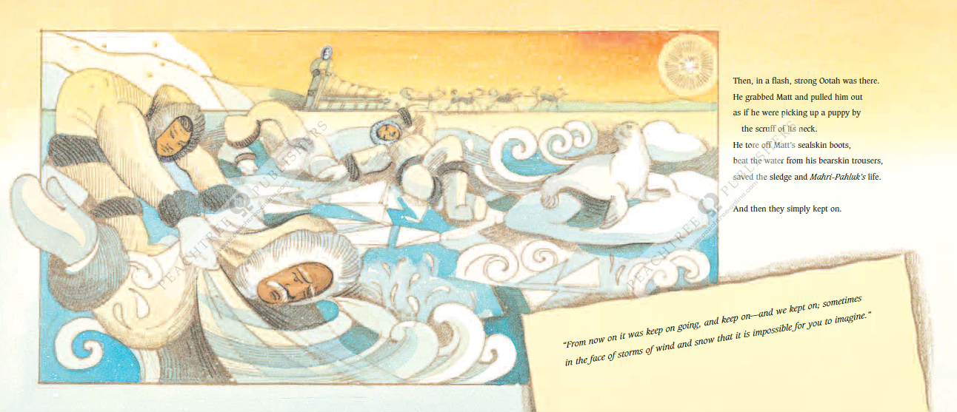
Why do you think Peary and Matthew and the team keep going after everything they have been through?

Slide 36
Why was it important to put up a flag?

Slide 37
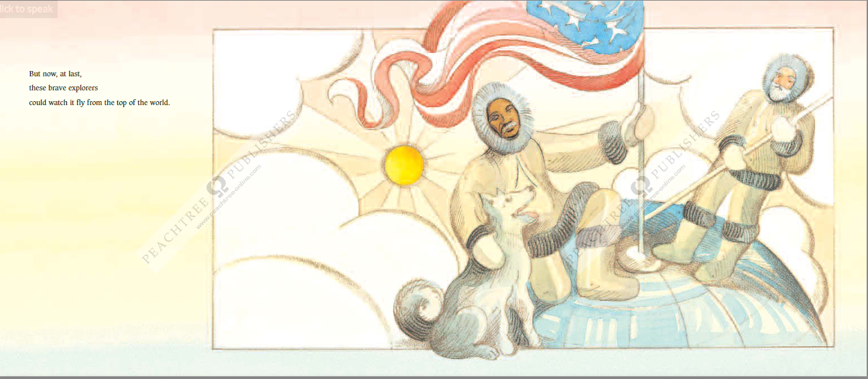

Slide 38
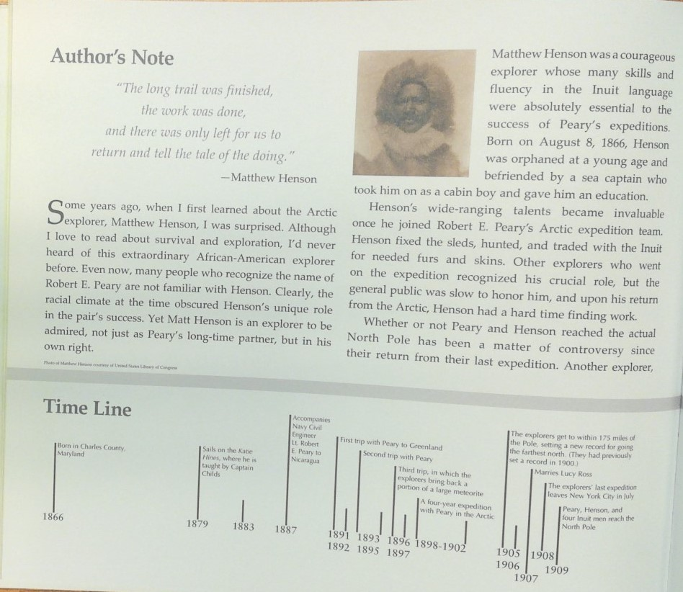
Why was there controversy over whether or not Peary and Henson were the first to reach the North Pole?
How many of you would have gone on the expedition if you’d been asked? Why?

Slide 39
Summarize Today’s Reading – Chronological Order
Most of the team goes home
Matt falls through the ice, but is rescued
1909 Reach the North Pole & plant a flag

Slide 40
Vocabulary
Resourceful
Definition: having the ability to find quick and clever ways to overcome difficulty.
Example: If you were about to solve a math problem quickly and in a unique way, you would be resourceful. The author told us that Peary “could not get along without Matt Henson, and described him as “experienced, resourceful, brave.” If you are resourceful, you have the ability to find quick and clever ways to overcome difficulty.
Sentence: I was resourceful because _____. When my father is making dinner, he has to be resourceful if _____.

Slide 41
Vocabulary
Devised
Definition: to plan or invent something
Example: devise lesson plans every day to help you learn new information. In the book, we read this sentence: “for human ingenuity has not yet devised any other means to overcome the obstacles of cold, storm, and ice that nature has placed in the way…” Devised means to plan or invent something.
Sentence: I devised a plan to _____. I devised a solution to _____.

Slide 42
Day 3: Expanding Sentences

Slide 43
Day 3: Expanding Sentences
Peary sent everyone back except Matt.
This simple sentence was really important. We can either start with an introductory word that tells how Peary felt, or we can tell why he did this. We may be able to do both.
By April 1st Peary sent everyone back except Matt because he couldn’t complete the mission without him since Matt was experienced, resourceful, and brave.

Slide 44
Day 3: Expanding Sentences
The flag hung limp and lifeless.
Let’s add by telling what happened next.
At first, the flag hung limp and lifeless, but then the wind picked up and it waved strongly, showing its colors.

Slide 45
Day 3: Your Assignments
Commas Practice & Correlative Conjunction Review
Commas TEST
Correlative Conjunction TEST
Writing: Pretend you were a part of the small team who made it to the pole. Write a second journal entry about your experience during the last leg of the exploration.
*be sure to expand your sentences in your writing.

Slide 46
Day 4: Intro to Informative Writing
So far this year we have learned about narrative writing and opinion writing. What are different parts in narrative writing?
We know that narrative writing is a different type of writing from opinion writing. Today we are going to learn about a third type of writing. We are going to learn about writing descriptions, which is a type of informative writing. Keep On! The Story of Matthew Henson is an informative book. It is a description of Matthew Henson’s life. Listen to this part:
How does this part of the text describe Matthew as a young boy?

Slide 47
Day 4: Intro to Informative Writing
Think about the Matthew Henson book and other informational books you have read. Make a list of what these types of texts have in common.
introduction that names the topic
facts
definitions
details
linking words
conclusion

Slide 48
Day 5: Learning about Informative Writing

Slide 49
Day 5: Learning about Informative Writing Letters From Rifka
Have you ever been determined to do something? In the book, Letters From Rifka, the main character was determined to leave Ukraine to get to America. Rifka, a 12 year old girl, is forced to leave Russia because if she doesn’t she will be killed. Along the way she is determined and that determination helps her to get to America. Rifka never gave up hope. In other words she had indomitable spirit.
In the beginning, at the Polish border when Rifka got off the train, the guards force her and her family to take off their clothes for the Doctor. They did this because the Doctor wanted to see if she had a disease. Her determination enabled her to stand there naked, even though it was an uncomfortable, humiliating situation.

Slide 50
Day 5: Learning about Informative Writing Letters From Rifka
Another time was when she was on the ship to America, she nearly drowned and lost a friend when a tempest hit. She goes into the hold which really smells. After the storm ends she looks for her friend, Peter, and learns that he has been lost at sea during the storm. Rifka returns to her cabin in tears. A few hours later, when she hears people ooing and ahing up on deck as the Statue of Liberty comes into sight she realizes she still wants to go to America. Her determination gave her the power to endure the emotions she had and then gave her strength to carry on without her friend.

Slide 51
Day 5: Learning about Informative Writing Letters From Rifka
Another example is when Rifka is in the hospital wing at Ellis Island. A Doctor asks Rifka to take off her kerchief so he can check her for ringworm. Rifka realizes that if he finds something wrong with her she can be sent back to Ukraine. She was so determined to get to America that she stood up to an American doctor. Other people that didn’t have as much determination might not have done that because they would be too frightened to stand up to someone who could send them back to their old country.
So as you can see, determination can get you anywhere. It got Rifka to America. How? It gave her the strength to carry on even though the obstacles were hard to overcome. Determination can help you achieve your goals too.

Slide 52
Day 5: Learning about Informative Writing Letters From Rifka
Introduction
Determination
Have you ever been determined to do something? In the book, Letters From Rifka, the main character was determined to leave Ukraine to get to America. Rifka, a 12 year old girl, is forced to leave Russia because if she doesn’t she will be killed. Along the way she is determined and that determination helps her to get to America. Rifka never gave up hope. In other words she had indomitable spirit.
In the beginning, at the Polish border when Rifka got off the train, the guards force her and her family to take off their clothes for the Doctor. They did this because the Doctor wanted to see if she had a disease. Her determination enabled her to stand there naked, even though it was an uncomfortable, humiliating situation.
Purpose
Subtopics

Slide 53
Day 5: Learning about Informative Writing Letters From Rifka
Facts and Definitions?
Subtopics
Another time was when she was on the ship to America, she nearly drowned and lost a friend when a tempest hit. She goes into the hold which really smells. After the storm ends she looks for her friend, Peter, and learns that he has been lost at sea during the storm. Rifka returns to her cabin in tears. A few hours later, when she hears people ooing and ahing up on deck as the Statue of Liberty comes into sight she realizes she still wants to go to America. Her determination gave her the power to endure the emotions she had and then gave her strength to carry on without her friend.
Does this have headings?
Quotations to Describe?

Slide 54
Day 5: Learning about Informative Writing Letters From Rifka
Another example is when Rifka is in the hospital wing at Ellis Island. A Doctor asks Rifka to take off her kerchief so he can check her for ringworm. Rifka realizes that if he finds something wrong with her she can be sent back to Ukraine. She was so determined to get to America that she stood up to an American doctor. Other people that didn’t have as much determination might not have done that because they would be too frightened to stand up to someone who could send them back to their old country.
So as you can see, determination can get you anywhere. It got Rifka to America. How? It gave her the strength to carry on even though the obstacles were hard to overcome. Determination can help you achieve your goals too.
Examples, illustrations or multi-media?
Content-specific vocabulary?
Linking Words?
Closing

Slide 55
Day 5: Learning about Informative Writing Family Reunion
It has been eight long months since we last saw our mother. She has emailed us some pictures of her and other soldiers, but that’s not the same as seeing her in person and being able to talk to her and hug her every day. My little brother Jackson and I have missed our mom so much. Jackson is only four so he doesn’t understand why she has been away. You see my mom is in the army, and she has been away at war in a foreign country.
While we waited for her plane to arrive, our dad was holding our hands. He missed mommy too. There were other families at the airport as well. Some had balloons, others had flowers, and some even had welcome home signs. The marching band from our high school was warming up. It was so great that they were there to welcome all of the soldiers home. I was thinking they would play patriotic music in their honor. Everyone was looking up at the sky waiting for the plane to make its appearance.

Slide 56
Day 5: Learning about Informative Writing Family Reunion
Eight months was a long time for Jackson and I not to see our mom. Since I am the oldest, I tried to be very brave, but it wasn’t easy. I read bedtime stories to Jackson every night just like mommy does. I made a countdown chart so that we could keep track of how many more days until we saw our mom. I missed her so much, but I tried not to think about what it was like for her to be in a war.
Finally, we saw the plane. It seemed like it took forever for it to land and even longer for the door to open and our mom to come out. The band started to play The Star-Spangled Banner. People waved flags and shouted for their loved ones. We just stared at the door waiting for our mom. There she was with a big smile on her face. She spotted us right away and ran as fast as she could to give us all the biggest hug ever. Our family was whole again. I hope she doesn’t have to go away any time soon. That was the hardest time of my life so far.

Slide 57
Day 5: Learning about Informative Writing
Read the text and evaluate the writing!

